Slide 1
Poetry Analysis
Figures of Speech =
Literary Devices

Slide 2
ALLUSION
An allusion is a popular literary device
When a writer makes a reference to a pre-existing work of art, or literature or to a person or an event, that is an ALLUSION.
Most ALLUSIONS are universally known and understood, or can be researched for their meaning.
In each of his 39 plays, William Shakespeare used many allusions: to Greek and Roman myths and characters, stories from around the world, as well as historical people.

Slide 3
Five Ways to Kill a Man by Edwin Brock
There are many cumbersome ways to kill a man.
You can make him carry a plank of wood
to the top of a hill and nail him to it. To do this
properly you require a crowd of people
wearing sandals, a cock that crows, a cloak
to dissect, a sponge, some vinegar and one
man to hammer the nails home.
Or you can take a length of steel,
shaped and chased in a traditional way,
and attempt to pierce the metal cage he wears.
But for this you need white horses,
English trees, men with bows and arrows,
at least two flags, a prince, and a
castle to hold your banquet in.
Dispensing with nobility, you may, if the wind
allows, blow gas at him. But then you need
a mile of mud sliced through with ditches,
not to mention black boots, bomb craters,
more mud, a plague of rats, a dozen songs
and some round hats made of steel.
In an age of aeroplanes, you may fly
miles above your victim and dispose of him by
pressing one small switch. All you then
require is an ocean to separate you, two
systems of government, a nation's scientists,
several factories, a psychopath and
land that no-one needs for several years.
These are, as I began, cumbersome ways
to kill a man. Simpler, direct, and much more neat
is to see that he is living somewhere in the middle
of the twentieth century, and leave him there.

Slide 4
ALLUSIONS to
There are many cumbersome ways to kill a man.
You can make him carry a plank of wood
to the top of a hill and nail him to it. To do this
properly you require a crowd of people
wearing sandals, a cock that crows, a cloak
to dissect, a sponge, some vinegar and one
man to hammer the nails home.
WHO?
WHAT?
WHERE?
WHEN?
WHY?

Slide 5
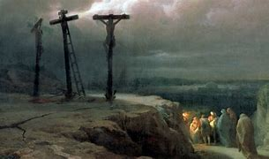
ALLUSIONS to
The bible and crucifixion
There are many cumbersome ways to kill a man.
You can make him carry a plank of wood
to the top of a hill and nail him to it. To do this
properly you require a crowd of people
wearing sandals, a cock that crows, a cloak
to dissect, a sponge, some vinegar and one
man to hammer the nails home.
WHO?
WHAT?
WHERE?
WHEN?
WHY?

Slide 6
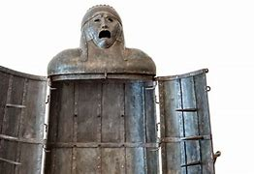

ALLUSIONS to
British History
Or you can take a length of steel,
shaped and chased in a traditional way,
and attempt to pierce the metal cage he wears.
But for this you need white horses,
English trees, men with bows and arrows,
at least two flags, a prince, and a
castle to hold your banquet in.
WHO?
WHAT?
WHERE?
WHEN?
WHY?

Slide 7
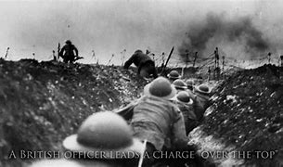
ALLUSIONS to
World War I
1914-1918
Dispensing with nobility, you may, if the wind
allows, blow gas at him. But then you need
a mile of mud sliced through with ditches,
not to mention black boots, bomb craters,
more mud, a plague of rats, a dozen songs
and some round hats made of steel.
WHO?
WHAT?
WHERE?
WHEN?
WHY?

Slide 8
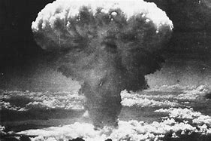
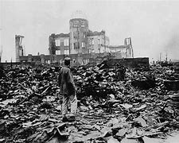
ALLUSION to Hiroshima
WHO?
WHAT?
WHERE?
WHEN?
WHY?
In an age of aeroplanes, you may fly
miles above your victim and dispose of him by
pressing one small switch. All you then
require is an ocean to separate you, two
systems of government, a nation's scientists,
several factories, a psychopath and
land that no-one needs for several years.

Slide 9

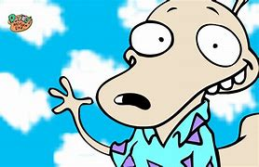
ALLUSION to
Modern life
These are, as I began, cumbersome ways
to kill a man. Simpler, direct, and much more neat
is to see that he is living somewhere in the middle
of the twentieth century, and leave him there.
WHO?
WHAT?
WHERE?
WHEN?
WHY?

