Slide 1
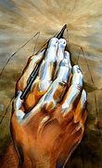
THE SHORT STORY
UNIT #2

Slide 2
THE SHORT STORY: A SHORT HISTORY
Among the earliest writers of the modern short story were Miguel de Cervantes (Spain), Walter Scott (England), Nathaniel Hawthorne (USA) and Edgar Allen Poe (USA). One of the earliest short story collections was the American writer Washington Irving’s Sketchbook (1820).
In 1837 Edgar Allen Poe wrote a critique that defined the short story. It is: 1) to be read at one sitting, 2) uses a limited number of characters, incidents, style and tone, 3) uses words efficiently and sparingly.

Slide 3
The publishing explosion at the turn of the 19th century was unprecedented in history. When the fiction-packed Strand magazine launched in England in January 1891, it sold 300,000 copies.
The magazine was to publish many of the Sherlock Holmes detective stories written by Sir Arthur Conan Doyle.

Slide 4
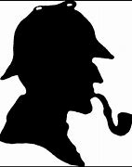
The Hound of the Baskervilles

Slide 5
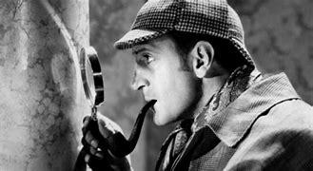
Basil Rathbone as Sherlock Holmes in 1939. Rathbone was cast as Sherlock Holmes in The Hound of the Baskervilles, the first of 14 screen appearances as Conan Doyle's master detective. He also played Holmes on radio from 1939 through 1946.

Slide 6
The idea of publishing short stories that had a beginning and an ending rather than stretching out a story as a serial from issue to issue took hold with the success of the Sherlock Holmes stories, beginning in July 1891.
Arthur Conan Doyle realised that serial stories in magazines were a mistake, because if the first number was missed, readers would not be able to follow the story; so he thought of writing a serial with each story standing alone, yet retaining a connecting link with the same leading characters.

Slide 7
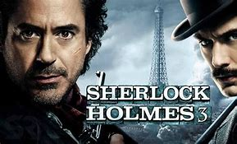
The most recent Sherlock Holmes
and his companion Dr. Watson
Warner Bros (2021) starring Robert Downey Jr.

