Slide 1
Introduction to Static Electricity
Charges and How They Behave
SNC1P
Findlay

Slide 2
Learning Goal
I will explain the law of electric charges with reference to common electrostatic phenomena.

Slide 3
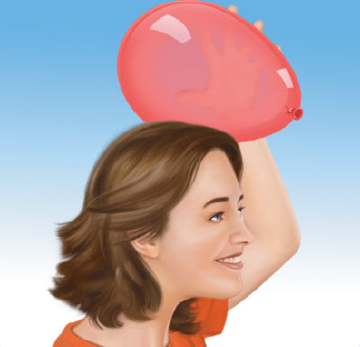
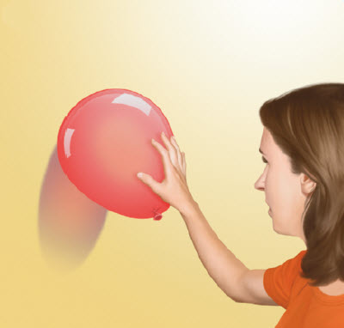
What are charges and how do they behave?
What will happen when a balloon you have rubbed against your hair is held against a wall?

Slide 4
What are the parts of an atom?
Negative charges are the type of electrical charges that can be rubbed off a material.
-ve
Electrons
The negative charges are parts of atoms called electrons. These charges are found outside of the nucleus.

Slide 5
What are the parts of an atom?
Positive charges are one type of electrical charges that are left behind when negative charges are rubbed off a material.
+ve
Protons
The positive charges are parts of atoms called protons. These charges are found inside the nucleus.

Slide 6
What are the parts of an atom?
Electrically neutral describes materials that have equal numbers of negative and positive charges.
The atom shown above has 8 negative charges (electrons) and 8 positive charges (protons), so it is electrically neutral.

Slide 7
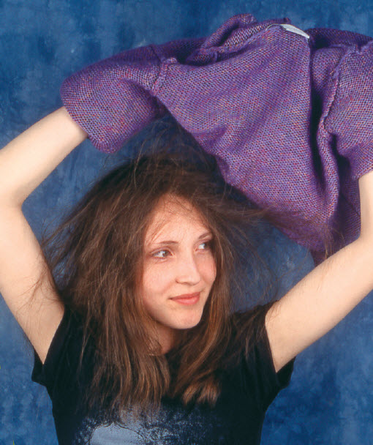
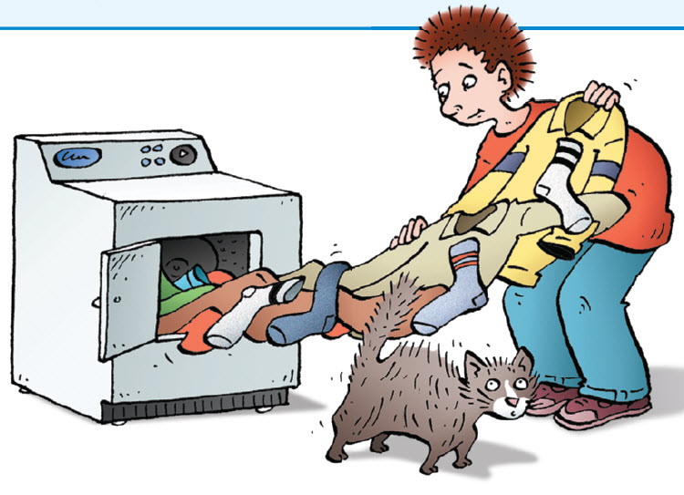
How do objects become charged?
Have you ever had your hair stick to a sweater when you took it off? Do your clothes stick together when you remove them from the dryer?
When different materials are rubbed together, some of the electrons (negative charges) may move from one material to the other.

Slide 8
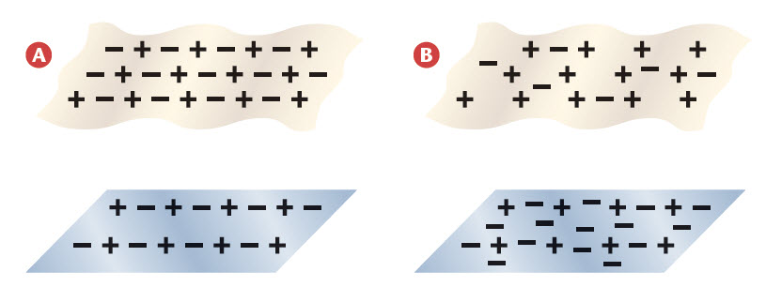
How do objects become charged?
The process of charging materials by rubbing them together is called charging by friction.
The materials shown in image A are both electrically neutral. When the two materials are rubbed together, their charges change as shown in image B.
(equal numbers of +ves and –ves in each material)
(excess +ves in the top material and excess –ves in the bottom material)
What is the electrical charge of the two materials after they have been rubbed together?

Slide 9
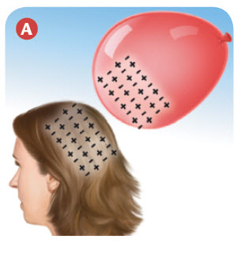
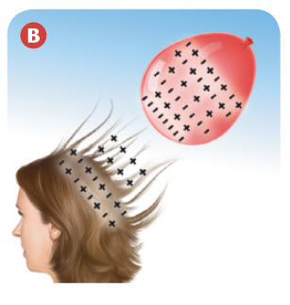
Why is hair attracted to a balloon?
What has happened to the charges of the hair and of the balloon after they have been rubbed together?
Why is the hair attracted to the balloon?

Slide 10
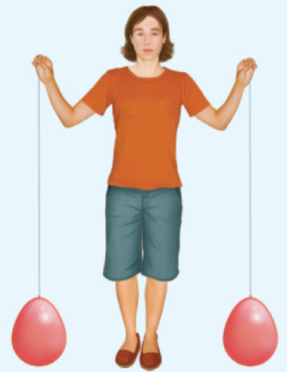
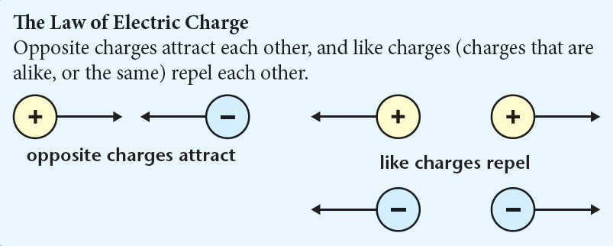
The Law of Electric Charge
Depending on the charges given to the two suspended balloons, they will either repel (move apart), attract (move together), or do nothing.
The balloons will behave according to The Law of Electric Charge.

Slide 11
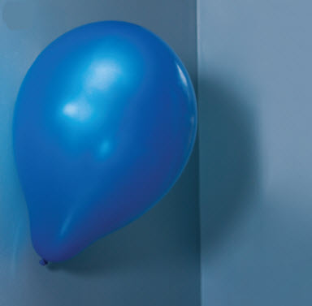
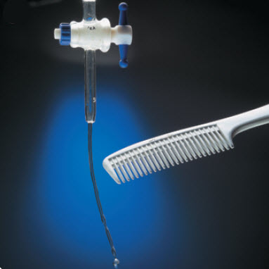
Charged Objects and Neutral Objects
The charged balloon is attracted to the neutral wall, and the charged comb is attracted to the neutral water.

Slide 12
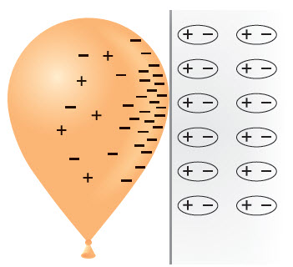
Charged Objects and Neutral Objects

Slide 13
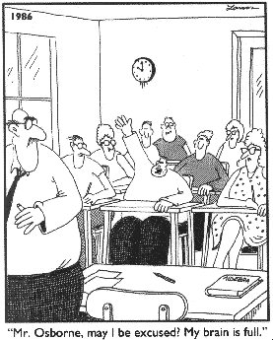
Homework
Charge it and Static Charge Detective Worksheets.

