Slide 1
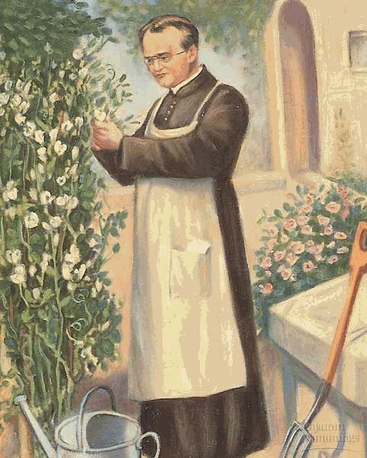
MENDEL’S EXPERIMENTS

Slide 2

Gregor Mendel
Gregor Mendel was a monk from the mid 19th century who performed famous experiments in his garden.
Mendel is considered the “Father of Genetics!”

Slide 3
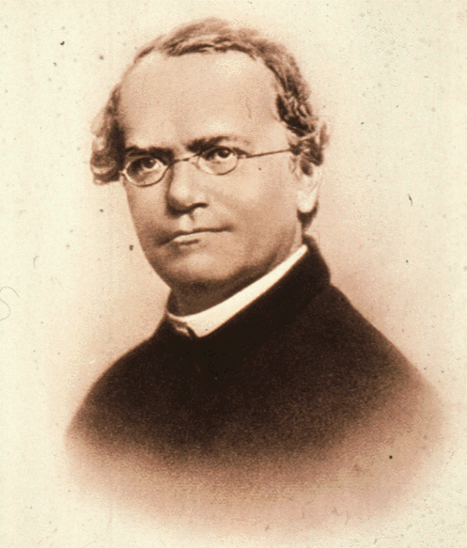
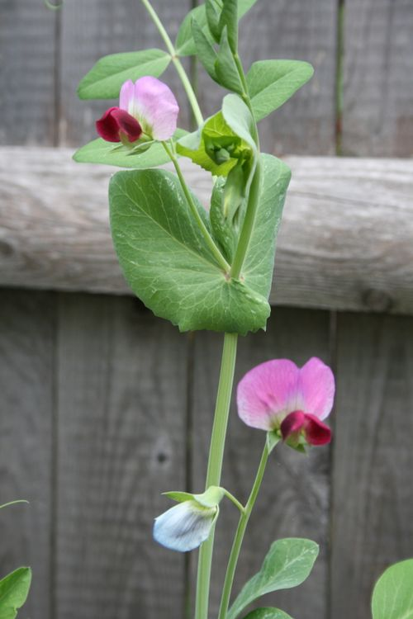
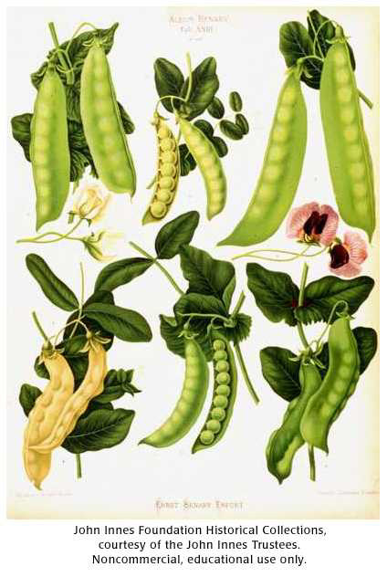
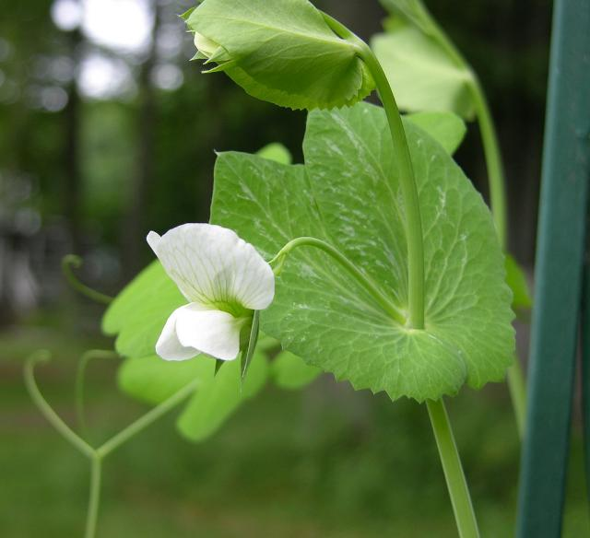
Gregor Mendel
While working in his garden, Mendel wondered why different pea plants grew tall, while others were short.
Some had green seeds, others yellow.
He called all these characteristics traits (a particular version of a characteristic that is inherited).

Slide 4
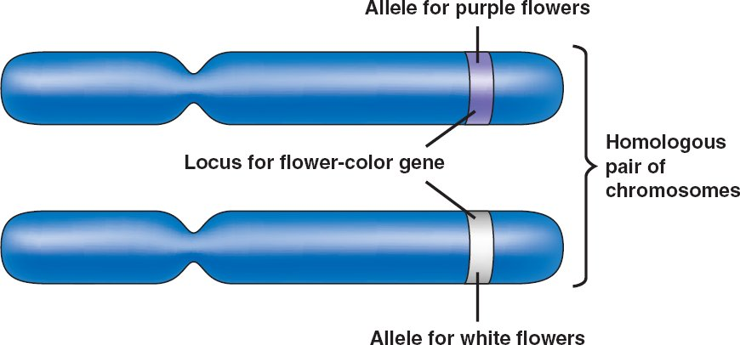
What are Traits Really?
Mendel discovered that traits exist in different forms (called genes), and each trait is controlled by two factors
Those two factors are different forms of a gene, or alleles

Slide 5
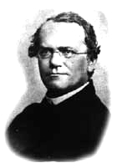
Mendel’s Experiments
Studied 7 characteristics of
pure-breeding lines:
Seed color (yellow vs. green)
Seed shape (round vs. wrinkled)
Flower color (purple vs. white)
Pod color (green vs. yellow)
Pod shape (round vs. pinched)
Stem length (long vs. short)
Flower position (along stem vs. at the tip)
“either - or” phenotypes with no intermediates

Slide 6
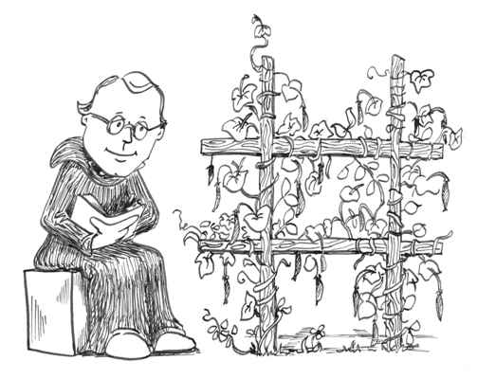
Gregor Mendel
Mendel experimented with thousands of pea plants to understand the process of heredity – the passing down of traits through generations.
Genetics is the scientific study of heredity.

Slide 7

The Scientific Process
Mendel was considered a pioneer in the development of the Scientific Method.

Slide 8
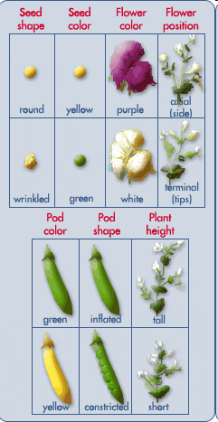
1. OBSERVED
Used garden peas (Pisum sativum)
Noticed that traits exist in alternate forms.
NO INTERMEDIATES
(ie. Tall stem crossed with short stem does NOT make a medium sized stem)
smooth

Slide 9
2. HYPOTHESIS
Educated guess
3. EXPERIMENT
Designed experiment where everything is kept the same (control) and only one thing is different (variable).
Things he would have considered would be water, sun, soil conditions

Slide 10
3. Experiment cont’d
Developed true-breeding/pure-breeding stock - plants that show the same trait to the parent from generation to generation
When self-pollinated or crossed with a similar true-breeding plant, they will always produce offspring that have the same trait.

Slide 11
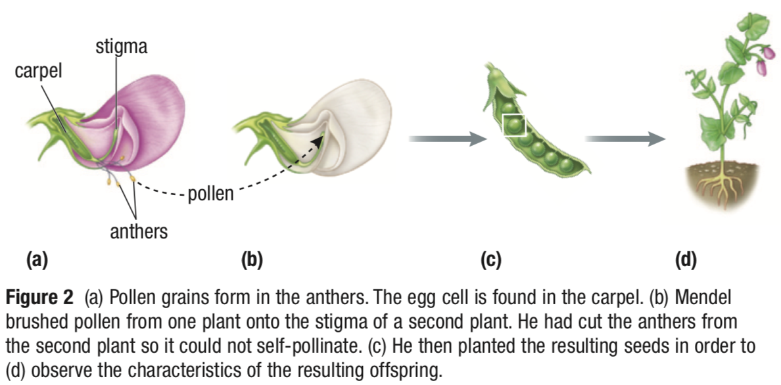
3. Experiment cont’d
Cross pollinated the alternate forms (Fig. 2 on page 184)
Example: purple flower x white flower
called the Parent generation the “P generation” for short

Slide 12
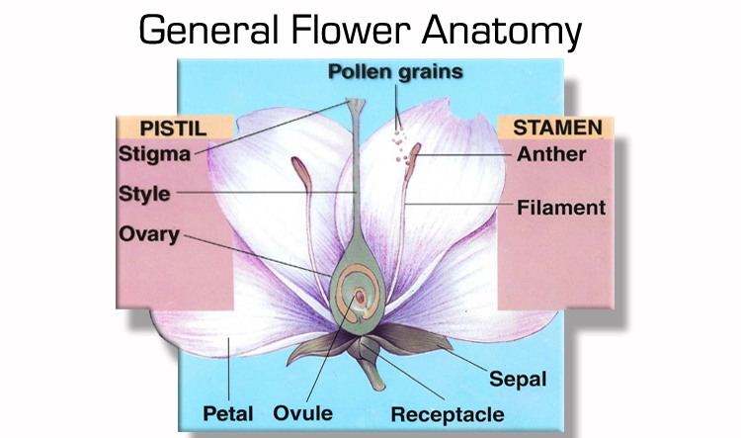
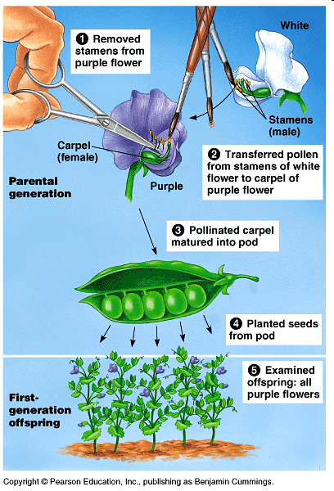
How did he Cross-pollinate?
When the egg and pollen (sperm) cells join, this is called fertilization.
Pea plants are usually self-pollinating – meaning they can pollinate themselves, even when they are alone.
Mendel developed a method to cross-pollinate – meaning he moved the pollen from one plant to the pistol of another. This is called “cross pollination” or “crossed” for short.

Slide 13
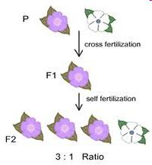
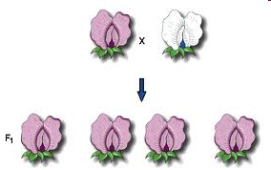
3. Experiment cont’d
Observed: F_{1,} first generation are all purple plants
Allowed these F₁ generation plants to self-pollinate, then plant seeds
In the F₂ generation, the “lost” form of the trait always reappeared in about 1/4th of the plants!

Slide 14
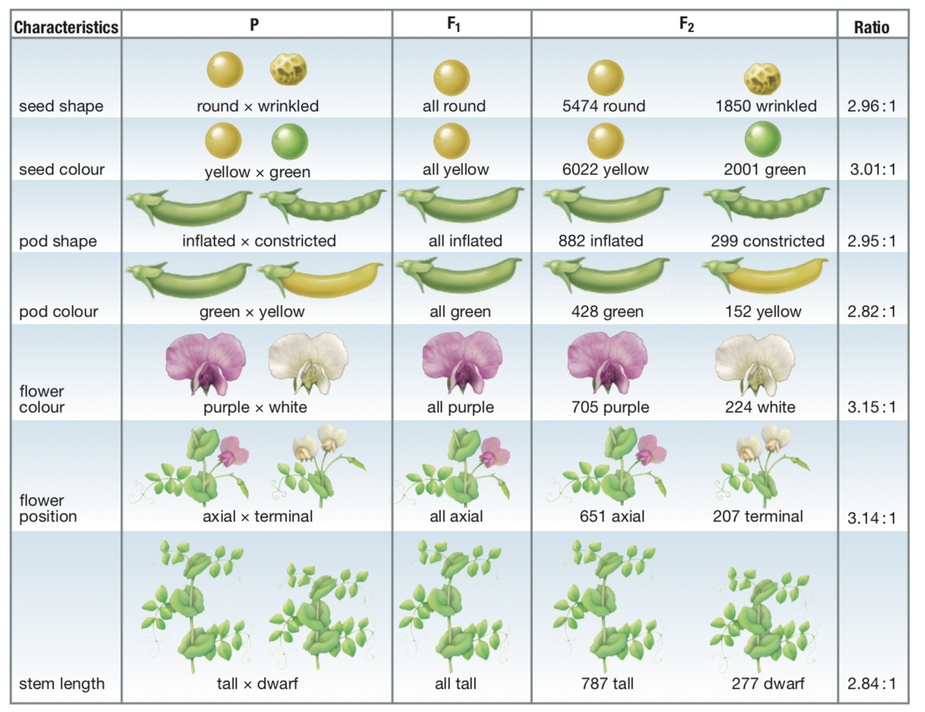
4. COLLECT DATA 5. ANALYSIS

Slide 15
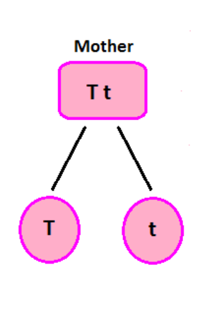
6. CONCLUSIONS
Data is redone many times before conclusions can be made. If data doesn’t support hypothesis, change the hypothesis and experiment again.
2 different “factors” determine a trait (now called genes)
One factor (gene) is dominant; it masks the effect of the other (recessive)
MENDEL’S LAW OF SEGREGATION:
During the formation of gametes (eggs or sperm), the two alleles responsible for a trait separate from each other.
Alleles for a trait are then "recombined" at fertilization, producing the genotype for the traits of the offspring.

