Slide 1

3
Productive Resources and Economic
Systems

Slide 2
Learning Goals
Once you have completed this chapter, you should be able to:
Recognize tangible and intangible productive resources as a country’s real wealth
Compare how different economic systems answer the three basic production questions and make choices about how productive resources are owned and used
Compare different national economies with regard to their ability to produce and share wealth, respect individual economic freedom, and promote the common good
Distinguish between production and productivity
Explain the economic concept of value added

Slide 3
Key Terms
productive resources
factors of production
Land
raw materials
labour
Capital
real capital
money capital
Productivity
Entrepreneurship
tangible resources
intangible resources
environment for enterprise
economic system
traditional economy
barter
command economy
capital goods
market economy
private enterprise
mixed economy
mixed market economy
Crown land
value added

Slide 4
Making Resources Productive
Productive Resources (or Factors of Production): Resources (such as land, labour, and capital) that are used the produce goods and services.
Land: A factor of production that includes all natural resources used to produce goods.
Labour: A factor of production comprising the physical and mental effort contributed by people to producing goods and services.
Capital: A factor of production that refers to the machinery, factories, warehouses, and equipment used to produce goods and services.
Real Capital: A more precise term than capital for the machinery, factories, warehouses, and equipment used to produce goods and services. It is distinct from money capital
Money Capital: The funds used to acquire real capital.
Productivity: A firm’s ability to maximize output from the resources available, usually measured as the firm’s output per worker.
Entrepreneurship: The contribution made by an owner, manager, or innovator who organizes land, labour, and capital to produce goods and services.

Slide 5
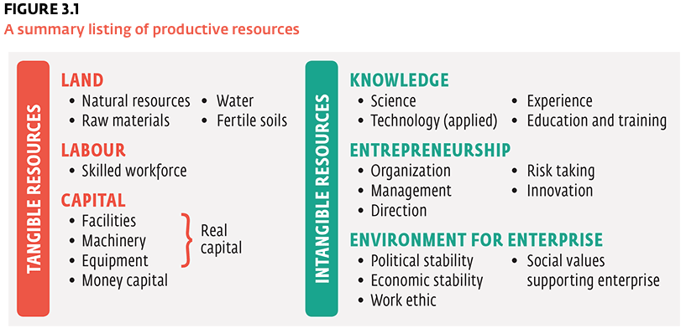
Tangible and Intangible Resources
Tangible Resources: Physical resources (such as land and labour) that are necessary for production and are visible.
Intangible Resources: Resources that are necessary for production, such as entrepreneurship, knowledge, and an environment for enterprise. Intangibles are not as visible as tangible resources, but they are no less important.

Slide 6
Environment for Enterprise
Economists also recognize a third, and even more intangible, factor as important in the production of goods and services—an economy’s environment for enterprise
A country has an environment for enterprise when its social and cultural values and its political and economic institutions are conducive to doing business.
For example, a stable government gives people and businesses the security they need to make sound planning and production decisions. It also bolsters both investor and consumer confidence, thereby creating a climate favourable to increased economic activity.

Slide 7
Economic Systems and Production Questions
What to Produce?
  What goods and services should our society produce, and in what quantities?
  What is worth producing, and what is not?
  What are we giving up to produce these goods and services?
How to Produce?
  By whom, with what resources, and in what way should goods be produced?
  Should goods be made in many small factories or in a few large operations?
  How much automation should be used? How much manual labour should be used?
For Whom to Produce?
  How will total output be shared among the different members of society?
  Who will get which goods and services? Will goods be shared equally?
  On what basis should decisions concerning distribution be made?

Slide 8
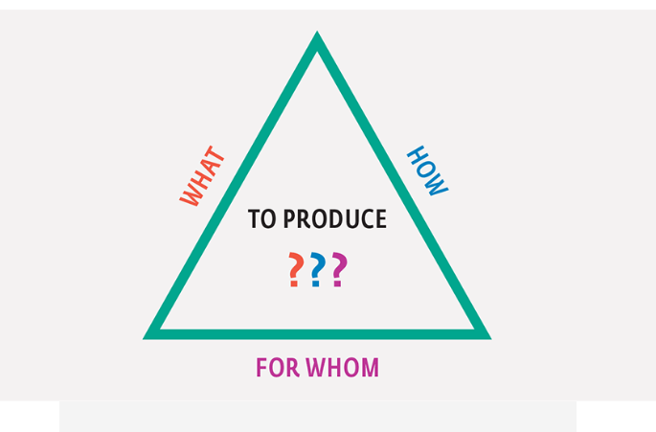

Slide 9
Economic Systems and Production Questions
Economic System: The laws, institutions, and common practices that help a country determine how to use its resources to satisfy as many of its people’s needs and wants as possible.
Traditional Economy: An economic system in which production decisions are determined by the practices of the past.
Command Economy: An economic system in which production decisions are made by government-appointed central planners.
Market Economy: An economic system in which production decisions are made by the actions of buyers and sellers in the marketplace.
Mixed Economy: An economic system, that contains elements of market, command, and traditional systems.
Mixed Market Economy: An economic system predominantly featuring characteristics of a free market system but also incorporating some qualities of command economies, such as government-owned enterprise.

Slide 10
Centuries ago, the traditional economy was the most common economic system throughout most of the world.
People lived in small rural communities. They had modest needs, most of which could be met by using the natural resources provided by the local environment.
They grew much of their own food, built their own homes, and made their own clothing and tools.
Surplus goods were usually traded to other families for essential items. This trading of goods (or services) without the use of a monetary system was known as bartering
barter
The trading of goods and services without the use of a monetary system; such transactions are common in traditional economies. barter
The trading of goods and services without the use of a monetary system; such transactions are common in traditional economies.

Slide 11
In a pure command economy production decisions are made by a small group of political leaders with the power to enforce their decisions throughout the entire economy.
In other words, the pure command economy is centrally planned. The central authority answers all production questions based on the best interests of the state.
The state owns the productive resources; the central authority allocates them on behalf of the state.
In this economic system, people are obligated to serve the state

Slide 12
Market Economy
The basic elements of a market economy are private property, freedom of enterprise, profit maximization, and competition. The government’s role is only to provide law and order and to assist economic development. Very few pure market economies exist today. Perhaps the closest examples are the economies of Hong Kong and the United States

Slide 13
Canada: A Mixed Market Economy
The Canadian economy is a classic example of this cross-pollination of economic models because it contains many elements of a market economy along with some characteristics of command and traditional economies.
For this reason, economists classify the Canadian economy as a mixed market economy
.

Slide 14
In the matter of land ownership, Canada has state-owned land (or Crown land ), which is a feature of command economies.
However, it also permits private ownership of land, which is a feature of market economies.
The federal government has also established many reserve lands for Indigenous peoples, who tend to have more traditional economies.

