Slide 1

4
Political Economies and Policy Goals

Slide 2
Learning Goals
Once you have completed this chapter, you should be able to:
Describe different political economies, their economic goals, and their approach to producing and sharing wealth, respecting individual economic freedom, and promoting the common good
Provide examples of economic choices (both individual and collective) that Canadians must make as a result of scarce economic resources
Recognize the advantages of cost-benefit analysis and how it is used to weigh economic options and make sound choices
Understand how governments set economic priorities and respond to economic challenges
Identify Canada’s 10 principal economic goals and describe the links and trade-offs among them
Conduct research using a variety of reliable sources (such as media, institutions, businesses, and interest groups) to address an inquiry question, and communicate economic information, research findings, analysis, and conclusions clearly, effectively, and accurately

Slide 3
Key Terms
Democracy
Dictatorship
political orientation
Capitalism
Communism
Socialism
Nationalization
Fascism
propaganda
public debt
economic growth
transfer payments
Inflation
Deflation
balance of payments accounts
consumer sovereignty

Slide 4
Understanding Political Economies
Capitalism: An economy characterized by private ownership of business and industry, the profit motive, and free markets.
Communism: A political system on the extreme left, founded on the theory of Karl Marx, that calls for government or community ownership of the means of production.
Socialism: A political system of the moderate left that calls for public ownership of the principal means of production, to be achieved in a democratic and peaceful manner.
Fascism: A political system on the extreme right, combining a free-market economy with a non-democratic form of government.

Slide 5
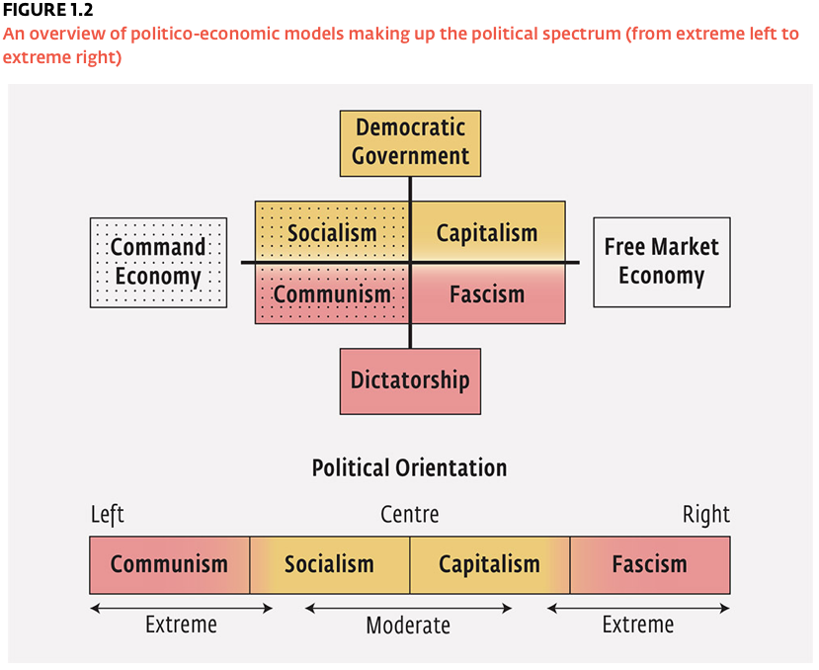
Understanding Political Economies

Slide 6
Setting Economic Goals
Political Stability: A stable government can help long-term planning and investment to flourish. Consistency in policy-making promotes both investor and consumer confidence and provides a climate conducive to economic growth.
Reduced Public Debt: With very few exceptions, government spending in Canada has increased faster than the revenues being collected through taxes, and as a result, Canada’s public debt has grown larger year after year. Concerned Canadians have begun to demand more balanced budgets from their elected government.
Economic Growth: Defined as an increase in the economy’s total production of goods and services. Economic growth can result from the discovery of new natural resources, and increase in the skilled labour force, technological innovations, and more efficient production processes.

Slide 7
Setting Economic Goals
Increased Productivity and Efficiency: Maximizing productivity means that scarce productive resources are put to efficient use to get as much as possible out of them. Economic efficiency is often the result of healthy competition.
Equitable Distribution of Income: The equitable, or fair, distribution of income may be the most value-laden of all economic goals; it is certainly the most controversial. When it comes to dividing up total national output, there can be as many interpretations of what makes for a fair division of wealth as there are stakeholders.
Price Stability: Stable prices generally indicate that an economy is healthy. Fluctuating prices complicate planning and discourage investment. Both inflation, a general rise in prices, and deflation, a general fall in prices, are symptoms of an unhealthy economy.

Slide 8
Setting Economic Goals
Full Employment: In an attempt to reach their optimal production targets, governments try to promote the full employment of the labour force. “Full employment” is usually defined as between 6 and 7 percent of the labour force being out of work.
Viable Balance of Payments and Stable Currency: The balance of payments accounts summarize all currency transactions between Canada and foreign economies. If Canadians import significantly more than we export, there will be a negative effect on employment rates in Canada as well as the foreign exchange value of the Canadian dollar.
Economic Freedom: Economic freedom refers to the freedom of choice available to workers, consumers, and investors in the economy. Canadian public policy generally promotes economic freedom.

Slide 9
Setting Economic Goals
Environmental Stewardship: Economic activity must be carried out without significantly harming the natural environment. Even if this means higher prices for consumers and lower profits for producers, it is important to find ways to reduce the negative effects we are having on the natural environment.

