Slide 1
More about Figurative Language –
Literary Devices
IRONY in Literature

Slide 2

What is IRONY?

Slide 3
IRONY can appear in three ways:
Verbal Irony (what is said)
Situational Irony (what happens)
Dramatic Irony (when the audience knows more about what's going on than the characters do.)

Slide 4
V E R B A L I R O N Y
A statement meant to infer the opposite of what is actually said
The speaker says one thing but means something different.
Looking at the dirty dishes and garbage on our kitchen table, my roommate announced, “Congratulations Mary. You deserve a gold medal for the way you kept our condo clean while I was away.”

Slide 5
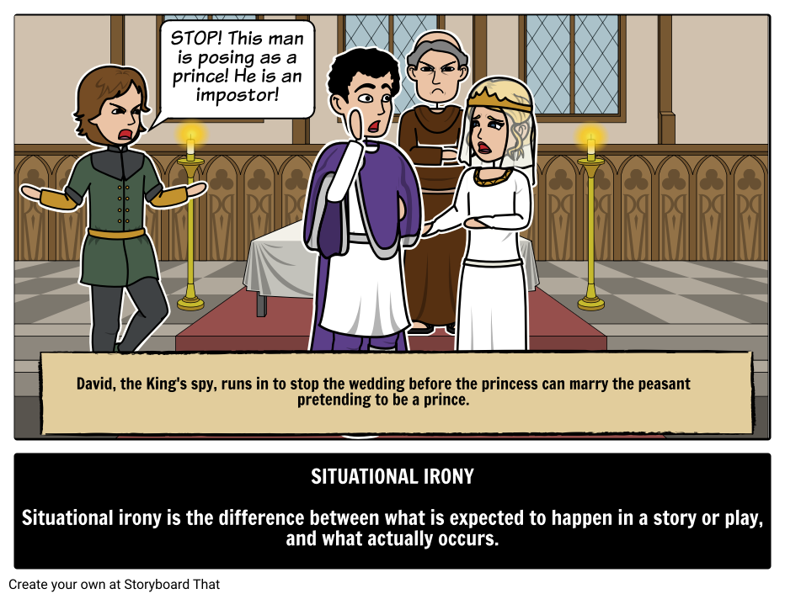
SITUATIONAL IRONY Where actions or events have the opposite result from what is expected or what is intended.
.

Slide 6
SITUATIONAL IRONY Where actions or events have the opposite result from what is expected or what is intended.
Mike wakes up one morning and thinks he is going to be late for school. After rushing around to get dressed, he suddenly realizes it is Saturday.

Slide 7
DRAMATIC IRONY
The audience knows more about what’s happening than the characters do.
In Shakespeare's Romeo and Juliet, the audience/reader knows that Juliet has faked her death by drinking a herbal potion that makes her look dead, but Romeo does not know that and he thinks she is really dead. (What does he do about it?)

