Slide 1
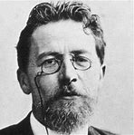
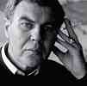
Carver ……….. Chekhov
Two Writers Compared

Slide 2
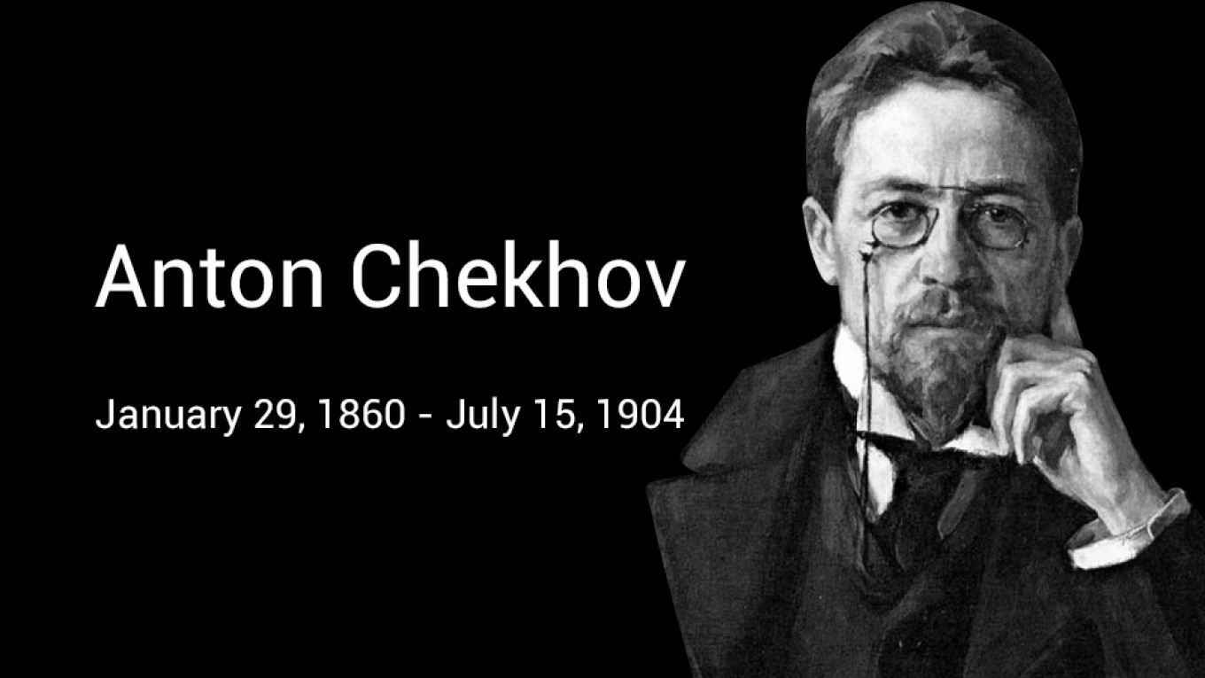
Anton Chekhov was a Russian playwright and short-story writer who is considered to be among the greatest writers of short fiction in history.
His career as a playwright produced four classics, and his best short stories are held in high esteem by writers and critics.

Slide 3


UNDERSTATEMENT: Chekhov's talent for understatement is one of his greatest achievements. His stories are frequently very short – often just a couple of pages long, but they suggest far more than what is stated.
impressionism: chekhov's stories fit within the style of impressionism, an art style wherE the artist is more concerned with capturing a subjective emotion rather than realism.

Slide 4
The use of 'epiphanies': Chekhov's stories and plays feature characters who have epiphanies.
AN EPIPHANY IS A SUDDEN AWARENESS OR INSIGHT:
“OH, I SEE !” “OH, I UNDERSTAND”
CHARACTERS SEE AND UNDERSTAND HOW their lives need to change.
A Mixture of pessimism and Humour: Chekhov's worldview is often described as 'tragicomic,' since he tends to describe humans alone and powerless, while sometimes showing their troubles in a comic way.
Most stories suggest the theme that we can never escape ourselves, and that we will cause our own unhappiness.

Slide 5
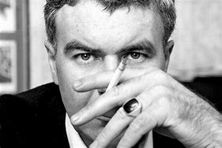
Raymond Carver
May 25, 1938 – August 2, 1988
Raymond Carver Jr. was an American Short story writer and Poet.
He is considered to be one of America's greatest short story writers.

Slide 6
Though Raymond Carver’s most frequently-cited influence was the American writer Ernest Hemingway, it is Chekhov's short stories that provide the best understanding of Carver's work.
There are a few qualities that Chekhov pioneered in his work that Carver copies, consciously and perhaps also unconsciously.
the connection was frequently acknowledged by Carver.

Slide 7
1) Impressionism: Carver's work is firmly grounded in the realist tradition, but the perspective of people and the world is often more palpable than the plot details. In fact, many stories leave out details, forcing the reader to piece the plot together from hints. This is a technique used by Chekhov as well.
2) Understatement: Like Chekhov’s, Carver's narrators frequently lack the vocabulary to express the depth of their feelings, which leaves the reader sometimes confused and having to 'read between the lines' to discover the full depth of the story.
Something is said that does not seem important BUT REALLY IS!!

