Slide 1

THE SHORT STORY
UNIT #3

Slide 2
THE SHORT STORY: A SHORT HISTORY
The earliest writers of the modern short story were Miguel de Cervantes (Spain), Walter Scott (England), Nathaniel Hawthorne (USA) and Edgar Allen Poe (USA).
In 1837 Edgar Allen Poe defined the short story as: 1) to be read at one sitting, 2) uses a limited number of characters, incidents, style and tone, 3) uses words efficiently and sparingly.

Slide 3
By the late 1890s, cheaper publishing methods meant that everyone could afford to buy books and magazines. In England, every issue of a magazine called The Strand was selling 300,000 copies.
The magazine began publishing the Sherlock Holmes detective stories written by Sir Arthur Conan Doyle.

Slide 4

The Hound of the Baskervilles

Slide 5
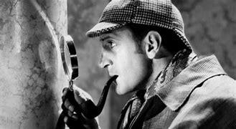
Basil Rathbone as Sherlock Holmes in 1939. Rathbone was cast as Sherlock Holmes in The Hound of the Baskervilles, the first of 14 screen appearances as Conan Doyle's master detective. He also played Holmes on radio from 1939 through 1946.

Slide 6
A Sherlock Holmes story continued from one issue into the next issue of The Strand. It is known as a serial.
Today we are familiar with the serial format in popular television series.
Arthur Conan Doyle realised that printing serial stories in magazines was a mistake. If the reader missed one issue of the magazine, they wouldn’t be able to follow the story.
He began to shorten his stories so that they would begin and end in one issue, yet he kept the same leading characters.

Slide 7
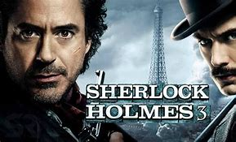
The most recent Sherlock Holmes
and his companion Dr. Watson
Warner Bros (2021) starring Robert Downey Jr.

