Slide 1

READING STRATEGIES
WHILE READING

Slide 2

Visualize the characters, the setting, and what you hope to discover …
Base what you see in your imagination on what you already know … from your life … from your past reading ….

Slide 3
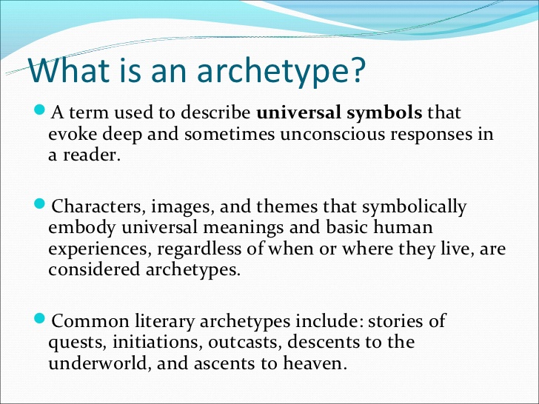
ARCHETYPES can be either: Characters
Images
Themes

Slide 4
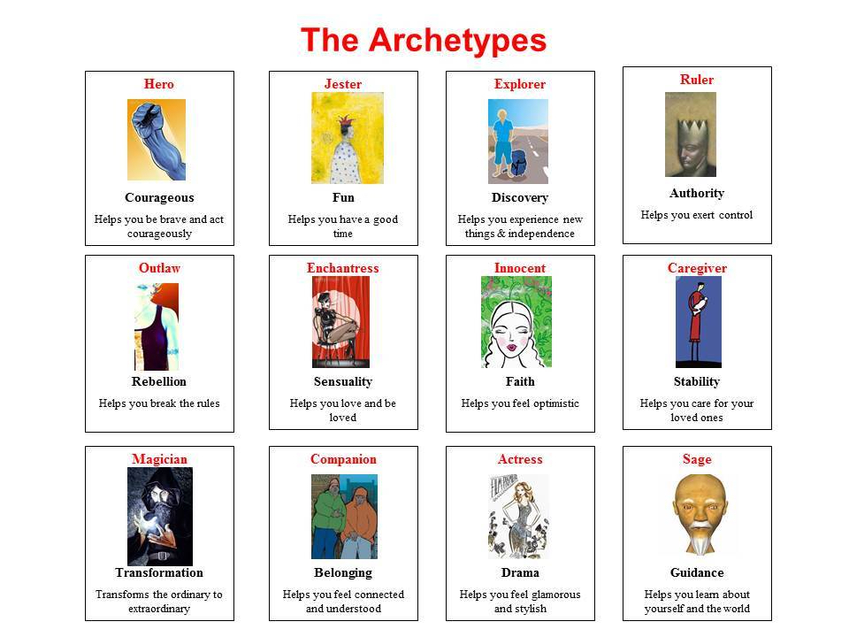

Slide 5
There are many more character archetypes
Archetypes are everywhere.
They are guiding, inspiring, possessing, ruling, and living through you each day.
Archetypes influence 99% of your behaviour.
It’s not a question of whether archetypes are influencing your behaviour; it’s a matter of degrees.
See the checklist @
https://scottjeffrey.com/archetypes-list/#Caroline_Mysss_Archetype_Cards
To the extent you’re aware of the archetypes operating within you is an indicator of your level of consciousness.

Slide 6
Use vocabulary strategies to understand unfamiliar words and phrases
Context clues
Root words. ex: effortlessly
Prefixes ex: Prediction
Suffixes ex: Preparation

Slide 7
Make point-form notes, graphic organizers or charts to remember ……….
Plot
Characters
Important Ideas

Slide 8
Mark parts of the text that you find confusing and ask about them later ……….
Use a sticky note
Use a highlighter
Write in the margin

Slide 9
As you read, ask yourself the following questions:
Does this make sense to me?
What is the writer saying?
What is the narrator’s point of view?
Do I agree? Why or why not ?

Slide 10
Adjust your reading rate
Skim and scan text (when appropriate) to locate specific information or ideas in the text
Slow down for detailed information (ex: character description, themes, literary devices etc)

