Slide 1
THE ESSAY
An ESSAY is a piece of writing that presents the author's own argument. They are compositions of several paragraphs (five or more) in which the author writes in detail about a certain subject.
TYPES OF ESSAYS: PERSONAL, ANALYTICAL/LITERARY, COMPARATIVE, OPINION/PERSUASIVE /ARGUMENTATIVE.
Essays are traditionally classified as FORMAL or INFORMAL. Formal essays are characterized by a serious purpose and logical organization, whereas the informal essay is characterized as personal and deal with subjects that involve the author (Examples: A Personal essay on such topics as travel, autobiography, hobbies, etc.)
Notes:
QuickStarter has created an outline to help you get started on your presentation. Some slides include information here in the notes to provide additional topics for you to research.

Slide 2
A QUICK OVERVIEW OF THE ESSAY
The Five-Paragraph Essay
The Introductory Paragraph with a Thesis Statement
The Body Paragraphs
The Concluding Paragraph
ALWAYS… ALWAYS … BEGIN WITH AN OUTLINE …….

Slide 3
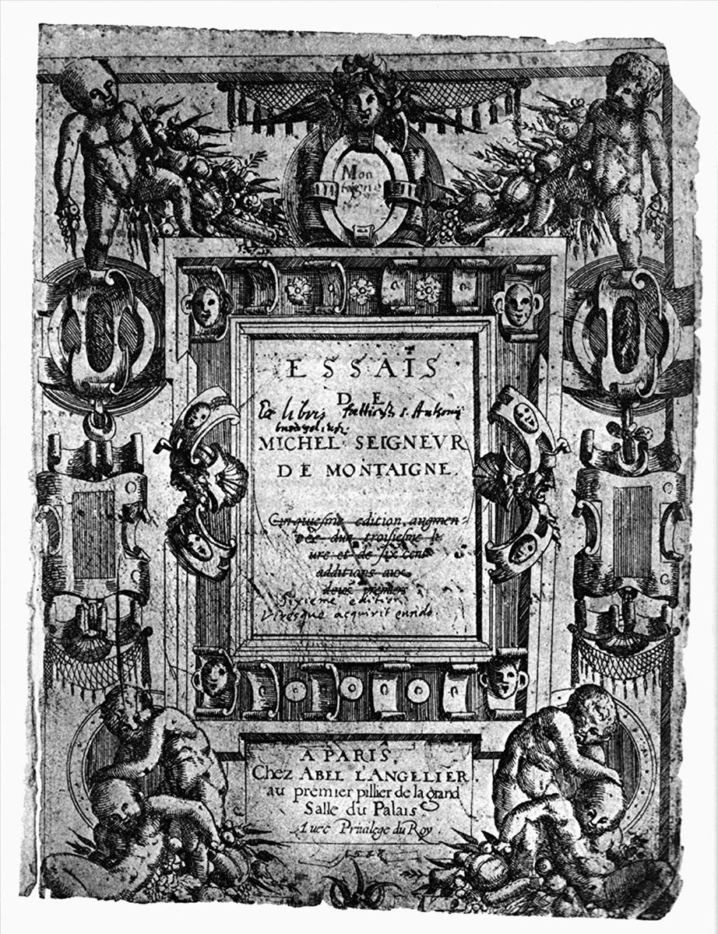
Essay
THE INTRODUCTION

Slide 4
The Introduction
The introduction must GRAB and HOOK the reader’s attention by being creative and imaginative.
Example: “A librarian once snatched me from the jaws of despair, but it’s too late now to thank her.”
From a personal narrative essay “HOW EDUCATION SAVED MY LIFE”!

Slide 5
The Introduction
The introduction must also introduce the MAIN IDEA and give a PREVIEW of a few key IDEAS / POINTS that will appear in the essay.
Example: “I’m probably not the first person to notice that we never seem to get around to thanking the people who have helped us most. They include teachers, fellow students, as well as friends and family. They can all play a big role in our education.”

Slide 6
The Introduction
The introduction’s final sentence (or two) must present the THESIS – the writer’s argument or belief about the topic!
Example: “I believe that we must all find ways to let these people know how much they have contributed to our lives and our well-being.”

Slide 7
T H E T H E S I S
Your THESIS statement controls all the ideas, arguments, facts that you put in your essay.
It is the road map and the steering wheel that guides you through the content and structure of your essay.
Stay focused on your controlling thesis and refer back to it often as you plan your outline and as you write.

Slide 8
Essay
THE
BODY

Slide 9
THE BODY
(3 or more paragraphs)
The BODY paragraphs do some or all of the following:
Each paragraph defines key terms and expands on them.
It explores similarities and differences between things.
It provides examples and evidence from (1) primary sources with quotations, and (2) secondary sources (quoted or paraphrased and cited with author and page numbers).
It considers the causes for certain events and behaviours, and discusses their effects.
It states a problem, gives details that emphasize and offer solutions supported with evidence and facts.

Slide 10
THE BODY
(3 or more paragraphs)
Each BODY paragraph begins with a TOPIC SENTENCE stating the main point-idea-argument to be covered in the paragraph. There may be other related sub-points in the paragraph, but don’t mention them in the topic sentence.
Each following BODY paragraph begins with a connecting word or phrase such as “Furthermore,” “In the same way …” “Additional evidence appears in …” However, don’t use simple words like “Secondly… Thirdly …” to move from point to point.
Each BODY paragraph ends with a CONCLUDING SENTENCE that summarizes the main point made in the paragraph and ties back to the THESIS.
Present your weakest point in the 1st BODY paragraph, go to your strongest point in the 2nd BODY paragraph, and save your 2nd strongest point for your final BODY paragraph.

Slide 11
Essay
THE
Conclusion

Slide 12
THE CONCLUSION
The CONCLUSION is a paragraph that is short.
It presents a brief SUMMARY of the main points in your essay.
It should not introduce new information.
It should restate the THESIS but using different vocabulary.
It should end with a ‘SO WHAT’ statement.
Example: “If everyone took just a few moments today to give thanks to others, the world might be a better place for all!

Slide 13
TIPS ON HOW TO STRUCTURE, ORGANIZE AND PLAN AN ESSAY
Using Chronological Order
This is the order in which things happen. Chronological order is often used to organize ideas in narrative and descriptive writing.
For example, you could organize an analytical/literary essay about the development of a character by following the progress of the character from the beginning of a novel to the end.

Slide 14
TIPS ON HOW TO STRUCTURE, ORGANIZE AND PLAN AN ESSAY
Using Cause and Effect
CAUSE and EFFECT is frequently used to present information clearly. It explains why something happens or what results from a certain action or condition.
For example, CAUSE and EFFECT can be used to explain a certain character’s actions, or may be used to discuss how something progresses or results from certain actions.
You can first write about an EFFECT and explain its cause or causes, OR you can write about a CAUSE and explain its effect or effects. For example: Mike failed the test because he thought he knew the subject, but also because he had the flu. OR …. Mike had the flu and consequently was unable to study, so he failed the test.

Slide 15
TIPS ON HOW TO STRUCTURE, ORGANIZE AND PLAN AN ESSAY
Using Inductive and Deductive Reasoning
INDUCTIVE REASONING means gathering facts and then using those facts to create a general statement and conclusion that you believe is true.
Example: Shakespeare wrote over thirty plays. He also wrote more than one hundred poems known as sonnets. Shakespeare was a very versatile and prolific writer.
DEDUCTIVE REASONING begins with a general statement
you believe is true, and then uses specific facts to confirm it.
Example: Shakespeare was a very versatile and prolific writer because he wrote over thirty plays and more than one hundred sonnets.

