Slide 1
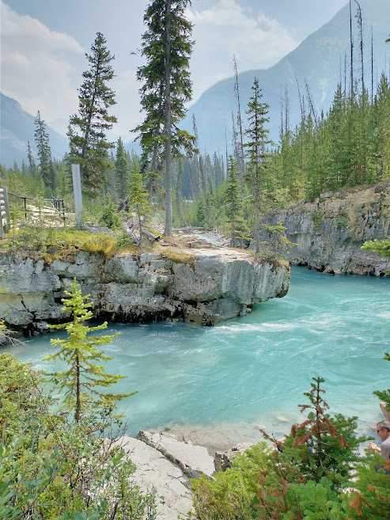
The Effects of Climate Change in Our Future Lives
By Shaheer Akram
Photos by Shaheer A.

Slide 2

Don’t throw your future away
Save the Earth because it is the only planet we have to live on.

Slide 3
We must wake up to the realities of climate change, as it will directly impact all aspects of our lives, such as
Food security,
Health challenges
The air we breath
Economic consequences.
Ozone Depletion
Deforestation
Pollution
Loss of Biodiversity
Ocean Acidification
Global Warming
Soil Degradation

Slide 4
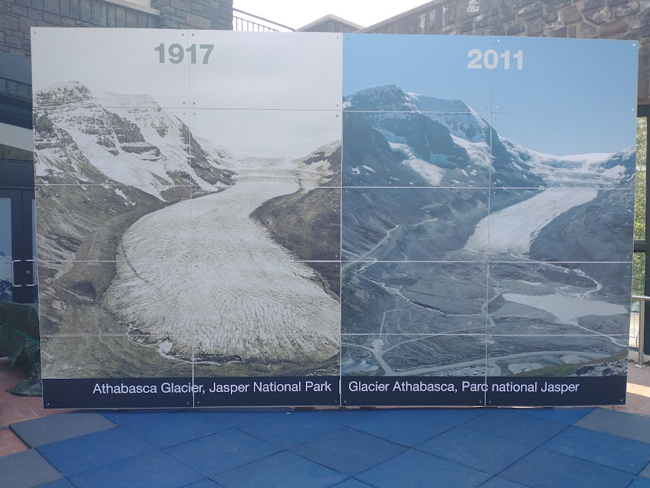

Slide 5
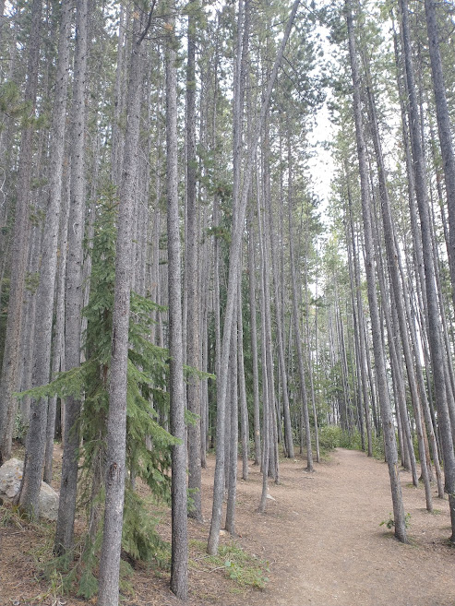
According to the World Meteorological Organization (WMO), the 2020 Antarctic ozone hole has peaked in size and depth.
Deforestation is a threat to biodiversity.
From mammals to birds, insects, amphibians or plants, the forest is home to many rare and fragile species, 80% of the Earth’s land animals and plants live in forests.
Forests also save the soil from erosion.
Tress provide oxygen.
Ocean acidification is the ongoing decrease in the pH value of the Earth's oceans, caused by the uptake of carbon dioxide (CO. 2) from the atmosphere. The main cause of ocean acidification is the burning of fossil fuels.

Slide 6
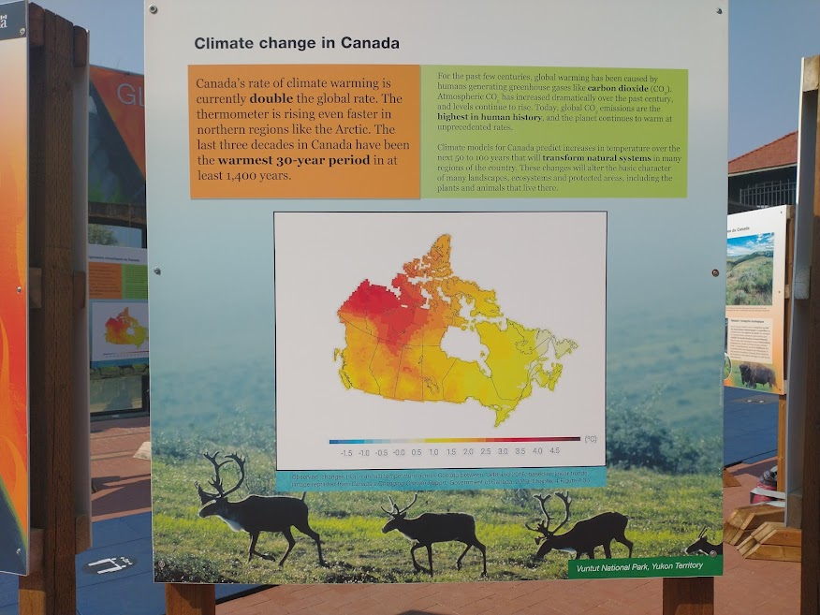

Slide 7
According to the findings from the IPCC’s report:
In the past 40 years, it is likely (66-100 per cent probability) that the global proportion of major (Category 3–5) tropical cyclone occurrence has increased

Slide 8
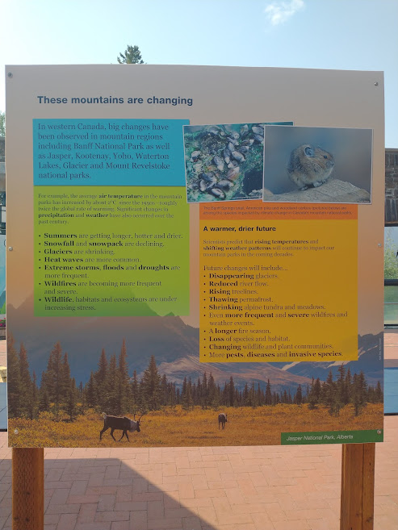
The Mountains are changing.
Summers are hotter and dryer.
Glaciers are shrinking
Heat waves are common
Storms, floods and droughts are common
Wild fire is frequent and severe.
Wildlife and ecosystem is under stress

Slide 9
With increasing global temperatures, increased environmental disasters will occur.
“Extreme events like droughts and floods, and greater CO2 concentrations in the atmosphere have already begun to impact staple crops around the world” (“Climate Change Food Security”).
Intense disasters will negatively impact agriculture. In terms of food availability, food prices are expected to rise.
In addition, climate change will also have a negative impact on the nutritional value of various agriculture.
Research has indicated that the increase of CO2 levels has led to the decrease of nutrients various crops. A lack of nutrients can lead to health and developmental issues (“Climate Change Will Reduce Nutrients in Crops”).
Overall, climate change will prove to have disastrous effects on the agricultural sector.

Slide 10
Climate change will pose significant health challenges around the world.
It will directly affect the air we breathe.
The increase of wildfires in different areas has resulted in difficulty breathing, and consistent coughing.
Particulate matter and chemicals in the air (from wildfires) can lead to adverse effects in the long run (“Climate Impacts on Human Health”).
Climate change also directly affects the increase of water-borne diseases.
According to WHO, fresh water contamination leads to many diseases.
Diseases spread by mosquitos, ticks, etc. will also become more frequent.
Warmer climates allow these vectors to begin travelling earlier on in the year (“Climate Impacts on Human Health”).

Slide 11
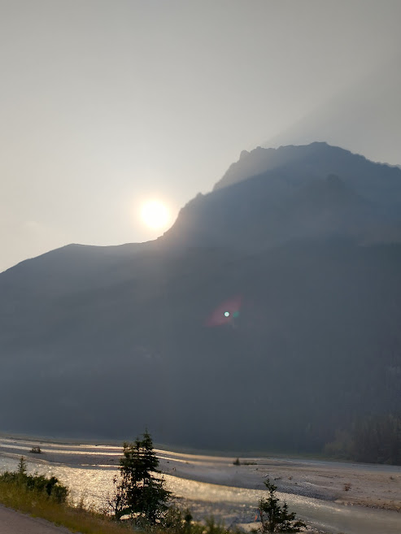
The smoke from the wild fire is spreading haze.

Slide 12
Climate change will have direct consequences in economics. The increase of environmental disasters will prove to be costly in affected areas. “Texas’s estimated losses from Hurricane Harvey were $125 billion
Many areas depend on agricultural means for the local economy. Increased heat, and excessive rainfall can prove brutal to these areas.
In terms of tourism, the economy will hit another downfall.

Slide 13
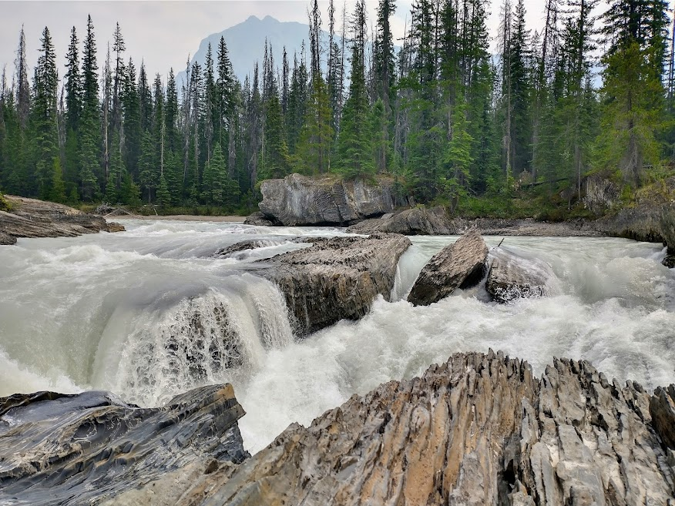
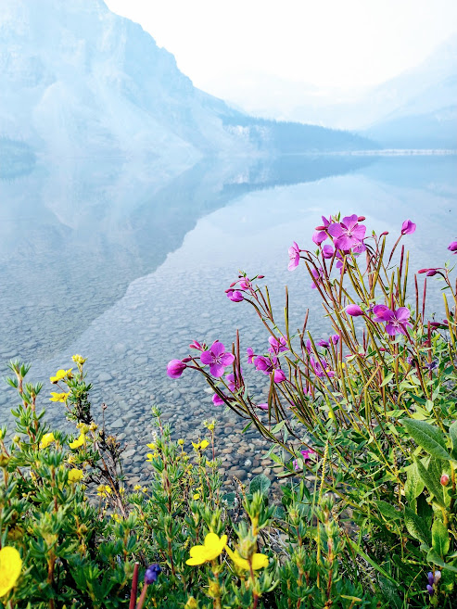
Our Earth is beautiful. We have to save it

