Slide 1
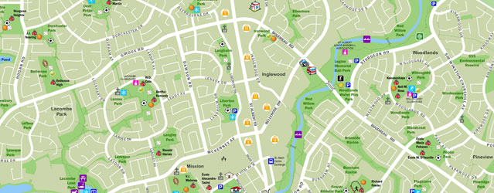
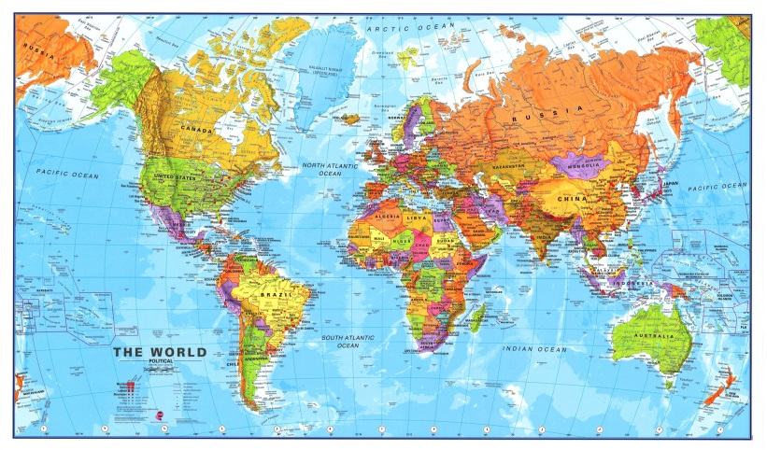
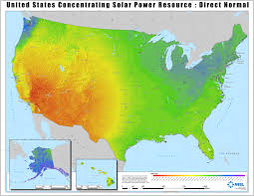
WHAT IS A MAP?

Slide 2
What is a Map?
A map is a representation of the Earth’s features drawn on a flat surface.
Maps use symbols and colours to represent features of an area, simplifying the real world.

Slide 3
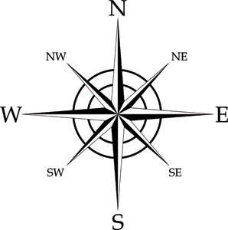
Features on a Map
Title – identifies the area shown, topic, focus, or purpose of the map
Underlined
Legend – explains the meaning of symbols and colours used on the map
Enclosed all around in a border, drawn with a ruler
Direction – often represented with an arrow
Include a compass rose or a North arrow

Slide 4
Features on a Map
Scale – represents the relationship between distance on the map and distance in the real world
Date of Publication – indicates how recent the map is

Slide 5
Map Labelling & Colouring
Cartography is the art of drawing accurate, easily readable, attractive maps.
Labels
Neatly printed
Spelled correctly
Horizontal
Use a dot (.) to label cities
city name should be as close to the dot as possible
draw a line to the dot if you aren’t able to place it close enough
Labels should not block other information on the map

Slide 6
Map Labelling & Colouring
Labels (continued)
Larger features usually have larger labels
Labels for similar features should be the same size and font – for example:
Water Body
City
PROVINCE
C O U N T R Y

Slide 7
Map Labelling & Colouring
Colouring
Colour coded to show the different areas on the map
Identified in legend
Shade evenly
Use solid colours only, no patterns
No White or black
Grey is only use for unimportant areas
Blue should only be used for bodies of water

Slide 8
Your Task
Map of Canada #1: Provinces, Territories and Capital Cities
International boundaries highlighted
Provincial boundaries highlighted
Provinces and Territories labeled (horizontal, name in full, all caps)
Provincial capital cities (accurately located!)
Nation’s capital (accurately located!)
Include any Map Features you may be missing.
Your name, date, and class (CGC 1D-04/05) should be in the bottom right corner of the map, enclosed in a box

