Slide 1
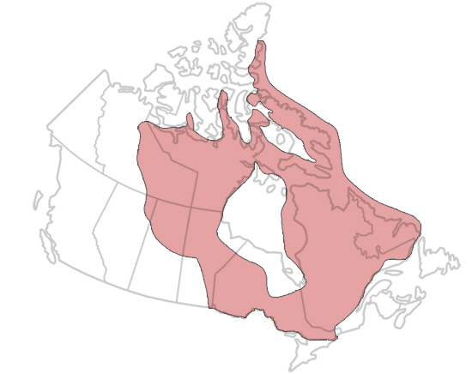
Canadian Shield

Slide 2
How Was the Canadian Shield Formed?
The Canadian Shield formed over 3 billion years through processes such as plate tectonics, erosion and glaciation.
Plate tectonics refers to the movement and collision of the Earth’s outer crust. When these crustal plates collide they may weld together, forming larger landmasses.
The Shield can be thought of as a jigsaw puzzle of different crustal blocks, sometimes known as “provinces,” welded together over time.
Each block is bounded by a belt of younger rock created when the blocks collided.

Slide 3
The mountains of the Canadian Shield were subsequently eroded by weather such as wind and rain. Comparable to sandpaper on wood, these forces slowly wore down the mountains.
800 million years ago, the low-relief surface of the Shield had been created.
These weathering processes were interrupted by a number of ice ages occurring over the last 2.5 million years.
Glaciers grow and move they also smooth the landscape, as well as move sediment.

