Slide 1
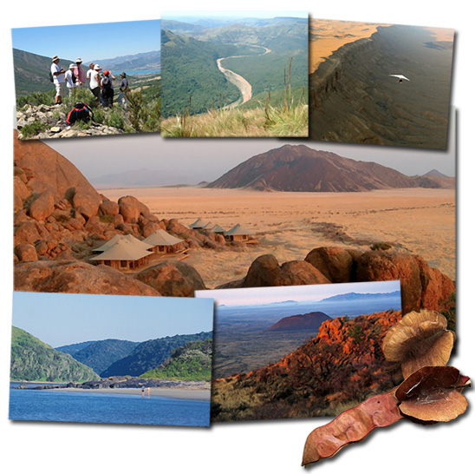
Geotourism

Slide 2
Tourism
What is it?
What does it bring to a country?

Slide 3
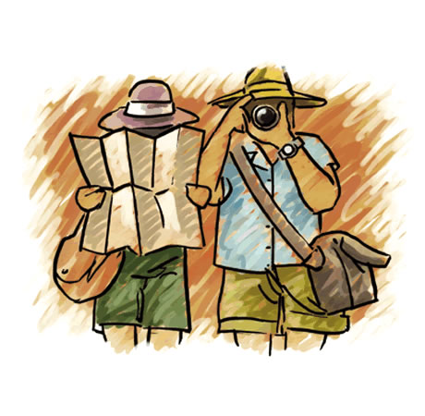
What is tourism?
1. The practice of traveling for pleasure.
2. The business of providing tours and services for tourists.

Slide 4
Tourism
Globally, tourism is one of the world’s most remarkable growth industries… majority of destinations around the globe showing increased arrivals and tourism spending each year

Slide 5
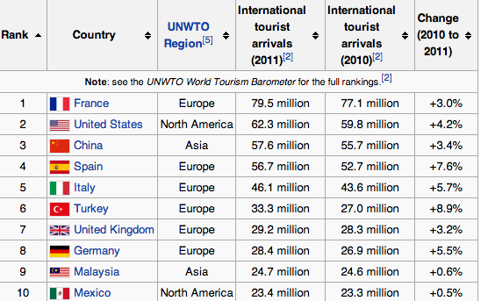
Top 10 Tourist Destinations (in 2011)

Slide 6
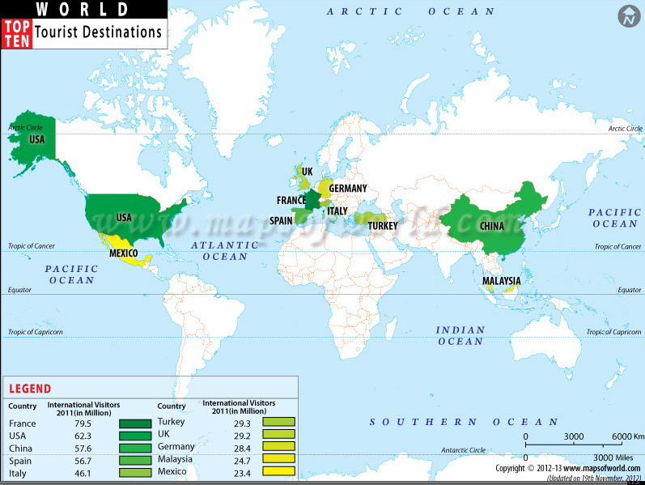

Slide 7
Canada’s Tourism
$84.8 billion industry
Benefits and brings money to transportation services (deliver visitors) , the hotels and other accommodations and the attractions

Slide 8
Tourism Jobs
http://tiac.travel/Tourism_Jobs.html

Slide 9
Tourism Commericals
https://www.youtube.com/watch?v=LxFSkBK8Vf4
https://www.youtube.com/watch?v=yrIPjfwhpQ4

Slide 10
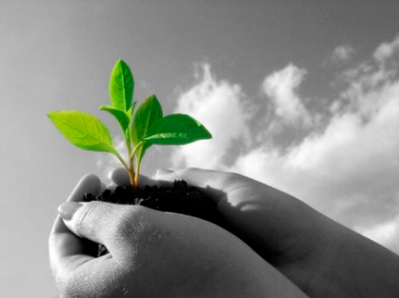
What is sustainability?
The process of something being able to be used and maintained for a long period of time.
For example:
Cutting down a tree
to make paper, but
planting another
one in its place

Slide 11
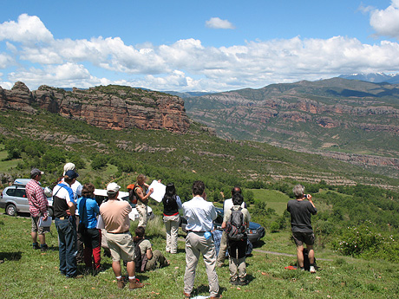
So what is Geotourism?
It is sustainability and tourism put together.

Slide 12
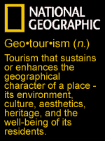
What does Geotourism mean?
Maintains or makes better the place that is visited.
It can be done through:
Environment
Heritage
Culture
Well-being of people who
lives there

Slide 13
What happens?
Tourism is made special through natural and human efforts
For example:
Historic sites are restored (fixed)
Culture created through food, celebrations, festivals etc
Economy increases through sales of local crafts etc
Arts developed for tourists (dance, artwork, music etc)

Slide 14
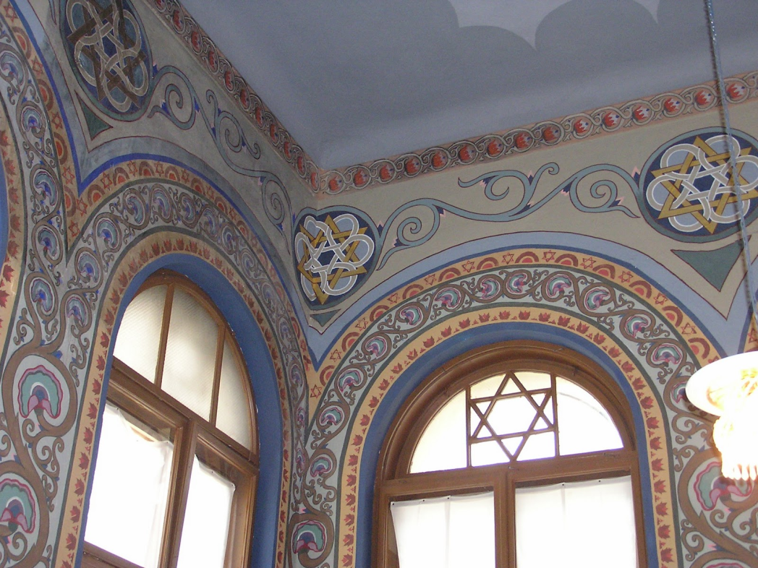
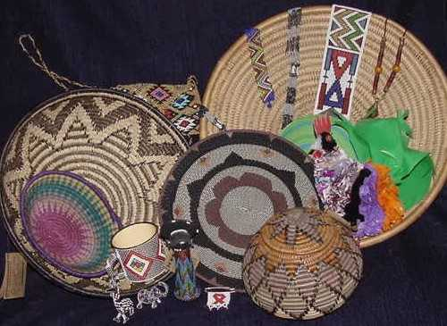
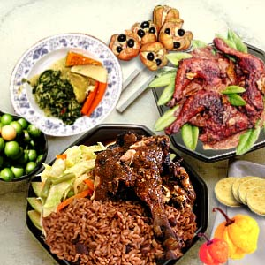
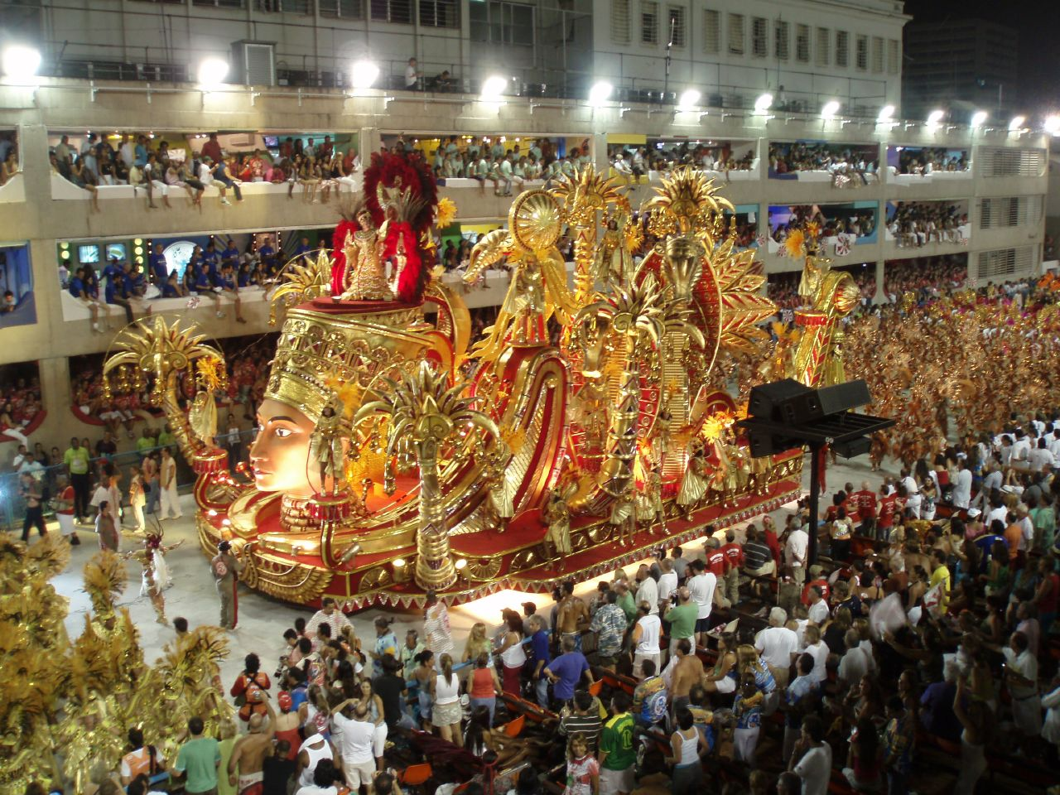

Slide 15
Example -Oman
http://www.youtube.com/watch?v=RR9mtInhaa4
Arab state in southwest Asia , bordered by the United Arab Emirates (UAE) to the northwest, Saudi Arabia to the west, and Yemen to the southwest.

Slide 16
What is good about it?
Gives jobs to local people
Encourages the locals to like the tourists and make experience better
Visitors like it because locals are friendly and informative
Encourages visitors to maintain respect for the area

Slide 17
if you like this topic…
In grade 11, you can take a course call Geography and Tourism and learn more!
☺

Slide 18
What you are going to do:
You are going to create your own “eco-friendly tourist destination”
Use the National Geographic Magazines and create a collage of photos of your “destination”
You must include:
A title for your location (make something up!)
Photos of different activities for tourists to do (that will not negatively affect the environment)
A paragraph explanation of why this place demonstrates qualities of “geotourism”

