Slide 1
Fisheries

Slide 2
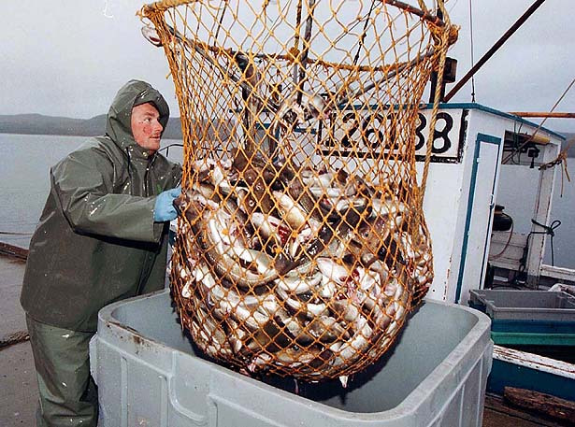
Canada’s Fisheries…

Slide 3
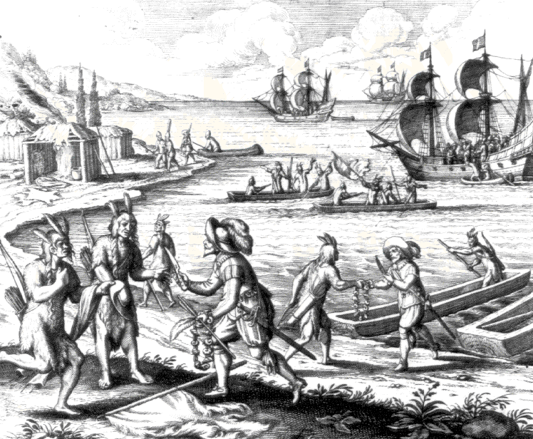
History of Fishing in Canada:
The Beothuk were the native people of Newfoundland, and survived on a diet of fish
Fish was a source of protein for many First Nations peoples
Notes:
With British and French coastal settlements, the Beothuk were forced inland. The lack of their normal food source gradually decreased the Beothuk population. By the 19th Century, the tribe no longer existed.

Slide 4
Beothuk
The Beothuk are the Indigenous people of the island of Newfoundland. They were Algonkian-speaking hunter-gatherers who probably numbered less than a thousand people at the time of European contact.

Slide 5
History of Fishing in Canada:
With British and French coastal settlements, the Beothuk were forced inland
The lack of their normal food source gradually decreased the Beothuk population.
By the 19th Century, the tribe no longer existed.

Slide 6
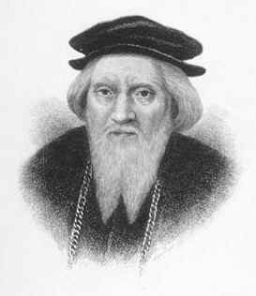
History of Fishing in Canada:
John Cabot send by British King to explore
Heritage Minute https://www.youtube.com/watch?v=ds8G9sFOK5w
John Cabot
Notes:
These fisherman for the most part would fish for a few months in the summer and would leave in the winter, with the exception of the Viking .

Slide 7
Cabot returned with stories of the Grand Banks, where cod appeared so thick that a person "could walk across their backs.”
That news opened the North West Atlantic fishery, which helped feed the world for centuries to come.

Slide 8
Types of Fisheries
Freshwater: Fish and seafood found within fresh water (lakes, rivers etc)
Saltwater: Fish and seafood found within salt water (oceans)
Recreational: Fishing done by people for personal gain and pleasure
Commercial: Fishing done by people for economic gain

Slide 9
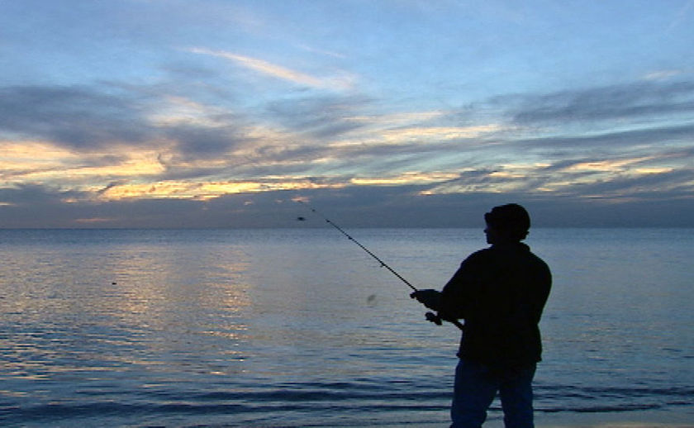
Recreational vs. Subsistence Fishing:
Recreational fishing, also called sport fishing, is fishing for pleasure or competition
Subsistence fishing is fishing for survival
For example: the Beothuk and many other First Nations were subsistence fisherman

Slide 10
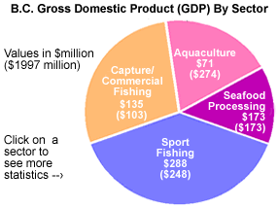
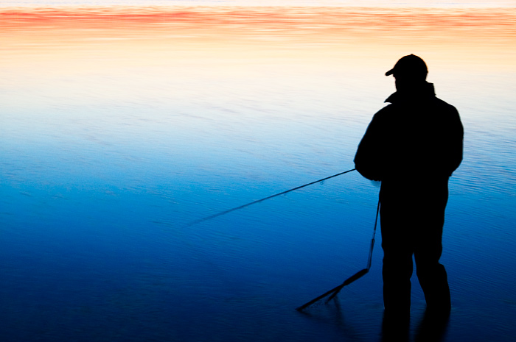
Recreational Fishing:
Millions of dollars a year are also made from recreational fishing, through tourism
Sport fishing generates $288 million a year in GDP in British Columbia alone!

Slide 11
Commercial Fishing:
Commercial fishing: is the activity of capturing fish and other seafood for commercial profit
Commercial fishing methods have become very efficient using large nets and factory ships
Fisheries refers to commercial fishing operations
Notes:
1. Prawn Trap 2. Dive 3. Groundfish Bottom Longline 4. Shrimp Beam Trawl 5. Groundfish Otter Trawl 6. Midwater Trawl 7. Hook and Line

Slide 12
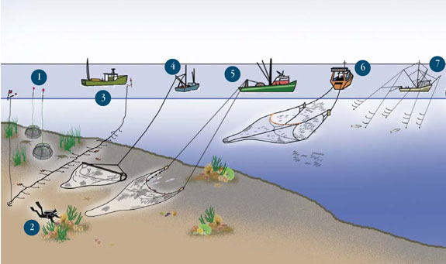
1. Prawn Trap 2. Dive 3. Groundfish Bottom Longline 4. Shrimp Beam Trawl 5. Groundfish Otter Trawl 6. Midwater Trawl 7. Hook and Line

Slide 13
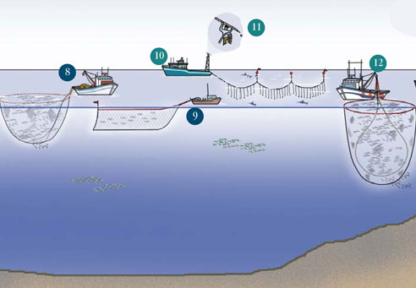
Commercial Fishing:
8. Salmon Purse Seine 9. Midwater Salmon Gillnet 10. Pelagic Longline 11. Harpoon
12. Purse Seine
Notes:
8. Salmon Purse Seine 9. Midwater Salmon Gillnet 10. Pelagic Longline (swordfish longline) 11. Harpoon (swordfish harpoon)

Slide 14
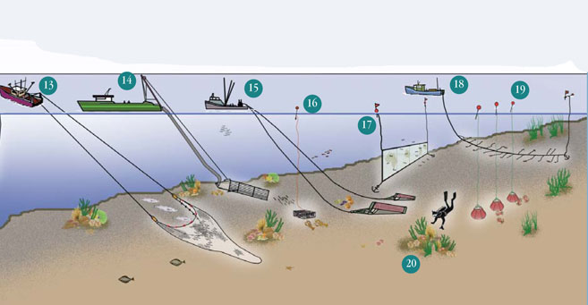
Commercial Fishing:
13. Groundfish Otter Trawl 14. Offshore Hydraulic Clam Dredge 15. Dredge 16. Pot and Trap 17. Bottom Gillnet 18. Groundfish Bottom Longline 19. Pot and Trap 20. Dive
Notes:
12. Purse Seine (herring seine) 13. Groundfish Otter Trawl 14. Offshore Hydraulic Clam Dredge 15. Dredge (scallop dredge) 16. Pot and Trap (lobster trap) 17. Bottom Gillnet (groundfish gillnet) 18. Groundfish Bottom Longline 19. Pot and Trap (crab pots) 20. Dive

Slide 15
How it helps Canada’s economy
Canada has one of the world's most valuable commercial fishing industries, contributing $2 billion a year.
The commercial fishing industry employs approximately 70,000 people (2009), and is the main industry of approximately 1,500 communities in rural and coastal Canada.

Slide 16
Canada is currently the world's eighth-largest exporter of fish and seafood products.
Seafood is the largest type of food exported by Canada.

Slide 17
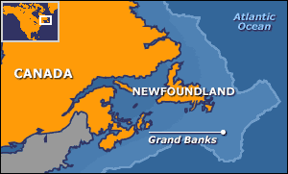
Main Sources of Commercial Fishing:
1) East Coast:
This includes fishing near the Atlantic Ocean and the Grand Banks
The Grand Banks are of the richest fishing grounds in the world
Species include:
Cod
Haddock
Capelin
Scallop
Lobster
Notes:
The Grand Banks of Newfoundland are a group of underwater plateaus southeast of Newfoundland on the North American continental shelf. These areas are relatively shallow, ranging from 80 to 330 feet (24–100 m) in depth. The cold Labrador Current mixes with the warm waters of the Gulf Stream here.
The mixing of these waters and the shape of the ocean bottom lifts nutrients to the surface. These conditions helped to create one of the richest fishing grounds in the world.

Slide 18
The Grand Banks:
For years there were no regulations or control over fishing in the Grand Banks
This depleted the fish in the area

Slide 19
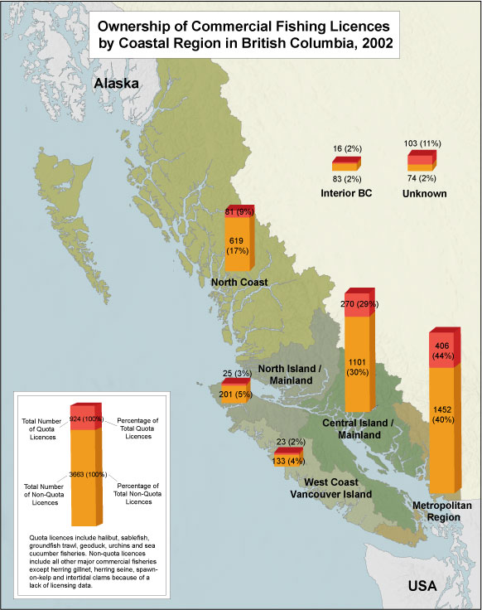
Main Sources of Commercial Fishing:
2) West Coast:
This is the area off the coast of British Columbia in the Pacific Ocean
Species Include:
Salmon
Herring
Tuna
Shellfish

Slide 20
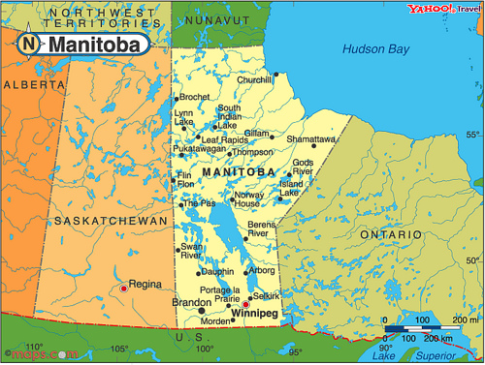
Main Sources of Commercial Fishing:
3) Fresh Water:
Canada’s freshwater system is the largest in the world, encompassing about 2 million rivers and lakes, totalling over 755,000 sq. km.
Currently, it is Manitoba's fishing industry that produces about 25% of the freshwater fish in Canada
There are about 13 species of fish that are being harvested commercially: including lake trout, northern pike, whitefish and yellow perch.

Slide 21
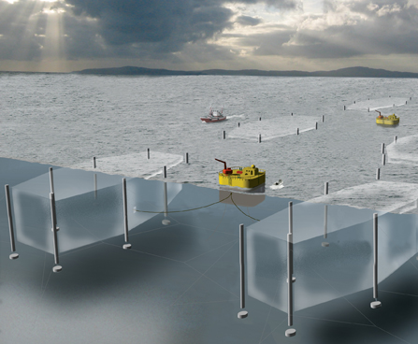
Main Sources of Commercial Fishing:
4) AQUACULTURE:
is the farming of aquatic organisms under controlled conditions
The main species are Atlantic and Pacific Salmon, Mussels and Trout
85 per cent of fish harvested is exported
Notes:
Aquaculture involves cultivating freshwater and saltwater populations under controlled conditions, and can be contrasted with commercial fishing (which is the harvesting of wild fish).

Slide 22
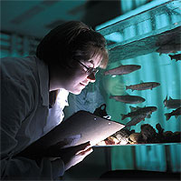
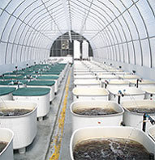
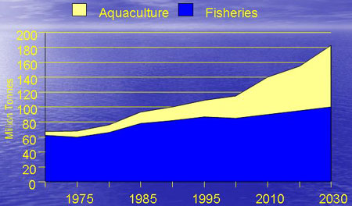
Aquaculture… the future of fishing?
In 2008, wild harvest and aquaculture exports totalled almost $4 billion
The aquaculture industry employed more than 16,000 people
There are aquaculture operations in every Canadian province and in the Yukon Territory.
Canada's aquaculture industry is continuing to grow

Slide 23
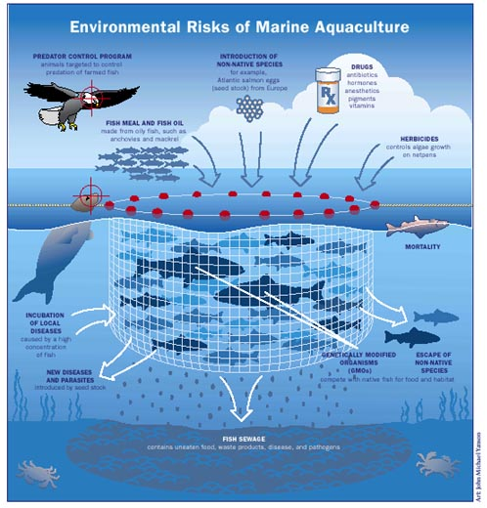
Aquaculture Risks:
Farmed fish can escape their pens and pose biological risks to wild populations
Large releases of nitrogen, phosphorus, and fecal matter from such farming can damage the coastal environment
Questions have also been raised about the nutrition, safety and taste of “farmed” fish

Slide 24
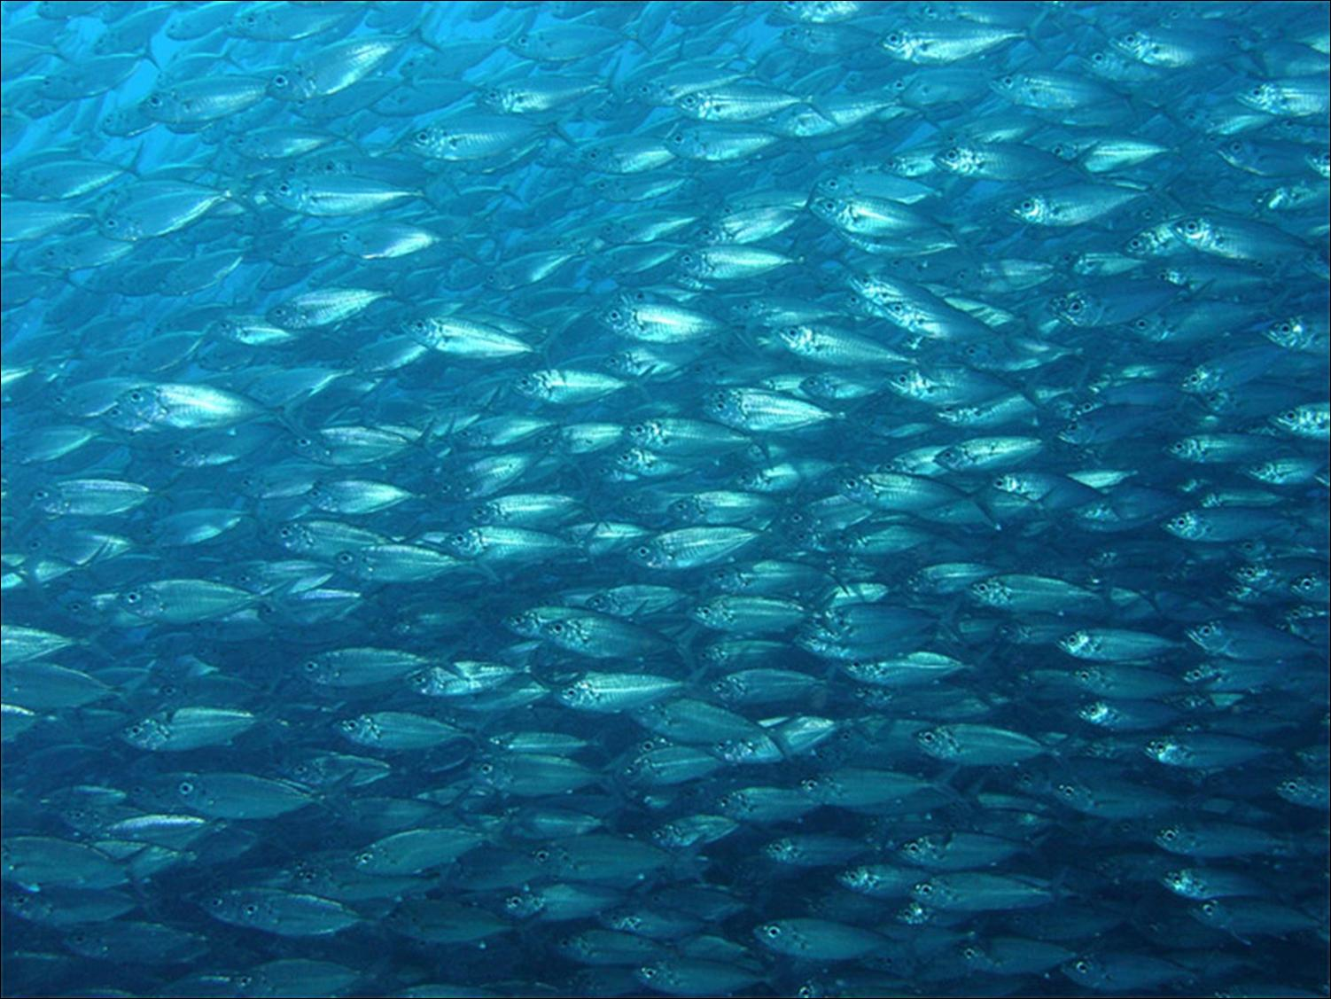
Fish as a Resource:
Fish are a renewable resource – that means with proper management the resource could last forever…
However, there are many threats to commercial fishing…

Slide 25
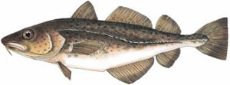
Case Study: The Collapse of the Cod Industry:
In 1992, the Cod industry in the Grand Banks (Nfld) collapsed
Less than 1% of initial population left
Atlantic cod were declared an endangered species and the federal government put a moratorium on the Newfoundland and Labrador cod fishery

Slide 26
Case Study: The Collapse of the Cod Industry:
40,000 people lost their jobs in the Maritimes
The communities are still struggling to recover
The marine ecosystem is still in a state of collapse

Slide 27
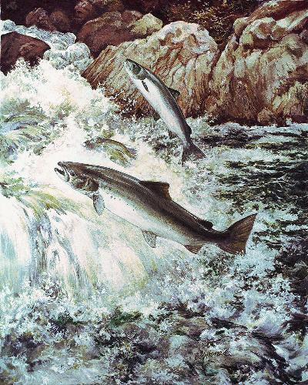
Salmon, the next Cod?
East coast salmon is also quickly disappearing
West coast salmon numbers are also declining
Today 350,000 wild salmon return to Nova Scotia’s Bay of Fundy area (down from 1.5 million in the mid-1970s)

Slide 28
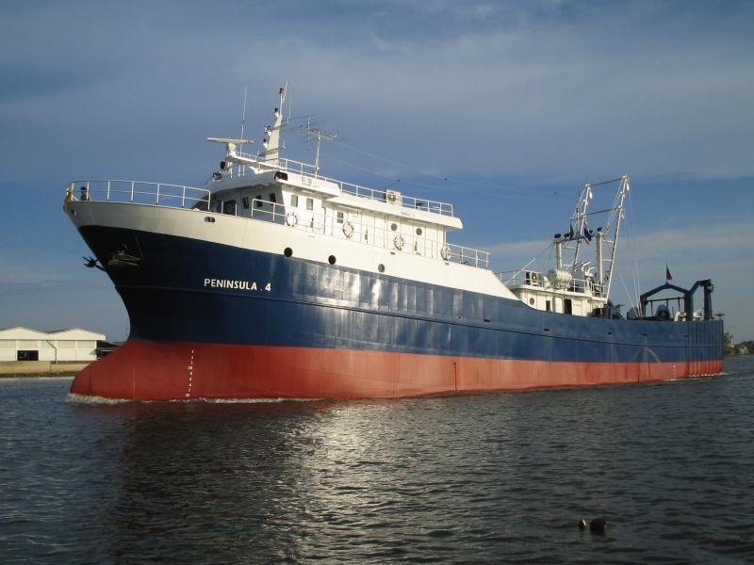
Threats to Commercial Fishing:
Technology
New technology is making it possible to find and capture fish more easily
Examples: radar, GPS
Trawlers are huge factor ships that make it possible to capture, gut and freeze fish instantly onboard
Draggers: huge nets that are dragged along the bottom of the ocean that catch everything in its path and destroy the underlying eco-system in the process

Slide 29
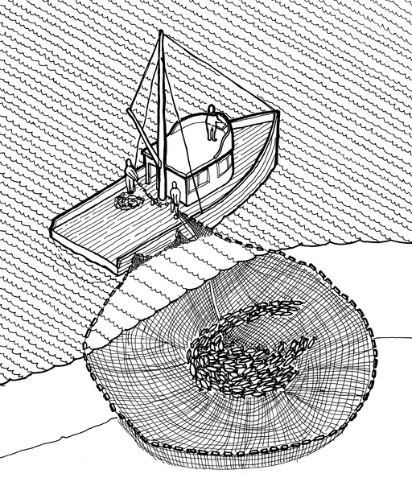
Technology cntd:
Example:
In 1972 it took traditional seine boats 51 days to harvest their quota in the West Coast
In 1994 it took less that four days for modern boats to fill their quota

Slide 30
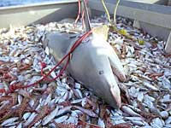
Threats to Commercial Fishing:
Overfishing
Simply means catching too many fish
Bycatch is when nets accidently catch small fish or other marine species
Bycatch is often 80 per cent of the stock

Slide 31
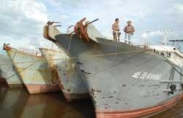
Threats to Commercial Fishing:
Foreign Fisherman:
Up until the 1950s, 250,000 tonnes of Cod were caught in Grand Banks alone
However, after the 1950s foreign fisherman began arriving at the Grand Banks in trawlers (huge factory ships)
Although Canada tries to maintain quotas, it cannot restrict anyone beyond the 200 nautical mile jurisdiction
Notes:
Foreign fisherman came from England, the U.S., the Soviet Union, East and West Germany. Spain, Portugal, Poland and some Asia nations such as Japan and Korea.

Slide 32
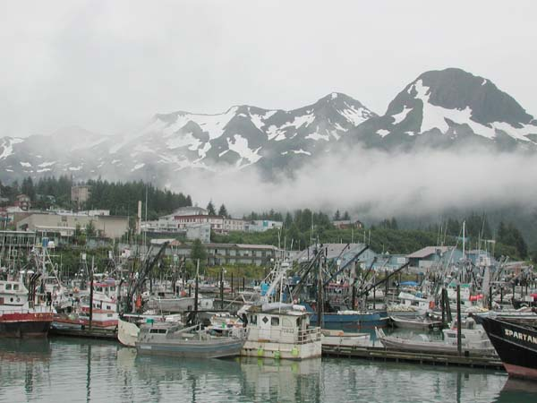
Foreign Fishermen:
The United States has a right to fish in the west coast due to the location of the state of Alaska
The American’s 2,500 Alaskan fleet is being partially blamed for depleting Salmon stocks

Slide 33
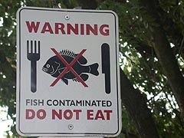
Threats to Commercial Fishing:
Environmental threats include:
Climate Change
Pollution
Accidental introduction of invasive species
Notes:
While the adaptive capacity of the Canadian fisheries sector with respect to climate change is generally poorly understood, there is growing recognition of the need to anticipate and prepare for potential changes, and increased realization that present-day decisions will affect future vulnerabilities. Fish can be exposed to high levels of pollution, as the bodies of water in which they live often receive contaminants from precipitation, storm water runoff and industrial effluents.
Exposure to harmful chemicals can weaken the immune systems of fish and impair reproduction and development. Some of these chemicals can be passed on to other animals and humans that eat them.

Slide 34
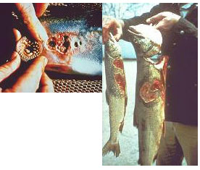
Environmental threats:
INVASIVE SPECIES: a non-native species, whose introduction will likely cause (or has already caused) damage to the host ecosystem
Examples:
Sea lamprey
Japanese oyster
Japanese oyster
Notes:
Aquatic invasive species (AIS) have already been responsible for significant devastation of some native fish species and fisheries in Canada. Annually, the problem is responsible for billions of dollars in lost revenue and control measures. Canada, with its huge freshwater resource and extensive coastline, is especially vulnerable to this threat.

Slide 35
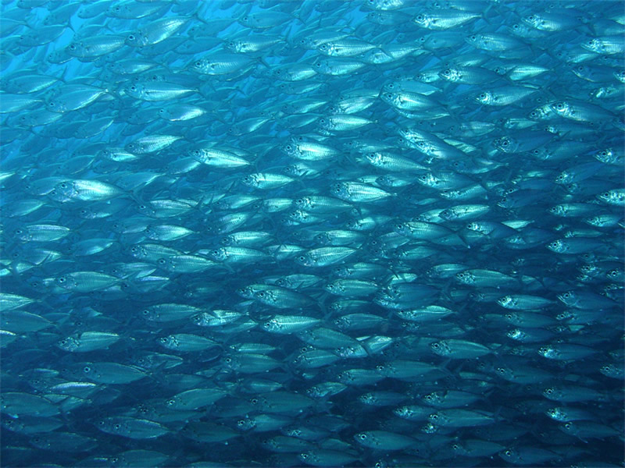
The Commercial Fishing Industry Today:
The fishing industry is still a big source of income in Canada
In 2005 over 1 million tons of commercial fish was harvested, valued at about $2 billion
Aquaculture production in the same year yielded over 150,000 tons, valued at over $700 million
Businesses belonging to Canada's fishing industry number about 11,000 (includes aquaculture, fish processing, ocean services, engineering and hydrography, among others)
However, this natural resource needs to be protected!

