Slide 1
Nature of Canada’s Economy

Slide 2
Key Questions:
How does the human environment affect and change our natural environment?
We will be looking at this through 3 different aspects:
1
Primary Industry
2
Manufacturing
3
Location Factors
Before we move on, we first need an understanding of what makes up the Canadian Economy

Slide 3
Economic Structure of Canada
Economic System
The organization in which products and services are made and used up

Slide 4
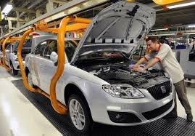

The economy is made up of two different types of people:
Producer:
Consumers:
people who harvest, manufacture products or provide services
people who use products and services

Slide 5
Types of Industry
4 main Types of Industry:
1
Primary Industry
2
Secondary Industry
3
Tertiary Industry
3
Quaternary Industry

Slide 6
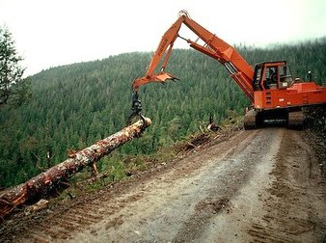
Primary Industry
Industries that take raw materials from the enviornment.
(Resources in their natural form)
E.g., farming, forestry, fishing and mining

Slide 7
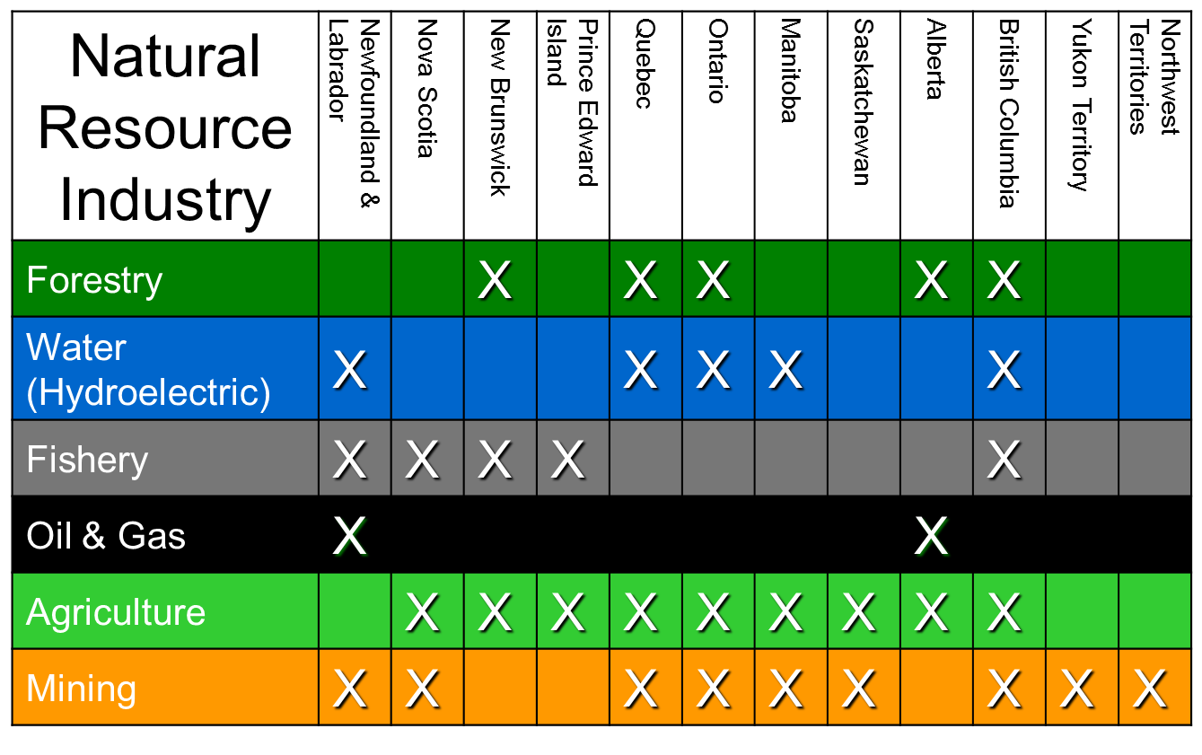
Provinces of Canada and their Primary Industries using natural resources

Slide 8

Labour
Lower number of people employed than other industry levels due to mechanization of the job (one person per big machine)
Skilled labour due to the specialization of the job (college diploma and apprenticeship)

Slide 9
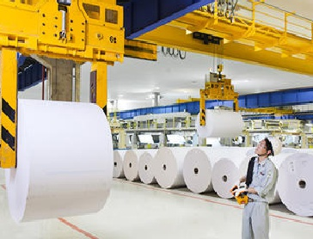
Process raw materials into industrial products
Examples: steel mills, paper mills, textile mills, plastic manufacturers, flour mill
Secondary Refining Industry

Slide 10
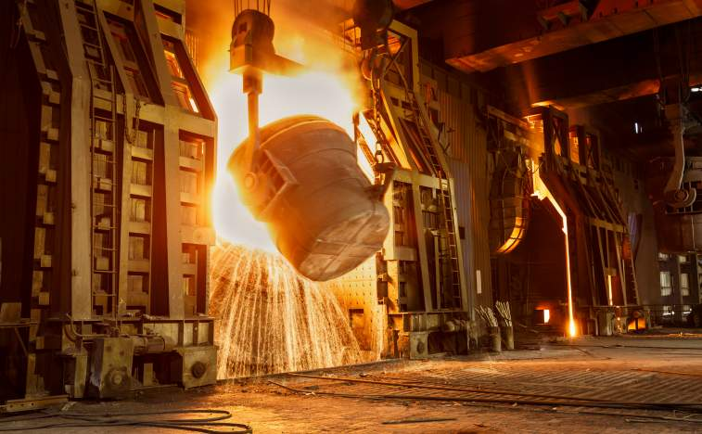
Labour
Larger number of people employed than primary industry but still lower than manufacturing industry
some college skilled labour (steel milling). Often industry trained labour

Slide 11

Secondary Manufacturing Industry
Involve the processing of primary industry products into finished goods.
Take raw materials and change them into things we can use.
E.g., Automobile production plant, factories

Slide 12
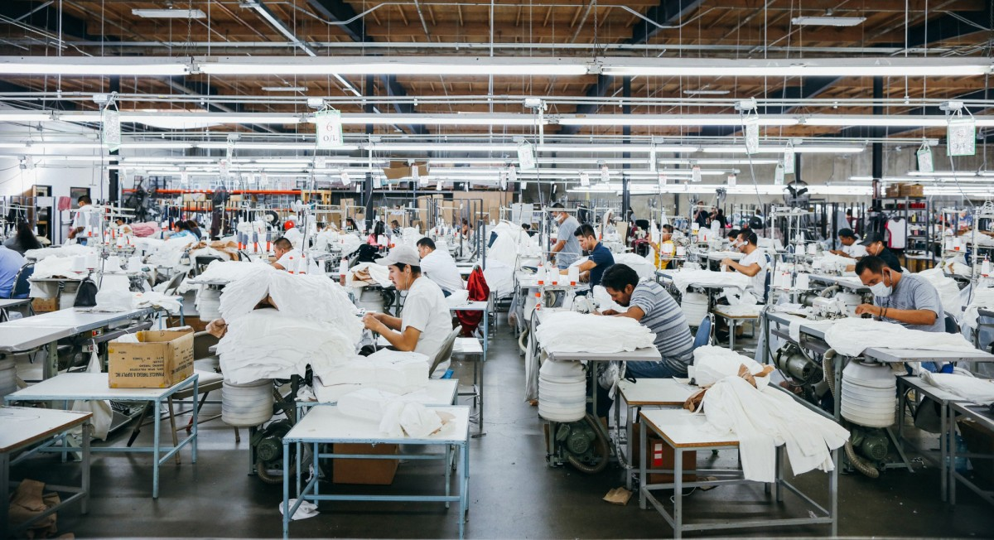
Labour
larger number of people in a factory
Often industry trained labour, low skill labour

Slide 13

Provide a wide range of servies that support primary and secondary industries.
These industries DO NOT manufacture products.
They provide SERVICES
E.g., Airlines, retail, doctors, teachers, lawyers
Tertiary Industry

Slide 14

Labour
Large number of people employed in this industry
Labour skill varies:
Low skill labour (e.g., cashier)
College trained (e.g., chef, paramedic)
University trained (e.g., accountant, pharmacist)

Slide 15

Non traditional jobs
E.g., High tech, research, consultants
Quaternary Industry

Slide 16

Labour
Small number of people employed in this industry
Very highly trained employees (many years of university)

Slide 17
Types of Jobs
Each of the different types of industries, no matter primary, secondary, tertiary or quaternary have jobs that are considered either basic jobs or non-basic jobs

Slide 18
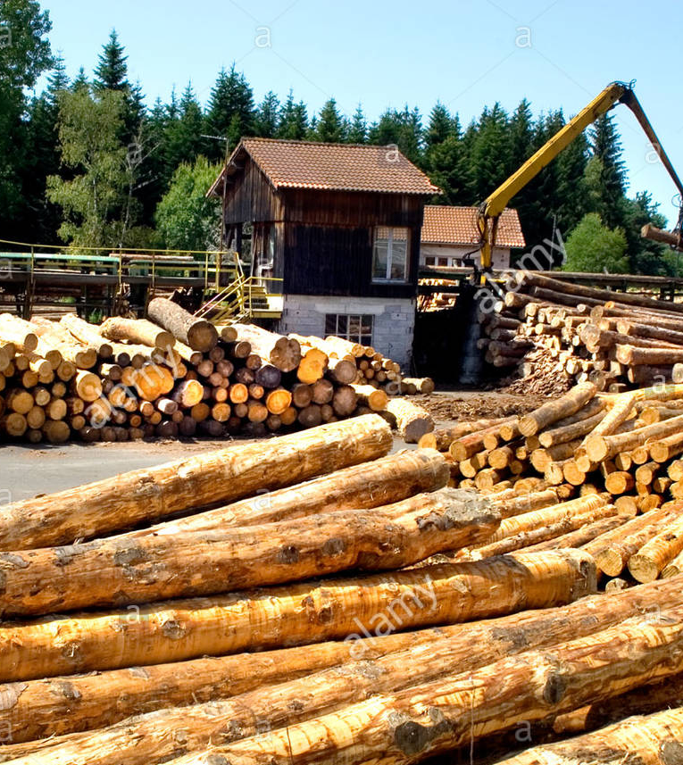
Basic Jobs
Selling goods or services to people outside of the local community
Bringing new money into the local economy

Slide 19

Basic Jobs
E.g. manufacturing something in your home town then selling it somewhere else
You make a painting (a good) and a guy from California buys your painting
You have a saw mill in BC and you sell lumber to a builder in Ottawa.

Slide 20

Non-Basic Jobs
Selling goods or services to people within the local community
Recycling existing money in the local economy

Slide 21

Non-Basic Jobs
E.g. getting your haircut at a local barber
Fry guy at McDonald’s restaurant

