Slide 1
Population Changes
How populations grow, shrink, and change

Slide 2
Remember…
What is population?
Urban vs. rural?
What is the equation for population density?
And why does this all matter?

Slide 3
Another thing human geographers like to look at is…
How populations grow and change, and WHY
To do this, they look at things like:
Birth Rate
Death Rate
Natural Increase Rate
Immigration Rate
Emigration Rate
Net Migration Rate

Slide 4
Video about population changes…birth rate and death rate
http://www.youtube.com/watch?v=VcSX4ytEfcE

Slide 5
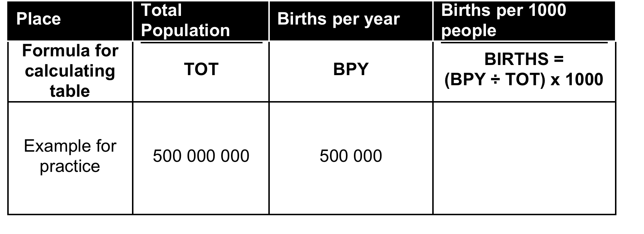
Birth Rate
The number of people born each year per 1000 people.
# of births / total population=BR
Then multiply that # by 1000 to get the # of births per 1000 people

Slide 6
# of births / total population x 1000 = BR
500 000/ 500 000 000 = 0.001
0.001 x 1000 = 1
Births per 1000 people= 1

Slide 7
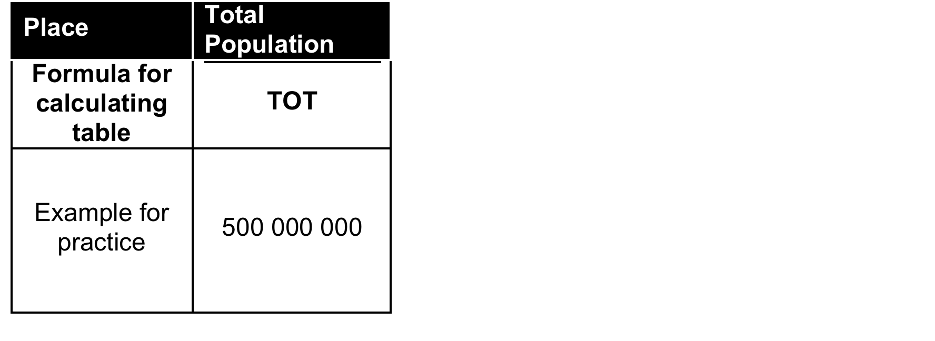
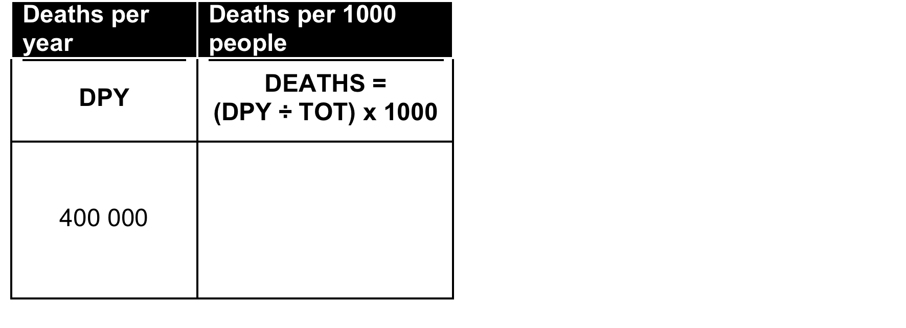
Death Rate
The number of deaths per year per 1000 people.
# of deaths / total population= DR
Then multiply that # by 1000 to get the # of deaths per 1000 people

Slide 8
# of deaths / total population= DR
400 000/ 500 000 000= 0.0008
0.0008 x 1000= 0.8
Deaths per 1000 people= 0.8

Slide 9
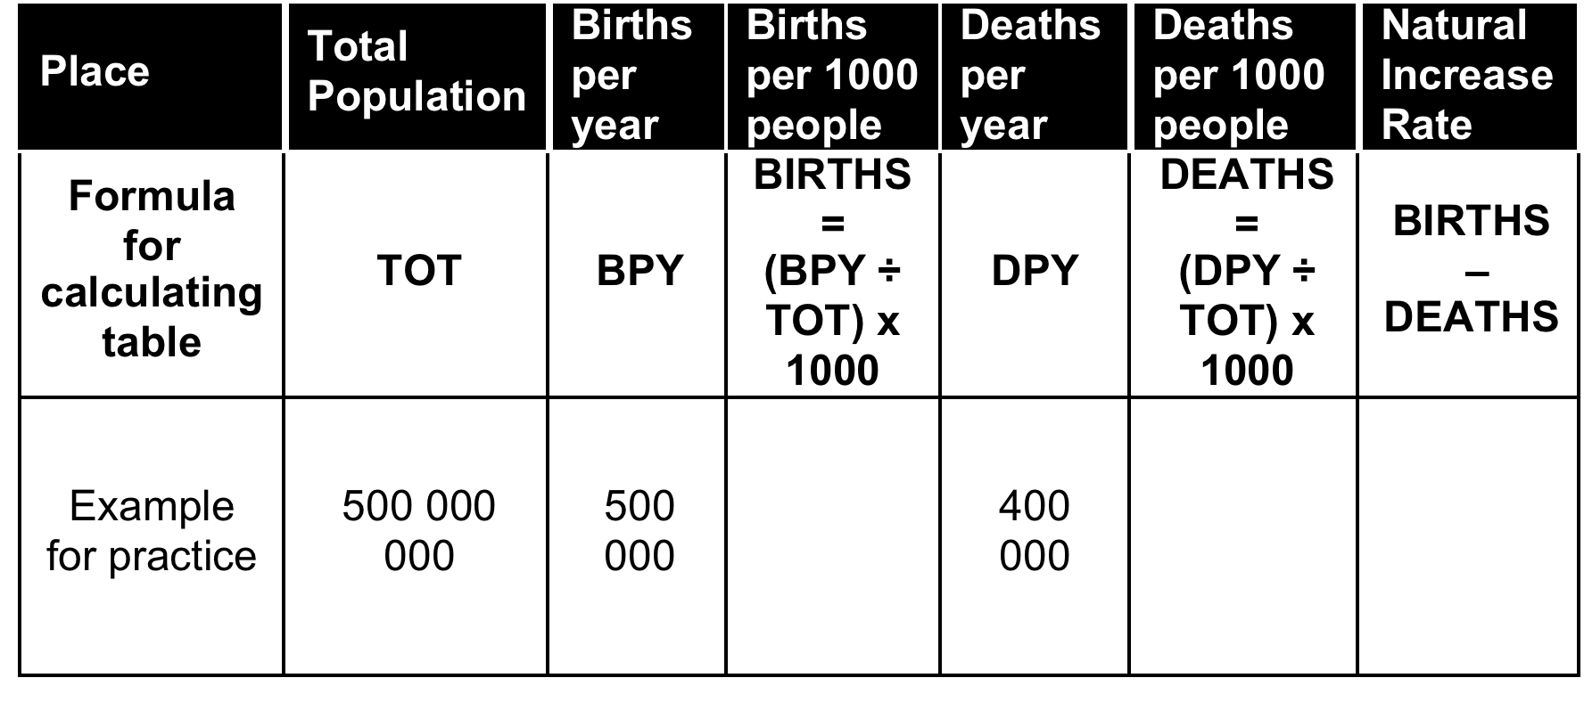
Natural Increase Rate
Natural Increase Rate
The difference between the birth rate and the death rate of a country.
Birth Rate- Death Rate= Natural Increase Rate

Slide 10
Natural Increase Rate
Births= 1
Deaths= 0.8
Births-Deaths= 0.2
Natural Increase Rate= 0.2
Birth Rate- Death Rate= Natural Increase Rate

Slide 11
Immigration Rate
Refers to the number of people per 1000 population in one year who immigrate
# Immigrants per year/ population= immigration rate
Then multiply x1000 to get the # of immigrants per 1000 people

Slide 12
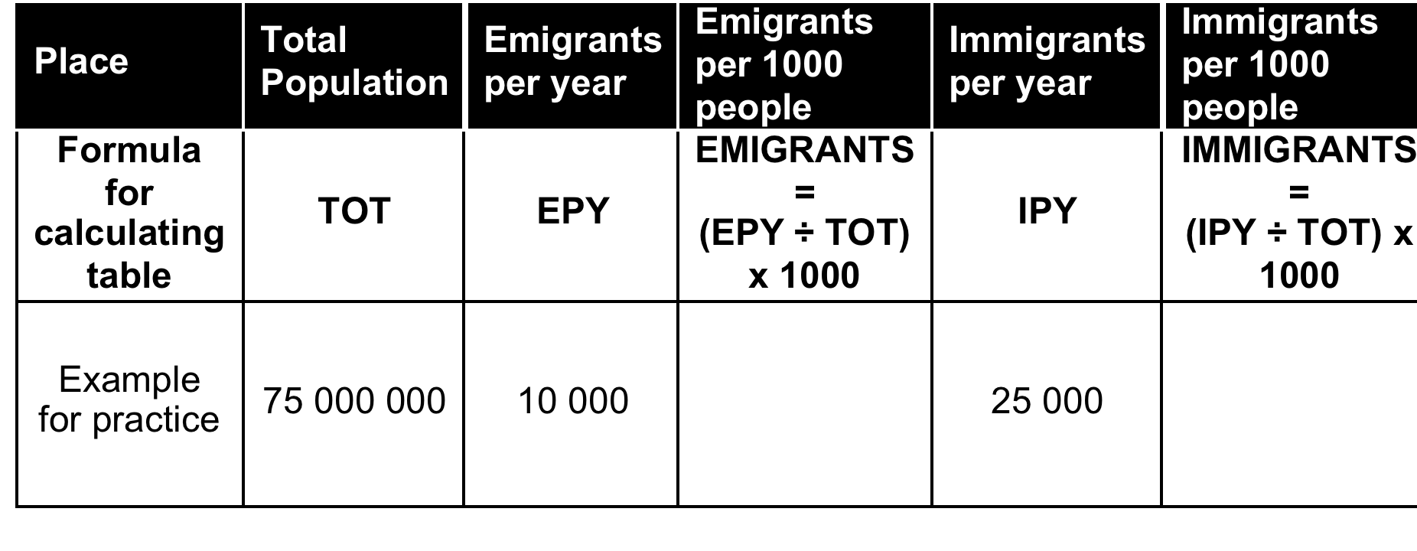
Immigration Rate
25 000/ 75 000 000= 0.00033
0.00033 x 1000= 0.33
Immigrants per 1000 people= 0.33

Slide 13
Emigration Rate
Refers to the number of people per 1000 population in one year who emigrate
# Emigrants per year/ population= Emigration Rate
Then multiply x 1000 to get # of emigrants per 1000 people

Slide 14
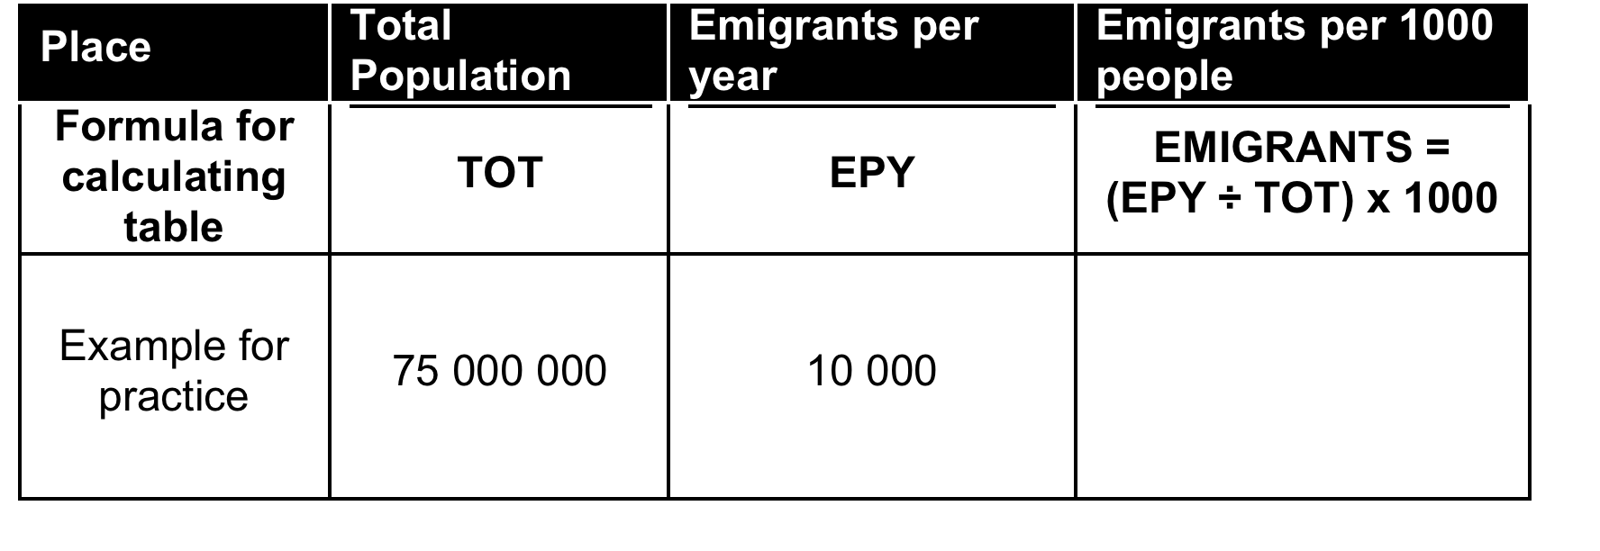
Emigration Rate
10 000/75 000 000= 0.00013
0.00013 x 1000= 0.13
Emigrants per 1000 people= 0.13

Slide 15
Net Migration Rate
The difference between people immigrating to a country and people emigrating from the same country.
Immigration Rate- Emigration Rate= Net Migration Rate

Slide 16
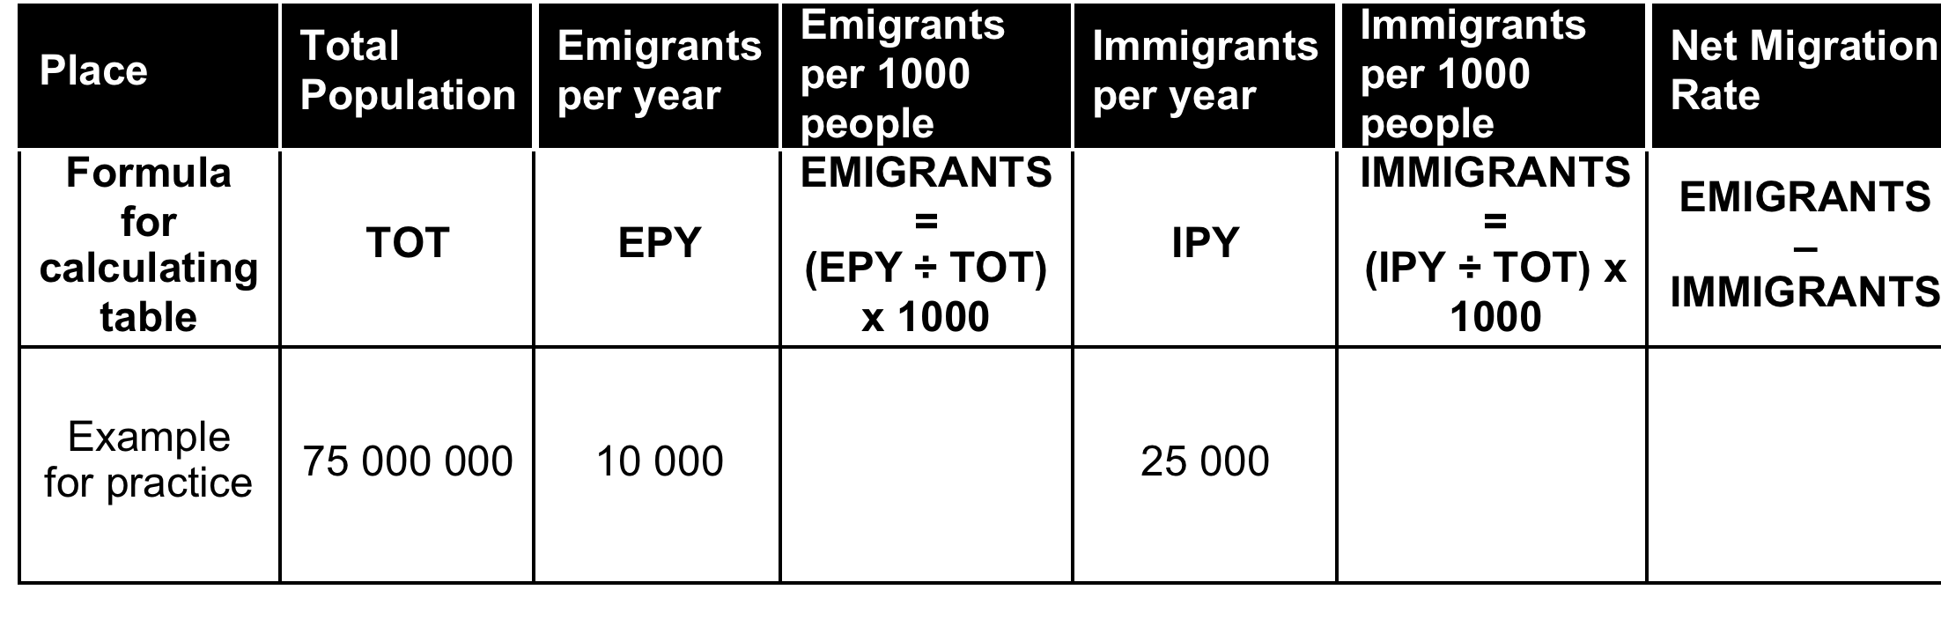
Net Migration Rate
Immigration Rate- Emigration Rate= Net Migration Rate
0.33- 0.13 = 0.2

