Slide 1

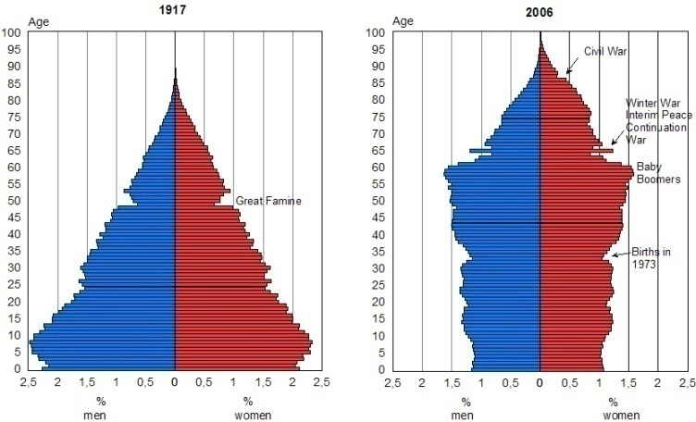
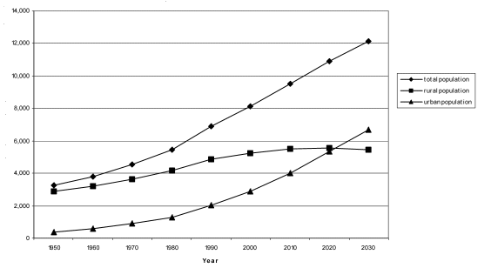
Population Calculations

Slide 2
Calculating population
Put simply, population is affected by 4 factors:
(+)
1) Birth
2) Death
( - )
3) Immigration
(+)
(moving permanently to a new country)
4) Emigration
( - )
(moving permanently from one’s native country)
Birth and immigration have a positive (+) effect on population
Death and emigration have a negative ( - ) effect on population

Slide 3
A simple formula
We can take all these factors and make a simple formula:
final population
starting population
=
+ births
- deaths
+ immigration
- emigration
For example: If Guelph has a population of 120,000 on January 1st , 2009, what will its population be at the end of the year if there are 3000 births, 2000 deaths, 8000 immigrants, and 6000 emigrants?
final population = 120,000 + 3000 – 2000 + 8000 - 6000
final population = 123,000

Slide 4


Comparing? Use rates!
In order to compare 2 different places, we need to use rates instead of simply total numbers
For example, let’s compare Canada with Italy:
In 2002, Canada had about 350,000 births while Italy had about 520,000.
So Italians have more babies than Canadians and they have bigger families than Canadians, right?
X
Well actually, NO!

Slide 5

In 2002, Canada’s population was only 31.9 million whereas Italy’s was 57.9 million. So we have to “level the playing field” by calculating the birth rate
Usually, the birth rate is calculated as how many births there are per 1000 people (using this easy formula: births ÷ population x 1000)
When we calculate the birth rates for Canada and Italy, we get these results:
Canada: 11 births / 1000 people
Italy: 9 births / 1000 people
So Canadians, on average, have more babies!

Slide 6



Some other rates
OK, so now that you know about the birth rate, you can learn the other rates…
Death rate (deaths per 1000):
  deaths ÷ population x 1000
Immigration rate (immigrants per 1000):
  immigrants ÷ population x 1000
Emigration rate (emigrants per 1000):
  emigrants ÷ population x 1000

Slide 7

Rates continued…
And finally:
Natural increase rate
  birth rate – death rate
Net migration rate
  immigration rate – emigration rate
Population growth rate
  natural increase rate + net migration rate

Slide 8
An example
OK, there were a lot of rates there. To help you remember and understand them, here’s an example:
Durktown (2011)
Total population | Births | Deaths | Immigrants | Emigrants
10,000 | 150 | 100 | 80 | 20
Birth rate = births ÷ population x 1000
Birth rate = 150 ÷ 10,000 x 1000
(per 1000 people)
Birth rate = 15
(that’s 15 per 1000 people … or 1.5%)

Slide 9
Example continued…
Durktown (2011)
Total population | Births | Deaths | Immigrants | Emigrants
10,000 | 150 | 100 | 80 | 20
Death rate = deaths ÷ population x 1000
Death rate = 100÷ 10,000 x 1000
(per 1000 people)
Death rate = 10
(or 1.0%)
Immigration rate = immigrants ÷ population x 1000
Immigration rate = 80 ÷ 10,000 x 1000
(per 1000 people)
Immigration rate = 8
(or 0.8%)

Slide 10
Example continued…
Durktown (2011)
Total population | Births | Deaths | Immigrants | Emigrants
10,000 | 150 | 100 | 80 | 20
Emigration rate = emigrants ÷ population x 1000
Emigration rate = 20 ÷ 10,000 x 1000
(per 1000 people)
Emigration rate = 2
(or 0.2%)
Now we have our first 4 rates. Let’s put them in our table of data:
Durktown (2011)
Total pop. | Births | Birth rate | Deaths | Death rate | Immigrants | Immigration rate | Emigrants | Emigration rate
10,000 | 150 | 15 | 100 | 10 | 80 | 8 | 20 | 2

Slide 11
Example continued…
Durktown (2011)
Total pop. | Births | Birth rate | Deaths | Death rate | Immigrants | Immigration rate | Emigrants | Emigration rate
10,000 | 150 | 15 | 100 | 10 | 80 | 8 | 20 | 2
Natural increase rate = birth rate – death rate
Natural increase rate = 15 – 10
Natural increase rate = 5
(or 0.5%)
Net migration rate = immigration rate – emigration rate
Net migration rate = 8 – 2
Net migration rate = 6
(or 0.6%)

Slide 12
Example continued…
Durktown (2011)
Total pop. | Births | Birth rate | Deaths | Death rate | Immigrants | Immigration rate | Emigrants | Emigration rate
10,000 | 150 | 15 | 100 | 10 | 80 | 8 | 20 | 2
Population growth rate = natural increase rate + net migration rate
Population growth rate = 5 + 6
Population growth rate = 11
(or 1.1%)

Slide 13

One last thing…
All these rates provide valuable information, but there is one more important statistic that has yet to be mentioned… doubling time
Doubling time refers to the amount of time it would take for a population to double (at the current population growth rate)
How long?

Slide 14
Doubling Time & Rule of 70
A quick and easy way to calculate doubling time is to use something called the Rule of 70
The Rule of 70 is simply dividing 70 by the population growth rate:
So the formula for doubling time is:
Doubling time = 70 ÷ population growth rate

Slide 15
Back to our example…
So for Durktown, with a population of 10,000, how long would it take for its population to double to 20,000?
By the way, notice we used 1.1 (the percent) and NOT 11 (the per 1000 people rate). This is important!!!
Doubling time = 70 ÷ population growth rate
Doubling time = 70 ÷ 1.1
Doubling time = 63.6
(or almost 64 years)
At the current population growth rate, it would take Friesentown about 64 years to double its population to 20,000.

Slide 16
Time for some practice
OK, now that you’ve learned about all these rates that are used in demography, let’s put them to practice!

