Slide 1
Population Pyramid

Slide 2
Population Pyramid
A population pyramid, is a graphical illustration that shows the distribution of various age groups in a human population (typically that of a country or region of the world), which normally forms the shape of a pyramid.

Slide 3
Population Pyramid
It typically consists of two back-to-back bar graphs, with the population plotted on the X-axis and age on the Y-axis, one showing the number of males and one showing females in a particular population in five-year age groups (also called cohorts). Males are conventionally shown on the left and females on the right, and they may be measured by raw numbers or as a percentage of the total population.

Slide 4
Cohort
A group of people of a certain age
Used to determine trends and see similarities and differences
5 year groups are most common

Slide 5
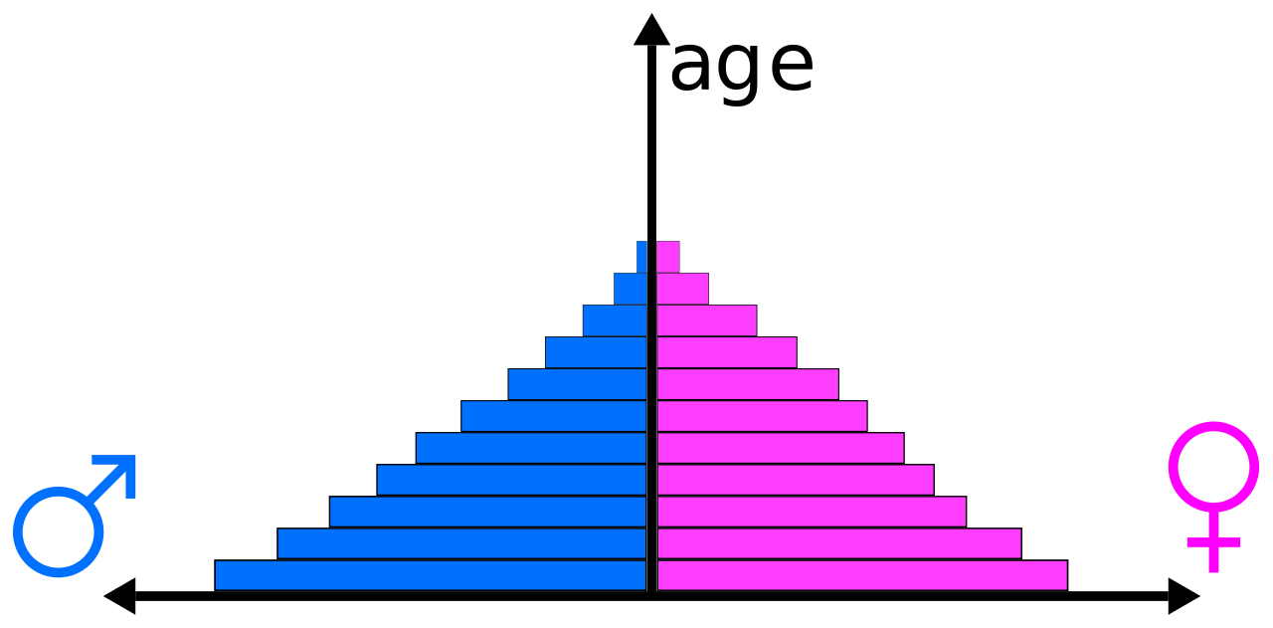
Population Pyramid

Slide 6
Population Pyramid
Population pyramids are often viewed as the most effective way to graphically depict the age and sex distributed of a population, partly because of the very clear image these pyramids present.

Slide 7
What do they tell us?
By analysing population pyramids and identifying trends, we can learn a lot about our society. These statics give governments and others one of the tools they need to make informed decisions that will affect our lives today and in the future.
    # of dependents (kids)
    Social trends towards having larger/smaller families
    # of retirees

Slide 8
Types of Population Pyramid
While all countries’ population pyramids differ, three types have been identified by the fertility and mortality rates of a country

Slide 9
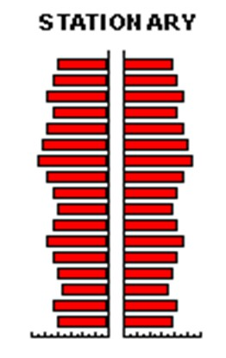
Types of Population Pyramid
Stationary pyramid - a population pyramid typical of countries with low fertility and low mortality (e.g., Argentina)

Slide 10
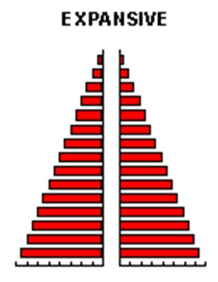
Types of Population Pyramid
Expansive pyramid: a population pyramid showing a broad base, indicating a high proportion of children, a rapid rate of population growth, and a low proportion of older people. This type of pyramid indicates a population in which there is a high birth rate, a high death rate and a short life expectancy. E.g., Kenya

Slide 11

Types of Population Pyramid
Constrictive pyramid: a population pyramid showing lower numbers or percentages of younger people. The country will have a greying population which means people are generally older. E.g., Sweden

Slide 12
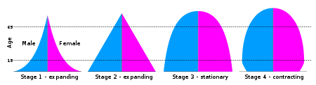
Population Pyramid
They can also be related to the DTM (Demographic Transition Model)

Slide 13
Stage One
Because of the high birth rates the bottom age group of the graph is full with a large percentage of living people there, while higher up it tapers off. This is due to the high mortality rate from birth upwards and also due to the short life expectancy in these countries.

Slide 14
Stage Two
The simplest way to describe is calling it a pyramid. The reason for the shape is that there is still a high birth rate; however the death rate is going down such that more people are reaching old age or at least that life expectancy has slightly increased.

Slide 15
Stage Three
The graph begins to bulge at the middle age groups because the birth rates have gone down and more people are surviving to the middle age group and the death rate is fairly low.

Slide 16
Stage Four
Stage four would be a convex graph shape because there are about as many deaths as births and more people are reaching middle age as mentioned in stage 3, but here the population is stable.

Slide 17
Young and Ageing Populations
Generally a population pyramid that displays a population percentage of ages 1-14 over 30% and ages 75 and above under 6% is considered a “young population” (generally occurring in developing countries, with a high agricultural workforce).

Slide 18
Young and Ageing Populations
A population pyramid that displays a population percentage of ages 1-14 under 30% and ages 75 and above over 6% is considered an “aging population” (that of which generally occurs in developed countries with adequate health services, e.g., Australia)

Slide 19
Dependency Load
The number of people who are too old or too young to support themselves
They are dependent on the rest of society
Generally it includes people who are under 15 years or over 65
The higher this number is, the more taxes have to be paid for schools, hospitals, daycare, etc.

Slide 20
Dependency Ratio

Slide 21
The (total) dependency ratio can be decomposed into the child dependency ratio and the aged dependency ratio:
Number of people aged 0-14
Child dependency ratio=____________________________ X 100
Number of people aged 15-64
Number of people aged 65 and over
Aged dependency ratio= ___________________________ X 100
Number of people aged 15-64

Slide 22
Example
In Canada, 1999, the dependency ratio was 44. This means that for every 100 people of working age in 1999, there were 44 dependents upon them.

Slide 23
Implications of Dependency Ratio
Aged population:
    More medical facilities
    Adaptation of transport
    More strain on the working class
    Younger population can learn from the present aged population

Slide 24
Implications of Dependency Ratio
Large Youthful Population:
    More spent on education facilities
    More strain on the working class
    Education of public on family planning and birth control
    More spent on early child care centres

Slide 25
Generation
Boomerang
http://www.cbc.ca/doczone/episodes/generation-boomerang

