Slide 1
HUMAN SETTLEMENT PATTERNS
. HUMAN SETTLEMENT PATTERNS Human settlement patterns are the science of how settlements of buildings and houses are designed and shown. Settlement patterns help to show how areas like communities have grown.

Slide 2
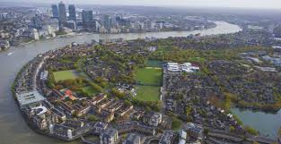
CLUSTERED SETTLEMENT
Clustered settlements are settlements in which buildings and houses are built to look grouped together. Clustered settlements help the look of a community. Clustered settlements also help to make up the population of cities and towns.

Slide 3
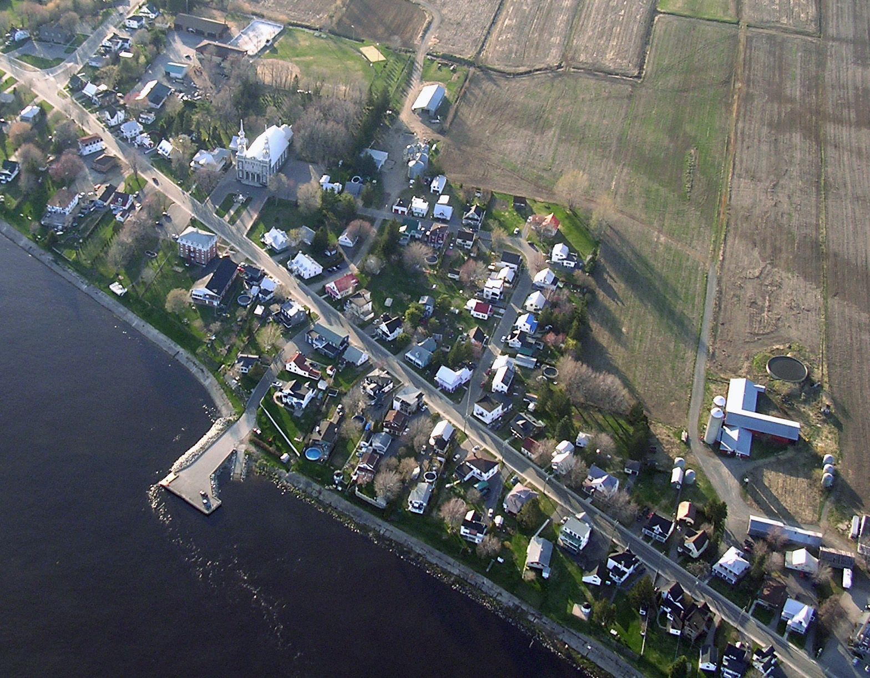
LINEAR SETTLEMENT Linear settlements are patterns of houses and buildings following the lines of the road/ transport routes. Linear settlements are usually constructed for easy access to transportation routes (roads) for people and goods.

Slide 4
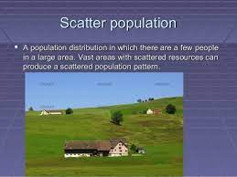
SCATTERED SETTLEMENT
Scattered settlements are landscapes with many farmsteads that are dispersed throughout the area. Scattered settlements usually take place out of cities and towns where the land is mostly just fields. The look of a scattered settlement is houses and farms randomly spaced far apart from other buildings not following any pattern. Scattered settlements are also known as dispersed settlements.

Slide 5
POPULATION DENSITY Population density is the way of measuring the people living in an area per unit area or volume. Population density can be calculated for a people living in a city, province or even country. Population density can also be used to measure area or volume of water and land area.

Slide 6
POPULATION DISTRIBUTION Population distribution is simply how a population is shown. The pattern of where people live. The distribution can also vary based on age, race and gender.

Slide 7
Canada as a whole has a population density of just 4 people per square kilometers, which makes it the 228th most densely populated country. The population density is among the lowest in the world, mostly because a great deal of the country to the north is virtually uninhabited.

