Slide 1
Canadian Migration

Slide 2
Key Terms
Immigration: the act of moving into a country to become a permanent resident
Immigrant: a person who comes to a country where they were not born in order to settle there
Emigration: the act of moving out of a country to become a permanent resident in another
Emigrant: a person who moves out of the country they were born and then resides in a new country

Slide 3
Types of Immigrants
An individual immigrating to Canada can enter as one of the following:
Family Immigrant
Refugee
Independent Immigrant

Slide 4

Family Immigrant
You can immigrate to Canada under a Family Class sponsorship if you have a relative who is a permanent resident or Canadian citizen.

Slide 5
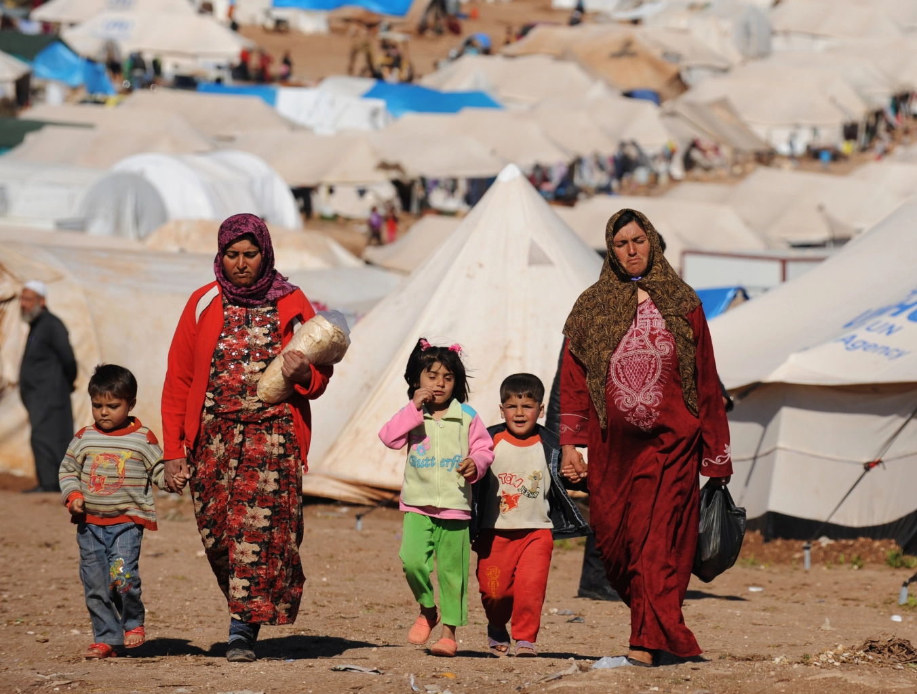
Refugee
An individual who flees their country for their safety.

Slide 6

Independent Immigrant
A person with a specific occupational skill, experience and personal qualifications who meet Canada’s selection criteria

Slide 7
Key Terms
Migration: the movement of people from one place to another
Push Factors: reasons why people leave a country
Pull Factors: reasons why people are attracted to a country

Slide 8

Pull Factors
Why are Immigrants Pulled to Large Cities?
Family: Immigrants may have been sponsored by family who already live in the city and therefore they want to live close to them

Slide 9
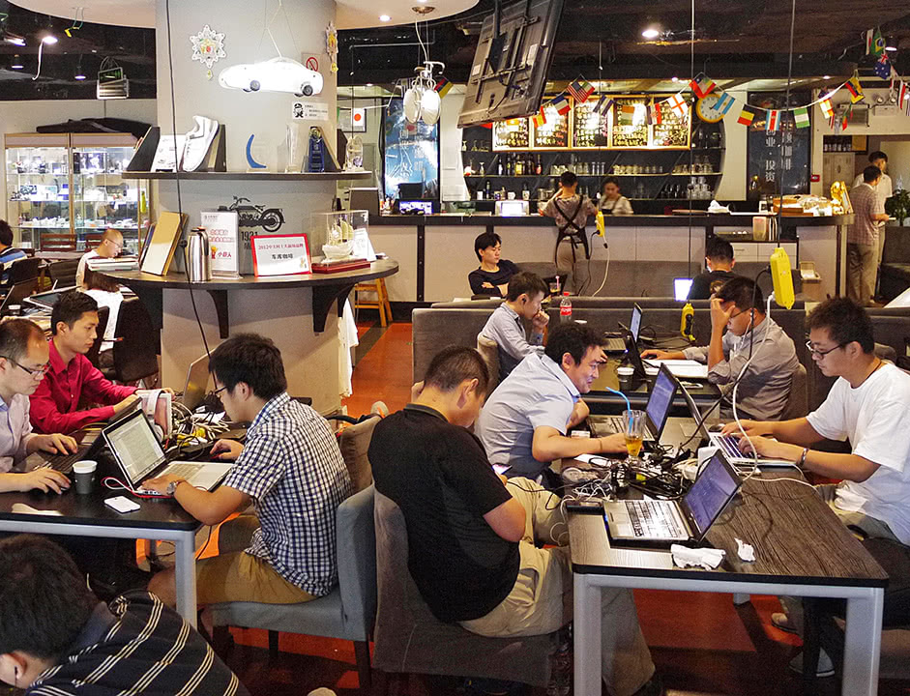
Pull Factors
Why are Immigrants Pulled to Large Cities?
Language: Immigrants who don’t speak English are attracted to large communities where their language is spoken

Slide 10

Pull Factors
Why are Immigrants Pulled to Large Cities?
Employment: Big cities have more jobs available

Slide 11

Pull Factors
Why are Immigrants Pulled to Large Cities?
Large cities are culturally diverse and therefore more welcoming for immigrants

Slide 12
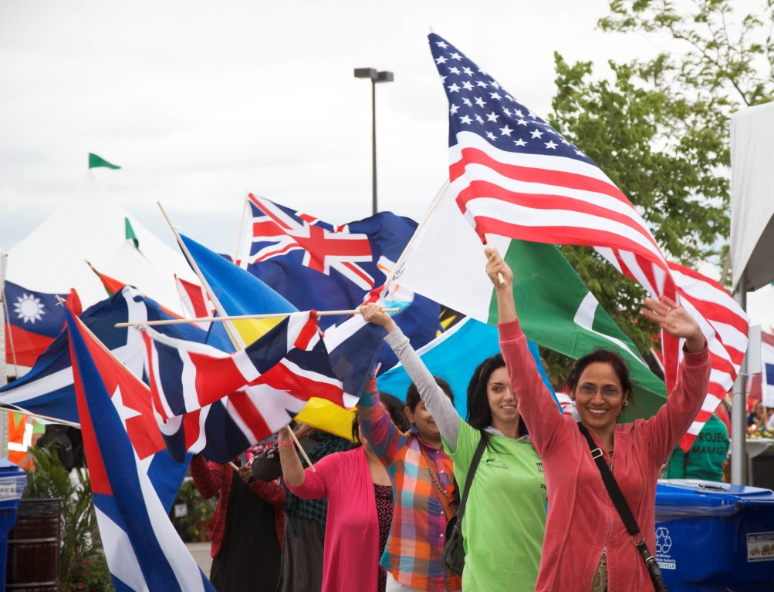
Cultural Imprint
The impact that a cultural group has on a neighborhood or community

Slide 13
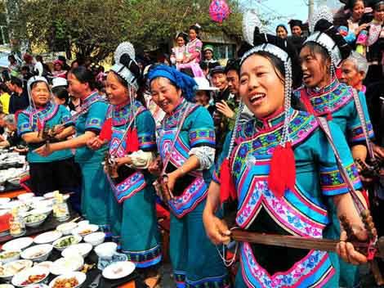
Ethnic Community
A particular ethnic group settling in one area within a city

Slide 14
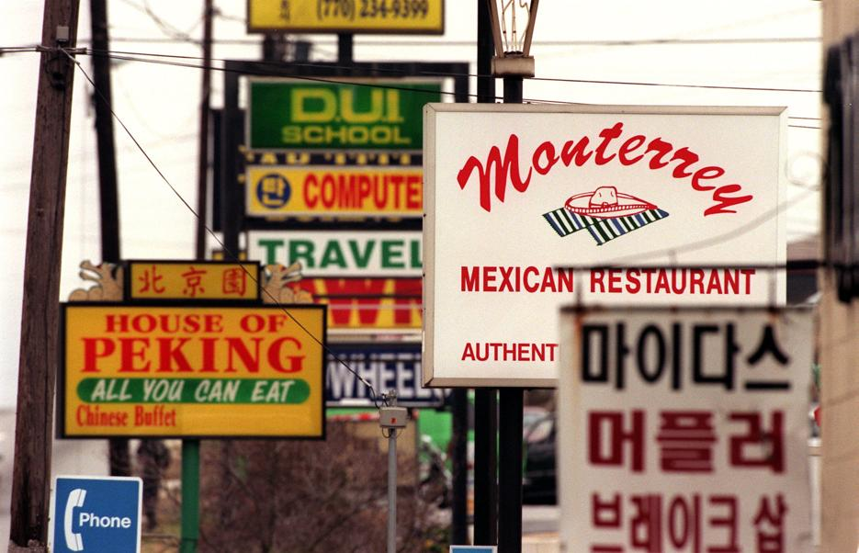
Items that Identify an ethnic neighborhood
Businesses place foreign language signs in the windows
Stores selling goods that have been imported from their home country
Restaurants serving familiar foods

Slide 15
Types of Migration
Ecological Migration: the movement of people from one place to another because of a negative change in the environment
Voluntary Migration: movement of people of their own free will from one place to another
Involuntary Migration: movement of people against their will. Often associated with persecution
Illegal Migration: the movement of people without the sanction of immigration laws

Slide 16
International Migration Consequences for Sending Countries
Pros | Cons
Employment competition is alleviated Relieves housing pressures Migrants return home better trained Migrants send money home to their country, which stimulates economy | Lose most of their most educated people Tough on developing countries People take their assets with them

Slide 17
International Migration Consequences for Receiving Countries
Pros | Cons
Immigrants bring with them skills that are in demand Support the workforce Support as taxpayers | Fear among citizens that immigrants are taking their jobs Immigrants usually perform the “3D” jobs - dirty, dangerous and difficult Violence against immigrants

Slide 18
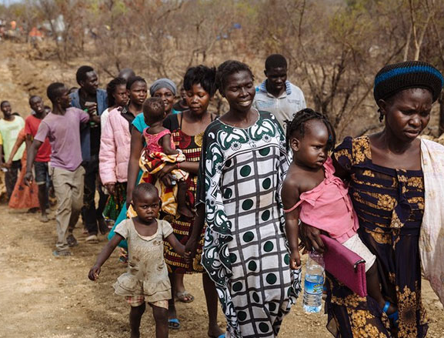
Refugees
Refugees are persons who flee to a different country because of a fear of persecution based on race, religion, nationality, social group, political opinion, armed conflict, and lack of a durable solution.

Slide 19
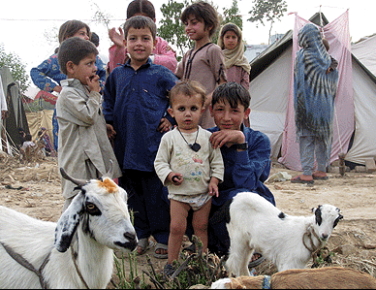
Internally Displaced
Internally Displaced, or “Internal Refugees,” share many charactertics with refugees but are legally defined different because they remain inside their own country despit flleeing persecution

Slide 20
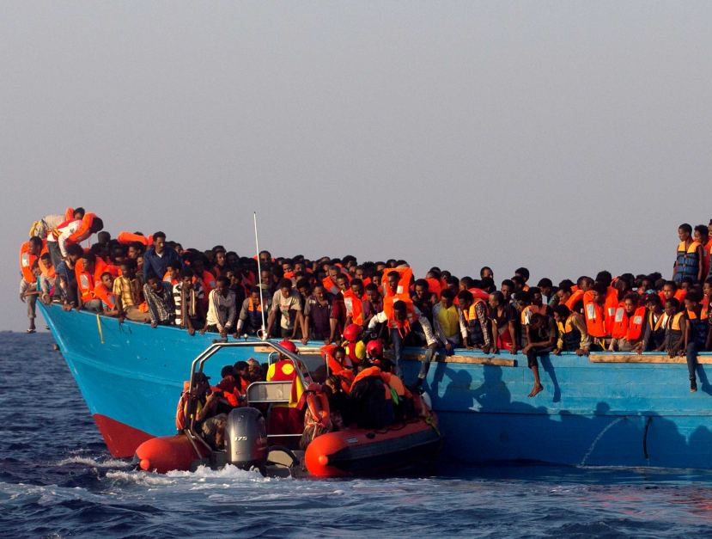
Asylum Seekers
People enter a country claiming to be refugees, even though they come from a country that is not experiencing war or a natural disaster.

Slide 21
UNHCR
United Nations High Commissioner For Refugees
Helping people who are legally defined as Refugees by:
Providing them with international protection
Helping them to resettle in new countries
Also help Asylum seekers, IDP’s and refugees that have returned home but still need help

Slide 22
Canada’s “Point System”
The Skilled Worker Visa for Canada is the most popular way of applying for migration to Canada.
An individual requires a pass mark of 67 out of 100 points to enter Canada
They are assessed on six main factors including age, education, work experience, language ability and adaptability
Refugees are not subject to the formal “point system”

