Slide 1

Measuring your Ecological Footprint
Resources
National Sustainability Teachers’ Academy

Slide 3

What is your
Ecological
Footprint?
National Sustainability Teachers’ Academy

Slide 4

Can everyone on the
Planet
Live like you do?
National Sustainability Teachers’ Academy

Slide 5

If everyone on the planet lived like a typical American, we would need 4½ Earths to support them all!
National Sustainability Teachers’ Academy

Slide 6


Not everyone has the same Ecological Footprint.
India
China
Costa Rica
France
United States
National Sustainability Teachers’ Academy

Slide 7
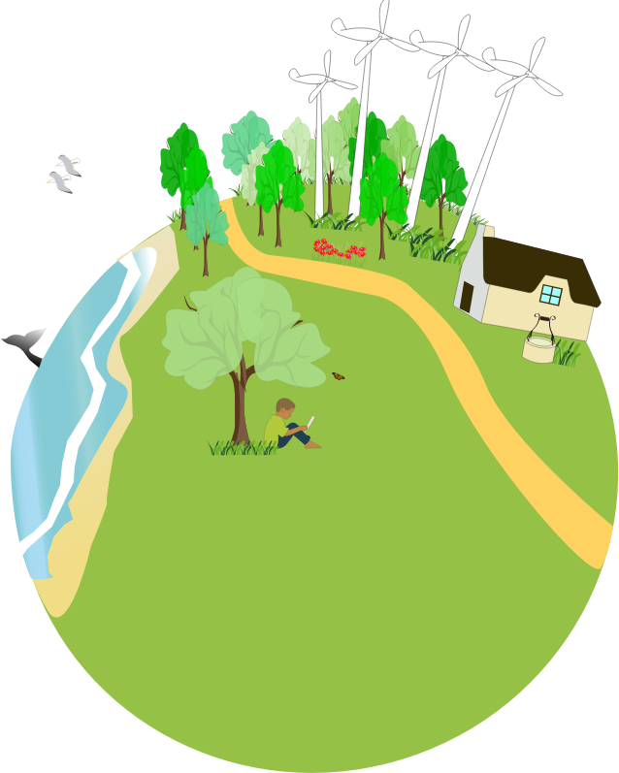
Biocapacity: the ability of the environment to provide the resources we need to live
What are the resources the Earth provides?

Slide 8
Ecological Overshoot: when a population uses more resources than the environment can provide
What happens if the Earth reached Ecological Overshoot?

Slide 9
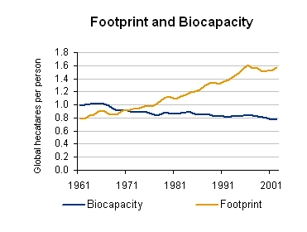
Is China in danger of Ecological Overshoot?
Graph from footprintnetwork.org
National Sustainability Teachers’ Academy

Slide 10


How can we avoid Ecological Overshoot?
Footprint
Time

Slide 11
What can you do
to reduce your
Ecological Footprint?
National Sustainability Teachers’ Academy

Slide 12
National Sustainability Teachers’ Academy

