Slide 1
Urban Land Use

Slide 2
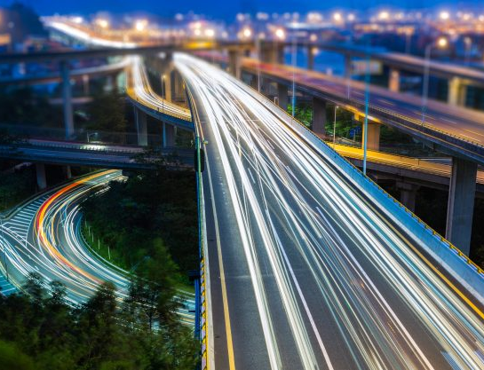
Transportation
About ⅓ of developed land in most Canadian cities is used for roads and highways
A cities transportation system is made up of 3 parts:
Vehicles
Travel Paths
Terminal Facilities

Slide 3
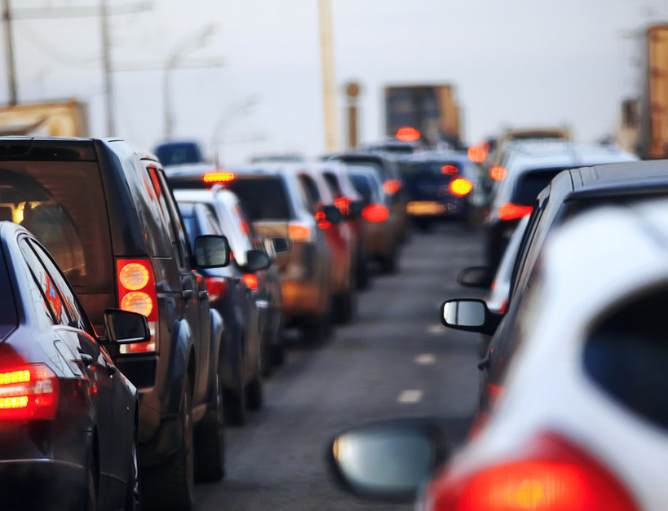
Vehicles
Large amounts of traffic can create congestion on urban roads
Mass-transit systems are another alternative, but are very expensive. They only make sense in highly densely populated areas

Slide 4
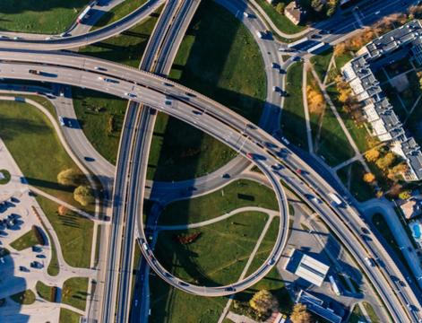
2. Travel Paths
Classified into 4 parts:
Expressways
Arterial roads
Local roads
Collector roads

Slide 5
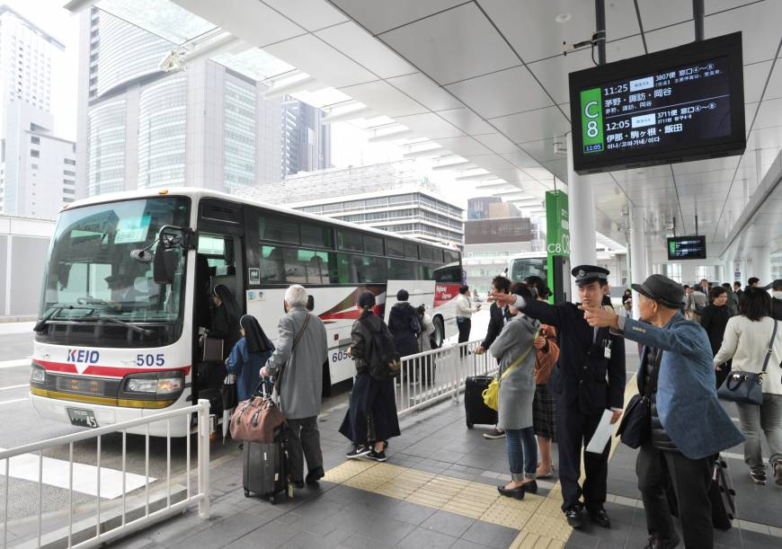
3. Terminal Facilities
Found at the end of a journey or transit line
May also include train stations, bus stations, airports, docks and other mass-trasit stations.

Slide 6
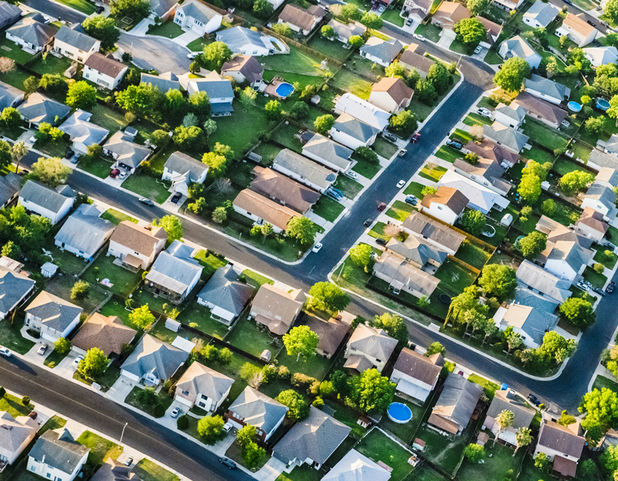
Residential
Includes all places where people live
Generally the largest land use in most cities, often taking up to 40% or more of developed land
The most important characteristc is its density
Two factors influence residential density
Cost of land
Age of the neighbourhood

Slide 7
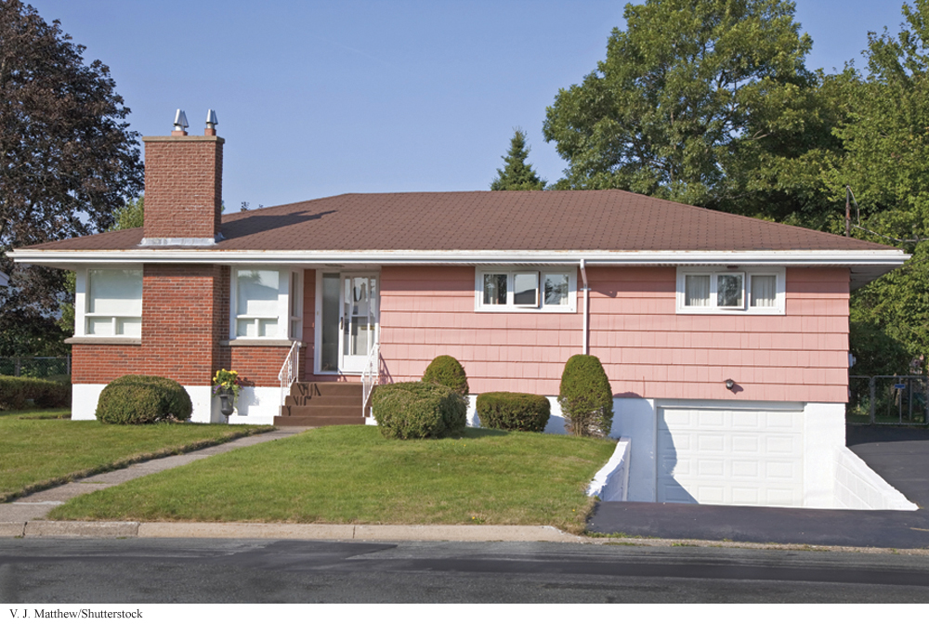
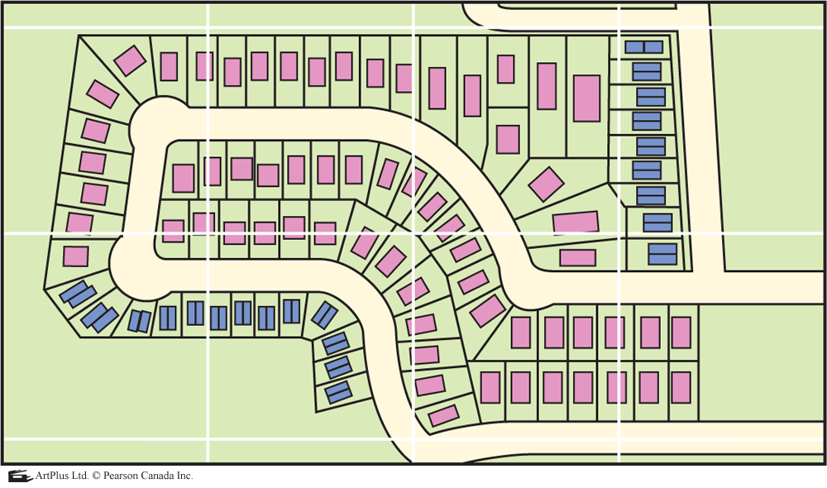
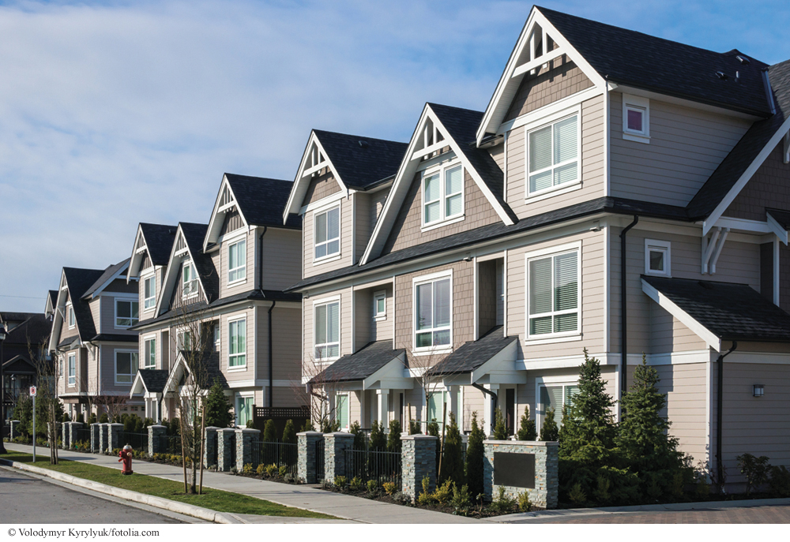
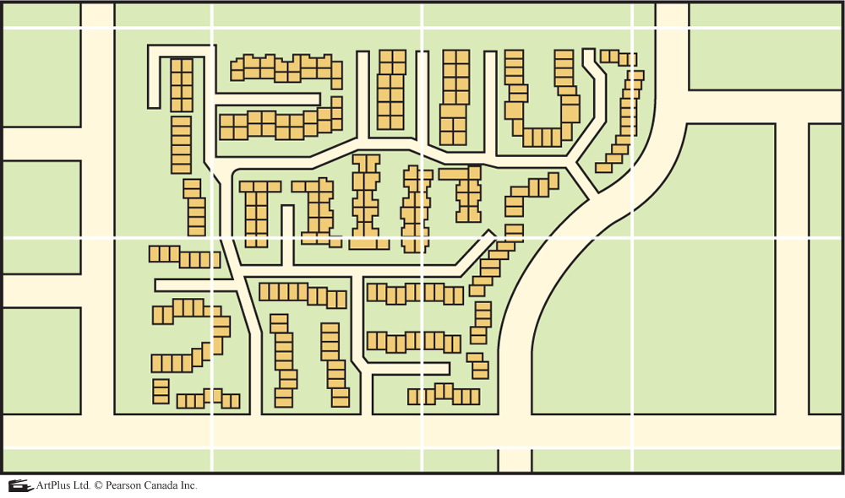
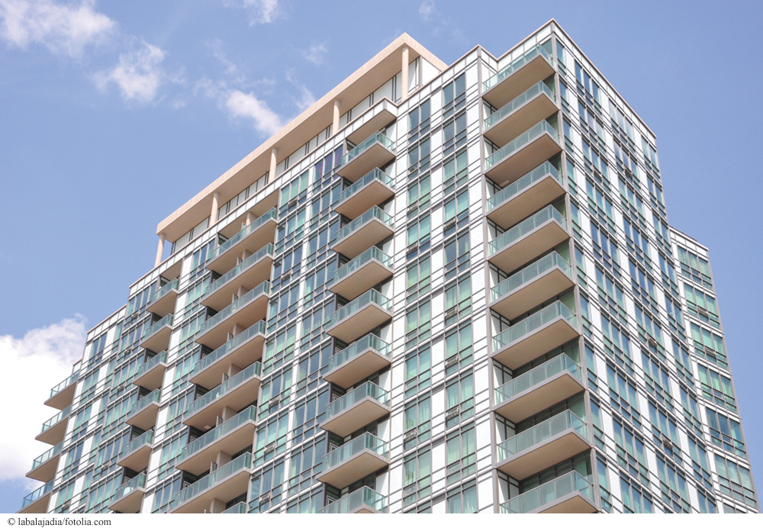
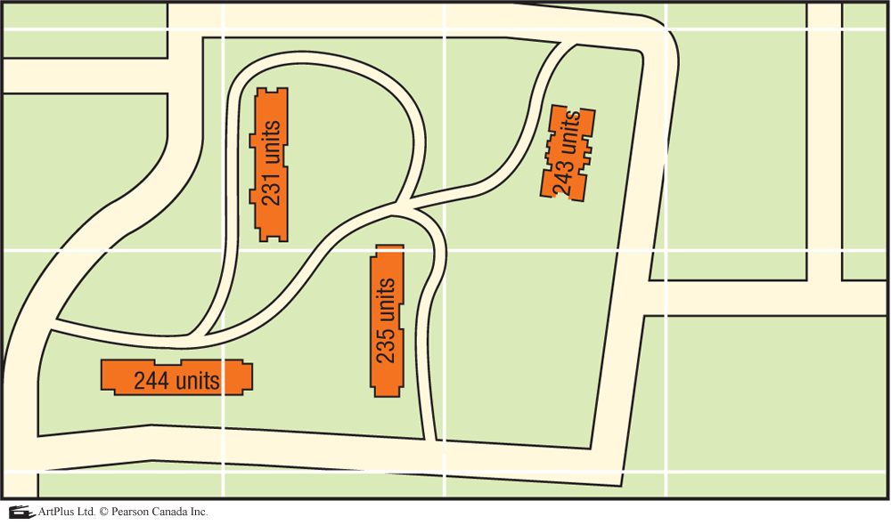
Low Residential Density
Medium Residential Density
High Residential Density

Slide 8
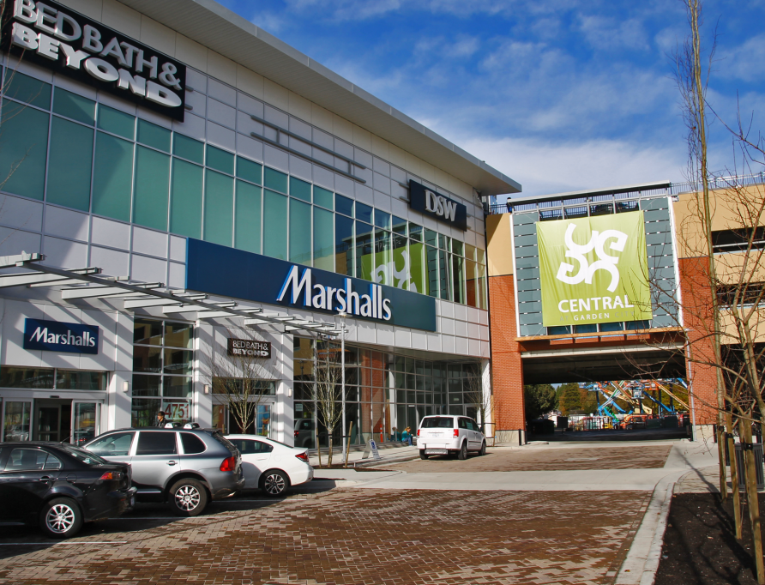
Commercial
Types of Goods:
Low Order - found everywhere (bread, milk)
Middle Order - willing to drive/travel further for item (clothing, specality foods)
High Order - purchased infrequently and have a limited market (Porsche)
About 5% of a city’s land is for commerical goods
These activities include the buying and selling of goods and services

Slide 9
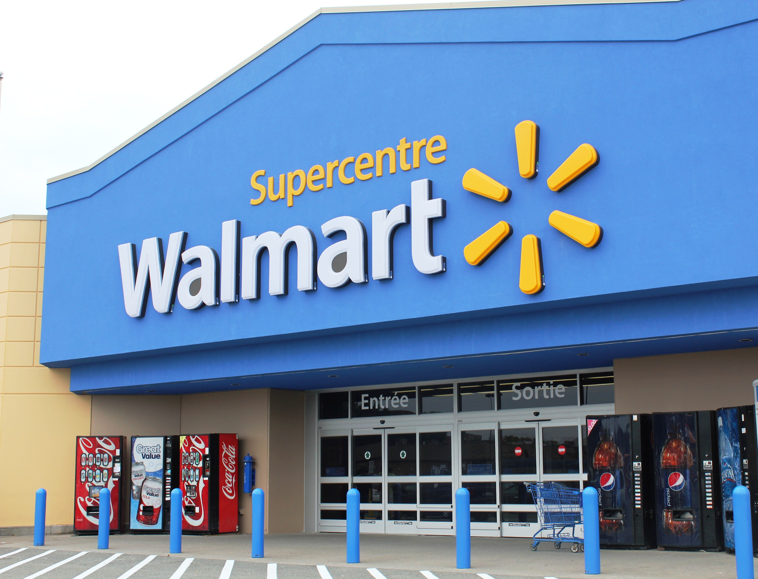
Commercial
There are 6 types of commerical land use:
Local service centers
Neighbourhood plazas and ribbons
Community shopping centers (malls)
Power Centers (big-box stores)
Regional shopping centers (Pen Centre)
Central Business District (Downtown)

Slide 10
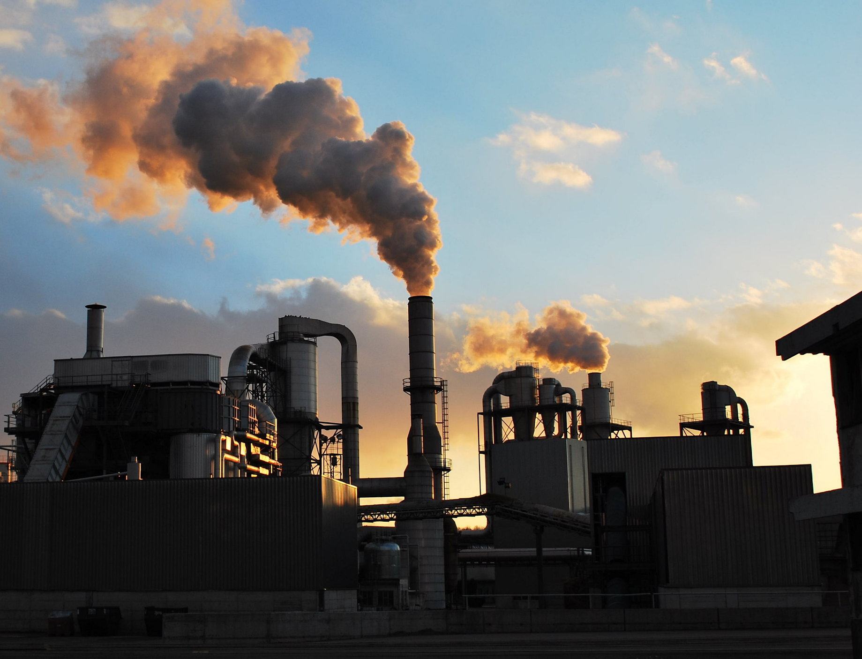
Industrial
On average about 6% of the developed land in most communities is used for industries such as factories
Before the 1940’s, factories were built on land near waterfronts and railway lines
After the 1940’s, better highways and long distance trucking have manufactured another alternative to shipping their goods.

Slide 11
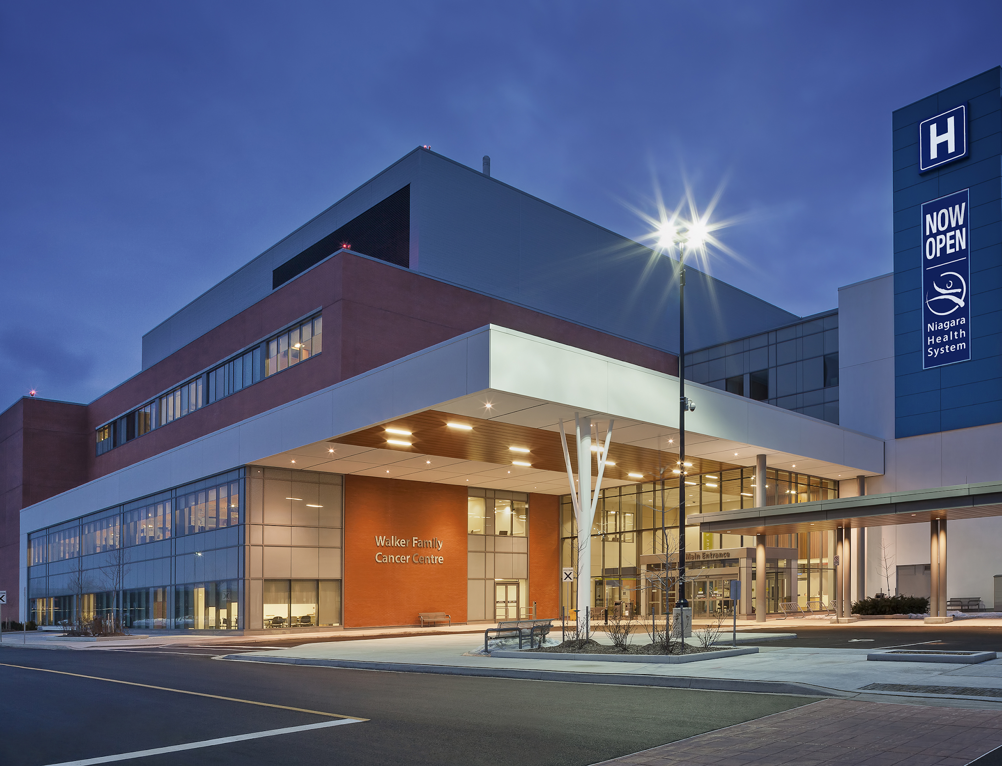
Institutional and Public Buildings
Such as schools, hospitals, City hall and places of worship
10% of land falls into this category

Slide 12
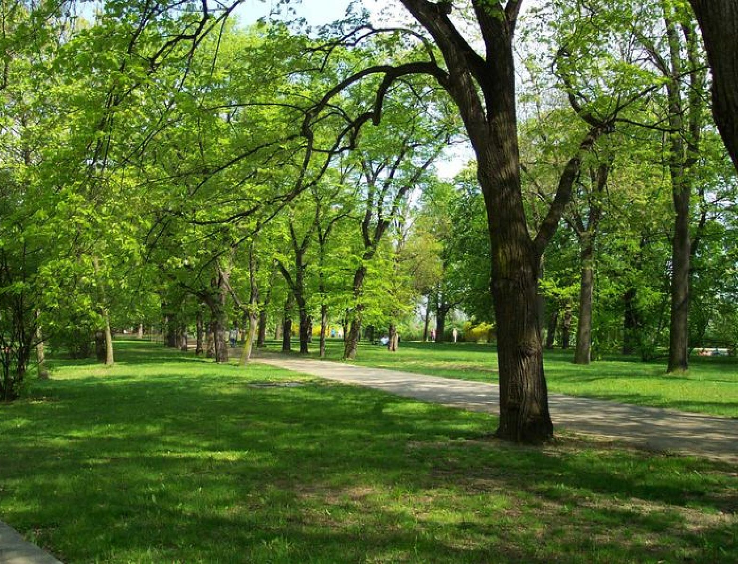
Recreational
Parks, playgrounds, playing fields, golf courses, etc.
Recreation is very important as it enhances your quality of life
Accounts for approximately 7% of urban land

Slide 13
Factors that Affect Land Use

Slide 14
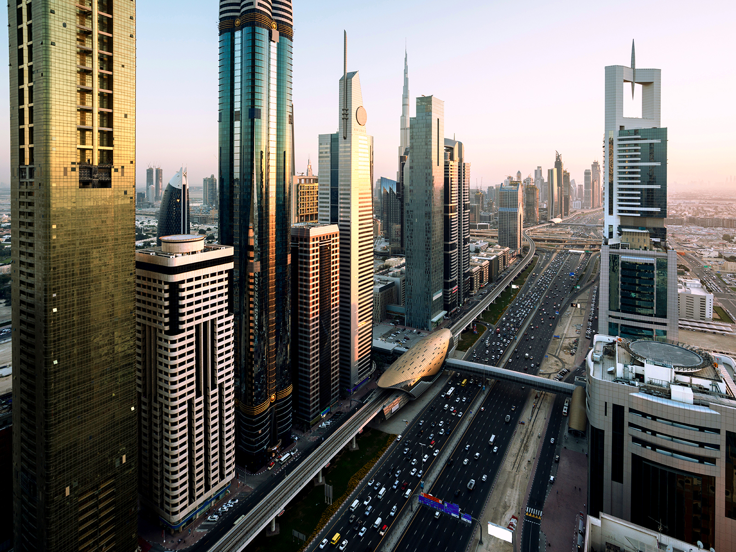
Land Value
Land values are the highest in areas of the city that are most accessible, such as the CBD (central business district), and beside major transportation routes
Large lot sizes are in high demand

Slide 15
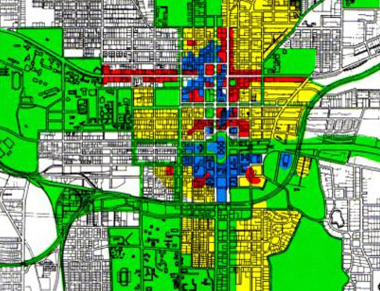
Zoning/
Technology
Zoning refers to laws usually passed by city governments that control the kind and amount of development in an area
Technology
Land use patterns reflect the technology that existed when the land was developed (e.g., roads and parking)

Slide 16
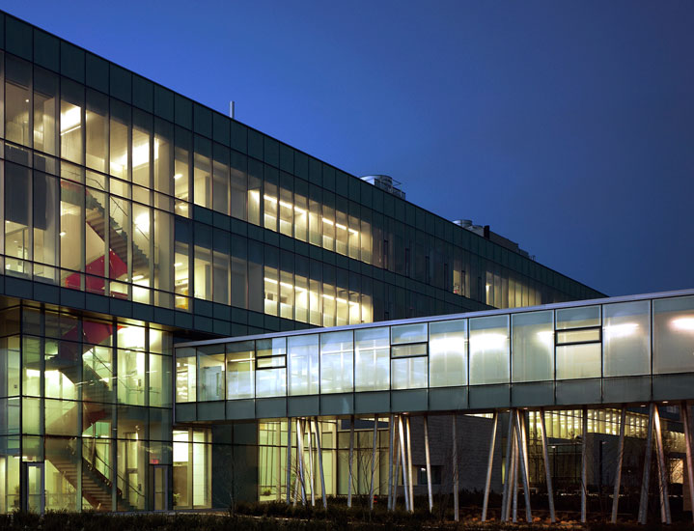
Climate
The winter city concept advocates the building of cities with inside and outside enviornments that are livable during long harsh winters
Many Canadian cities have built underground walkways in their downtown areas
Indoor shopping malls have been built
Bus shelters, covered bridges (brock covered bridge that connects buildings), etc.

