Slide 1
The Importance of Marketing Research in Business."

Slide 2
INTRODUCTION
Marketing research helps businesses make smart decisions.
It's like a detective that finds clues to make products better and help businesses understand their customers.
It provides valuable insights into product development, target markets, and distribution channels.
Today, we'll learn why marketing research is so important for businesses.

Slide 3
ROLE OF MARKETING RESEARCH
Marketing research informs product development by identifying consumer needs, preferences, and pain points.
It plays a pivotal role in target market identification, helping businesses understand who their customers are.
Marketing research determines the most appropriate channels of distribution, ensuring products reach the right audience efficiently.

Slide 4
MARKETING RESEARCH TOOLS
Example of a Marketing Research Tool: "Electronic Web Survey":
Electronic web surveys are widely used for collecting data from a broad audience.
Sample Questions: "How satisfied are you with our product?" or "What factors influence your purchase decisions?"

Slide 5
Test Marketing
Producing a limited number of products and introducing into a market is called test marketing.
Test markets are sites that mirror the demographic composition of the whole nations
Peterborough, Ontario
London, Ontario
Usually performed by independent parties
The details are usually kept secret to avoid the possibility of the data being skewed

Slide 6
OBSERVATIONS
Occasionally marketers will use observations to see how people behave
Mystery shoppers
Shopping behaviour
Generally observations is less effective because it is difficult to observe large numbers of shoppers.

Slide 7
Focus groups
A small group of people brought together to investigate a problem
8-12 participants
Representative of a larger group of individuals
Moderator should be skilled at asking questions
Observers may watch behaviour in addition to receiving response.

Slide 8
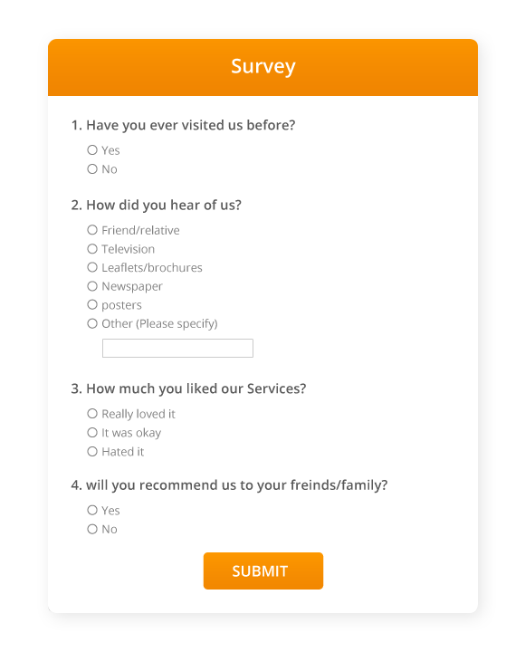

Slide 9
Tools for Interpreting Data
Tools for Interpreting Data: Imagine you have some data about who likes ice cream.
A pie chart is like a colorful pizza that shows how many people like each flavor.
Polls are like asking people what they think. "Do you like chocolate or vanilla ice cream?"
Databases are like big electronic filing cabinets that keep lots of information safe.

Slide 10
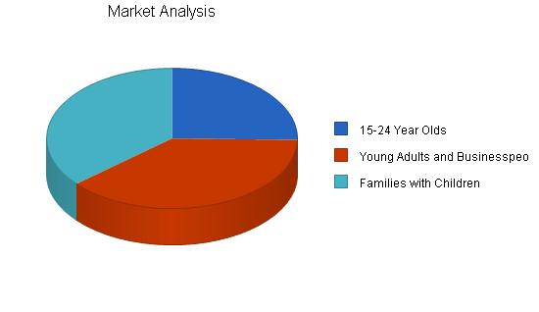

Slide 11
Data mining
Data mining is like searching for treasure in a mountain of rocks (data).
Data mining involves extracting meaningful patterns and insights from large datasets.
It helps us find special things, like who loves ice cream the most and why.
We can use it to discover interesting facts about our customers.

Slide 12
Benefits of Marketing Research
Benefits of Marketing Research:
Informed Decision-Making: Data-driven decisions lead to better business strategies.
Improved Products: Research identifies opportunities for product enhancements.
Increased Market Share: Understanding customers helps capture a larger share of the market.

Slide 13
Challenges and Considerations
Privacy and Ethical Concerns: Safeguarding customer data and respecting privacy.
We have to be careful with people's information.
Data Accuracy and Reliability: Ensuring the information collected is accurate and reliable.
Data must be accurate and trustworthy, just like a reliable friend.

Slide 14
Conclusion: Marketing research is integral to informed decision-making and business success.
It plays a vital role in understanding customer needs, improving products, and achieving a competitive edge.

