Slide 1
IMAGERY in Literature
More about Figurative Language / Literary Devices

Slide 2
What is IMAGERY?
When a writer uses words that suggest something is being experienced through one of the five senses – that’s IMAGERY

Slide 3
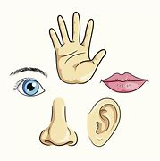
What are the five senses?

Slide 4
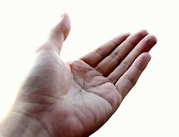
“The girl ran her hand along the soft silk dress.”
TOUCH

Slide 5
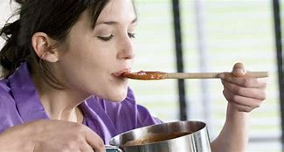
“The cook suddenly realized that her soup needed more salt and spices.”
TASTE

Slide 6
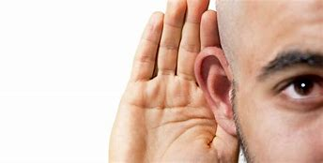
.
“The children ran screaming and shouting across the field.”
HEARING

Slide 7

t
“She was pulled towards the garden by the powerful aroma of roses.”
SMELL

Slide 8
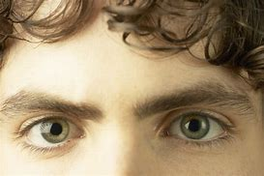
t
“The soldier looked into the forest searching for the enemy.”
SEEING

