Slide 1

Is this appropriate behaviour?
Wearing pyjamas to school.
Cheating on a test.
Getting tattoos.
Skipping class
Stealing food

Slide 2
Deviance
When the behaviour goes against what society expects we call it deviance.

Slide 3
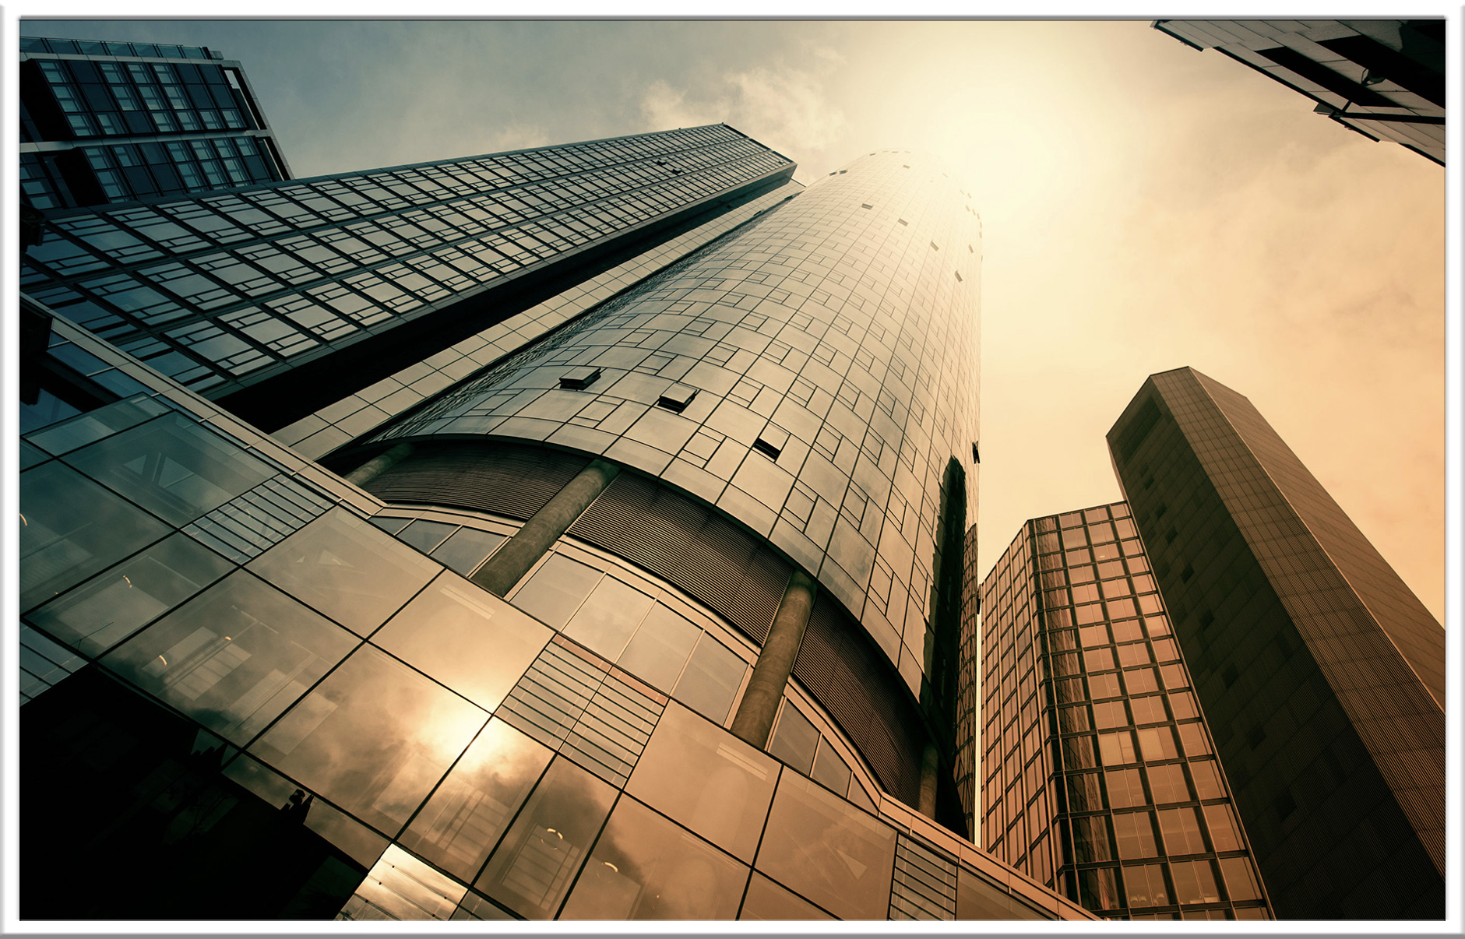

Slide 4
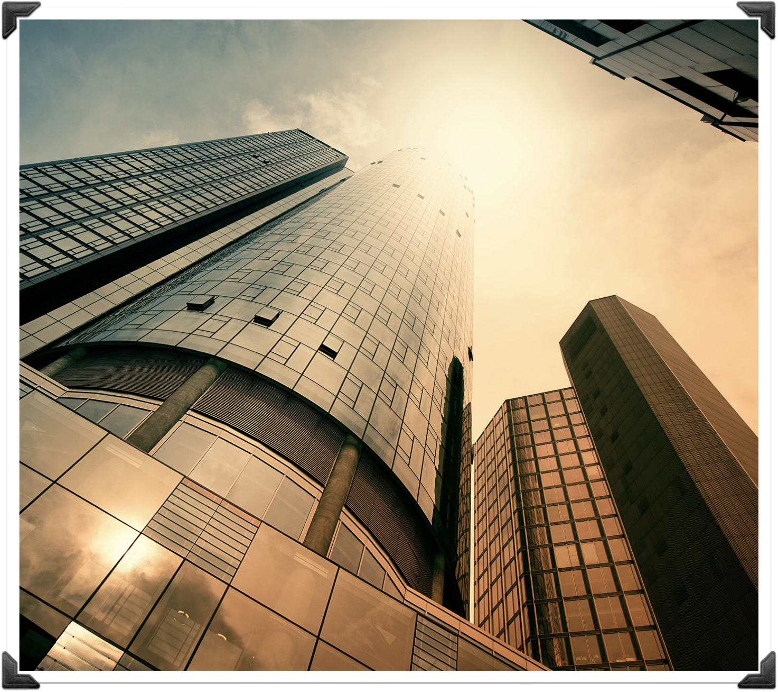
Subculture
A small group within a society has its own values and beliefs that differs from the mainstream culture

Slide 5
Types of Deviance
Positive deviance
Negative deviance
Criminal deviance
Non-criminal deviance

Slide 6

Positive Deviance
You break social norms in a way that helps others or create social change.
Eg.Protesting unfair laws
Speaking up against bullying
Reporting cheating

Slide 7
Negative Deviance
Breaking social norms in a way that harms people in the society
Eg. Stealing
Vandalism
Bullying

Slide 8
Criminal Deviance
Deviant behaviour that breaks the law and leads to legal punishment
Eg Robbery
Assault
Drug Trafficking

Slide 9
Non- Criminal Deviance
Breaking social norms but it is not illegal
Eg.Wearing pajamas to school
Getting many piercings

Slide 10
All crimes are deviant but not all deviance is a crime.

Slide 11
Example of Positive Deviance
Slut walk in Guelph(2011)
This is a protest against rape culture.They wanted to raise awareness about women’s rights and to stop victim blaming.This protest challenge power imbalance related to gender.

Slide 12
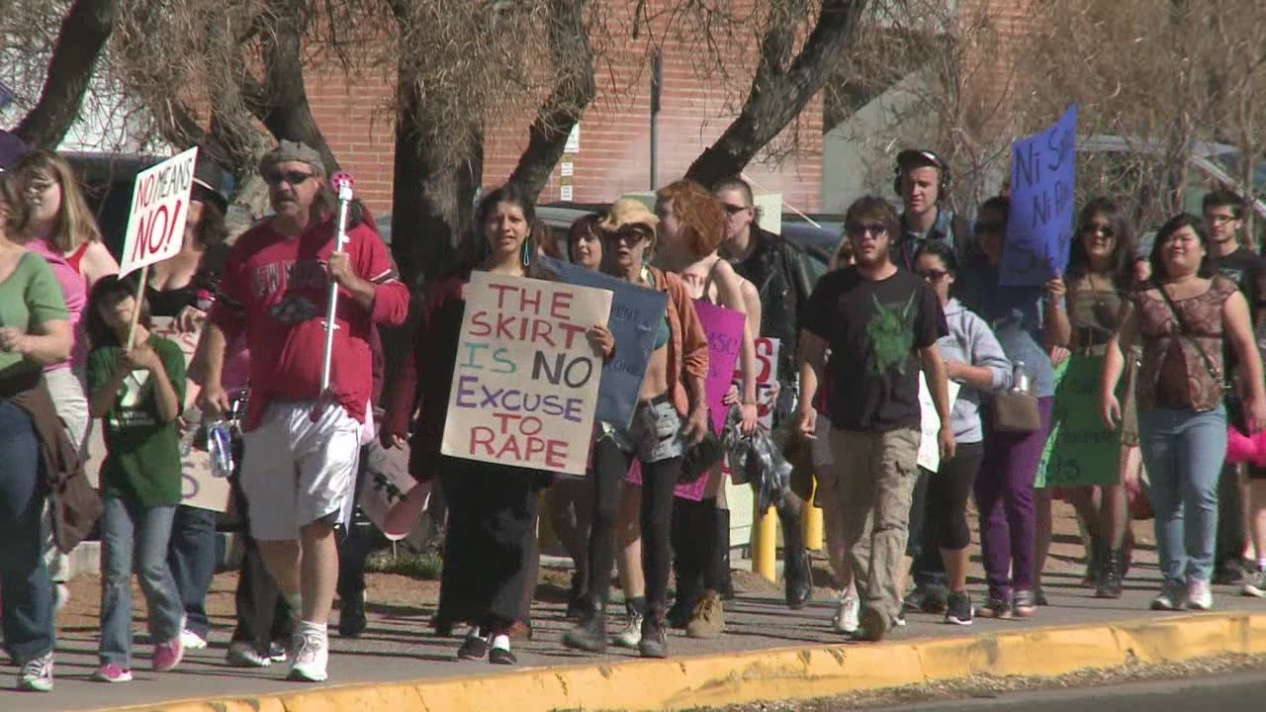

Slide 13
Positive Deviance
Louise Riel-He defended the rights of native people,especially the Metis people by leading an armed resistance against Canada’s government in 1869

Slide 14
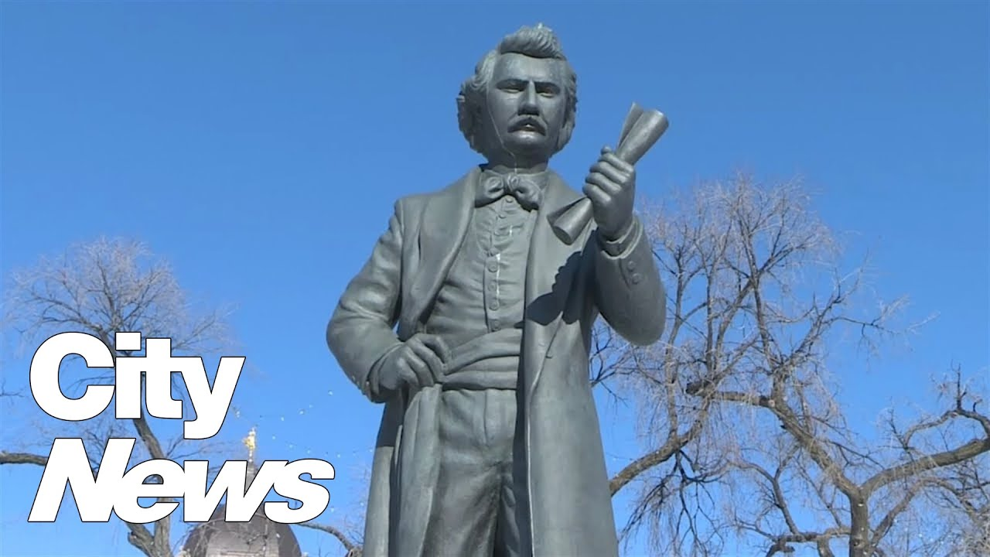

Slide 15
Let’s see how much you understand.

Slide 16
Kahoot!!!

Slide 17
Now that we understand the different types of deviance, the next question is:
What happens when someone breaks a rule?

Slide 18
How society responds to deviance?
Social control
Eg. Formal and informal social control

Slide 19
Formal Social control
Formal social control is when official organizations use written rules and laws to control behaviour, with set punishments for breaking them.
Eg.Getting a speeding ticket
Being fined for shoplifting
School suspension
Being fired from a job

Slide 20
Informal Social Control
Informal social control is the use of unwritten rules, social expectations, and everyday interactions to influence how people behave. It is enforced by people around us, rather than by official institutions.
Eg.Parents praising good behavior
Friends teasing someone for acting strangely
Feeling embarrassed after breaking a social rule
Peer pressure to fit in

Slide 22
A police officer gives someone a ticket.
Formal / Informal
Formal

Slide 23
Friends laugh at someone for cutting in line.
Formal / Informal
Informal

Slide 24
A school suspends a student for fighting.
Formal / Informal
Formal

Slide 25
Parents praise a child for cleaning their room.
Formal / Informal
Informal

Slide 26
Formal social control uses written rules. T / F
True

Slide 27
Informal social control is enforced by police. T / F
False

Slide 28
Praise can be a form of social control. T / F
True

Slide 29
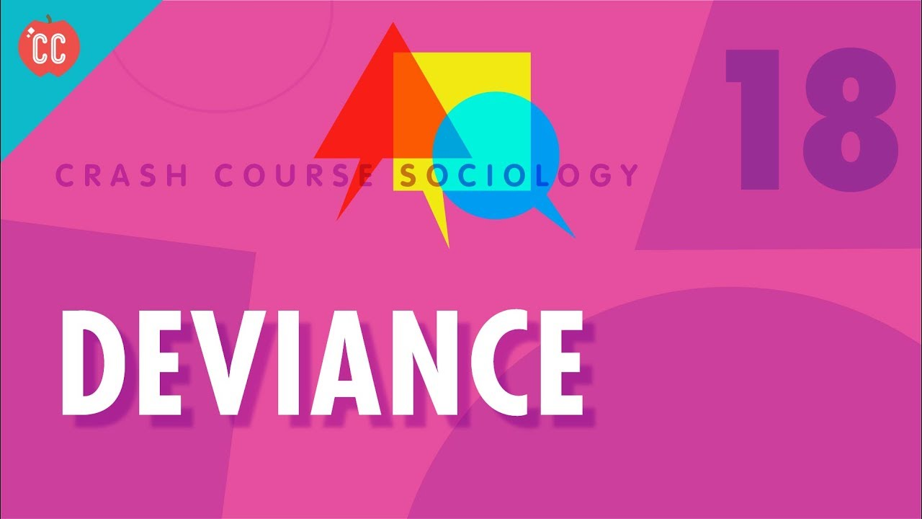

Slide 30
Watch and complete the video analysis

Slide 31
Do you think social change is possible without deviance? Explain.

