Slide 1

Canadian History: 1929 - 1945

Slide 2
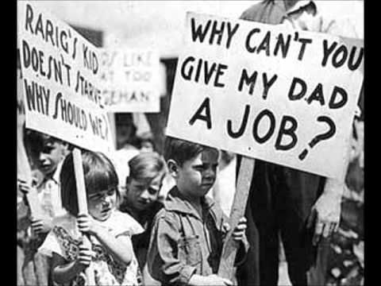
Canada in the Great Depression

Slide 3
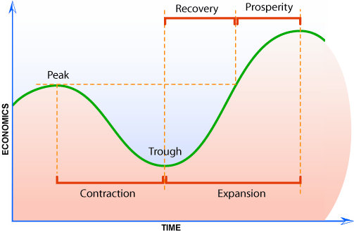
The Business Cycle: Boom and Bust

Slide 4
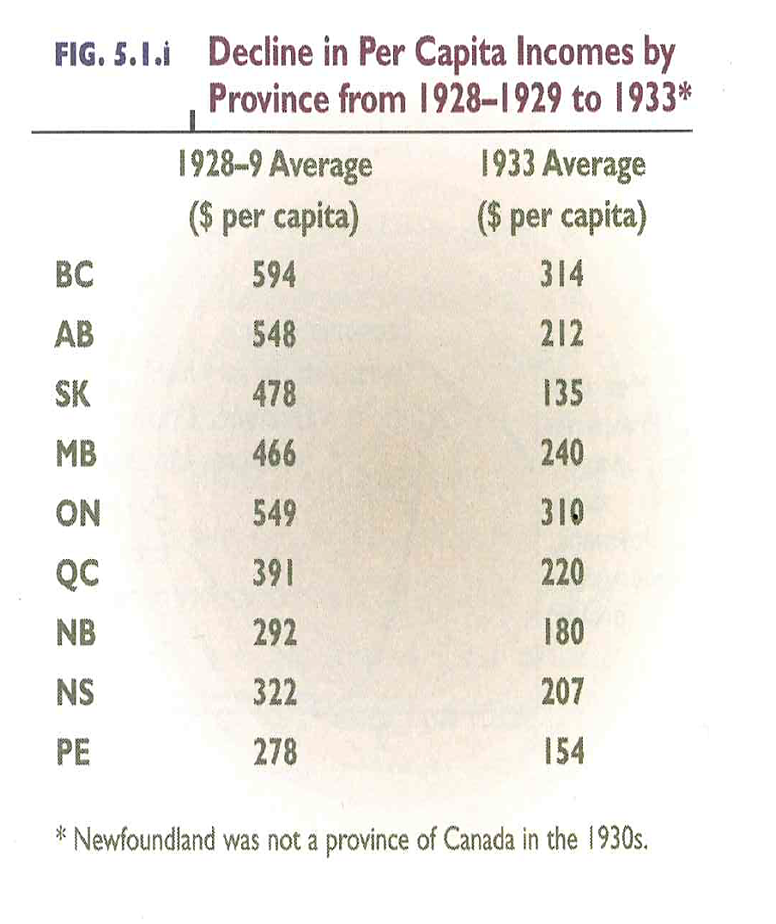
ANSWER:
Which province had the biggest decrease in income?
Which had the lowest?

Slide 5
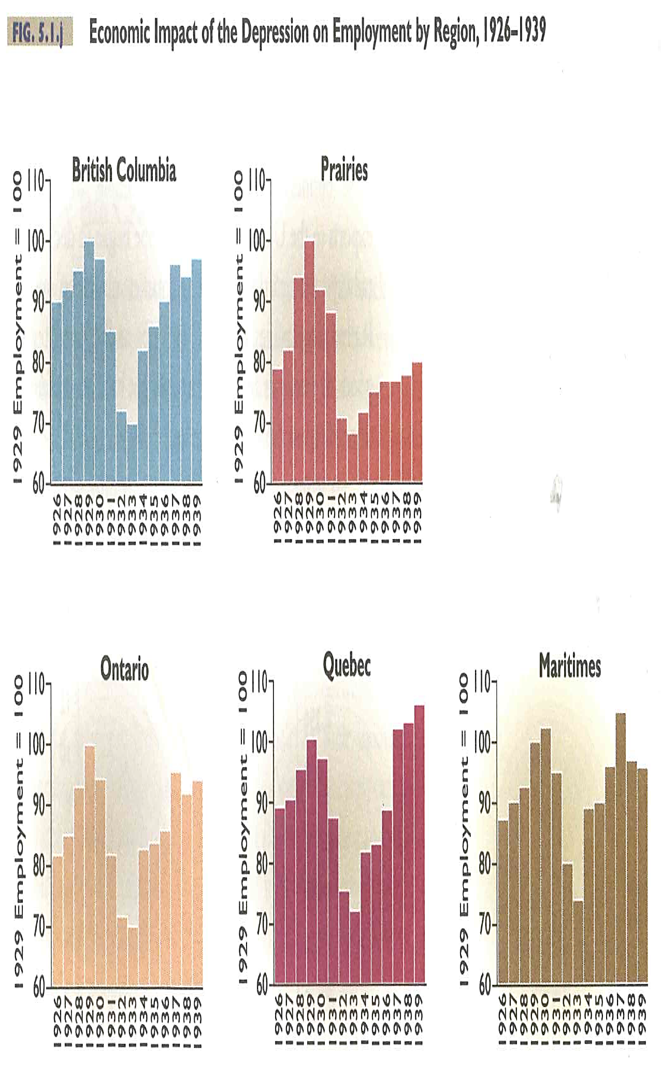
ANSWER:
When was the “trough” of the business cycle of the 1930s?

Slide 6
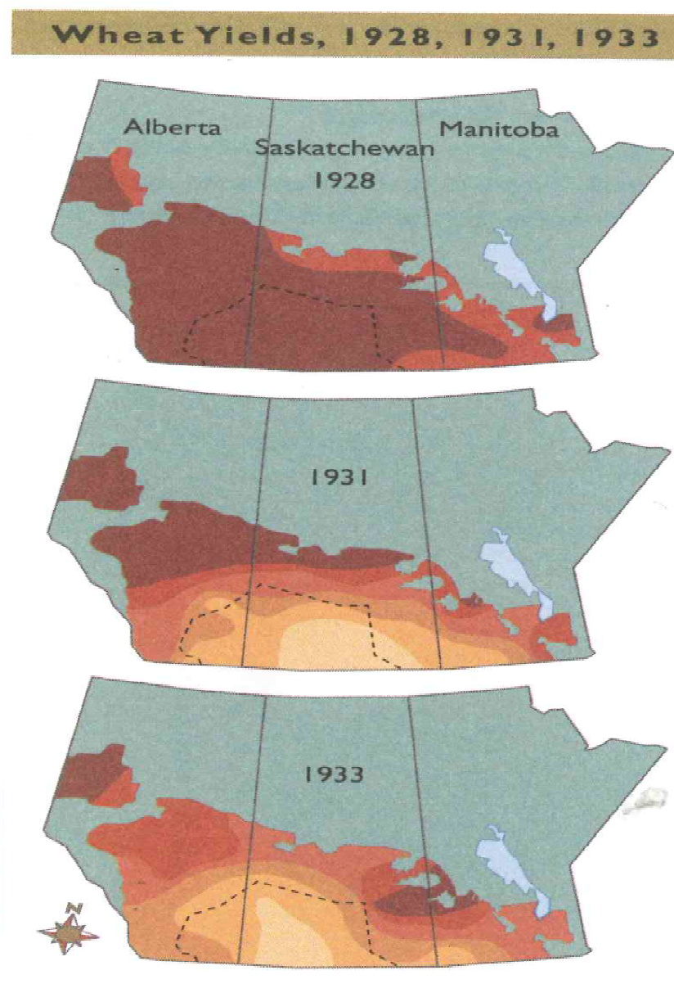
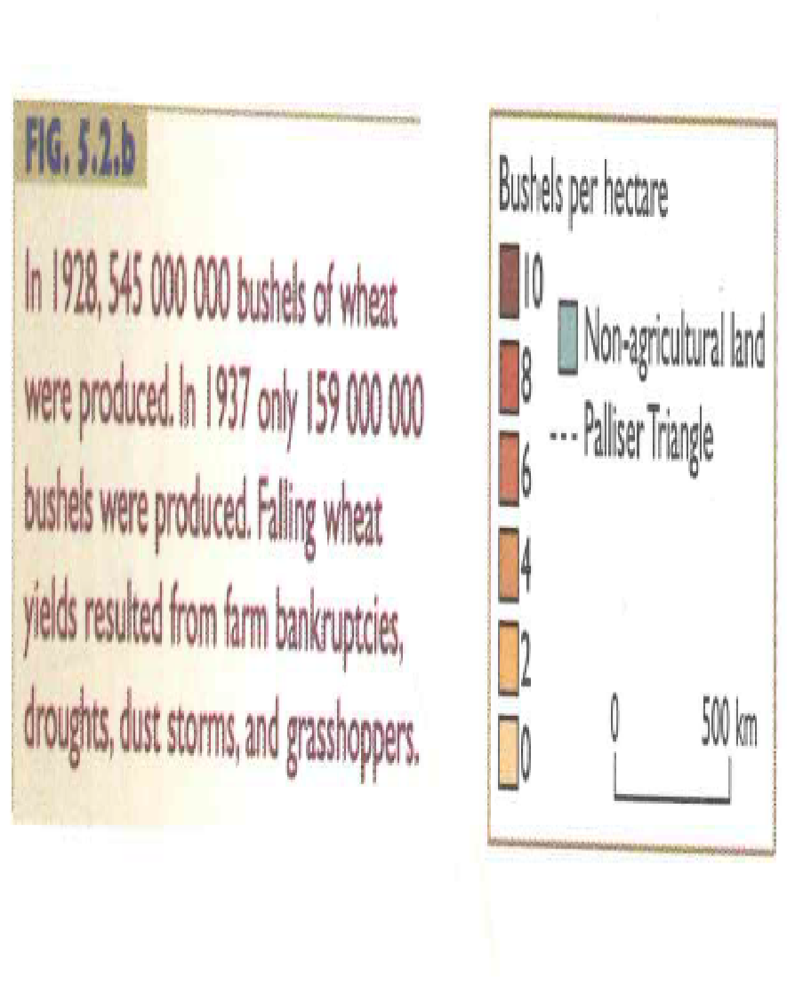
ANSWER:
Hypothesize – why do you think wheat production fell so dramatically?

Slide 7
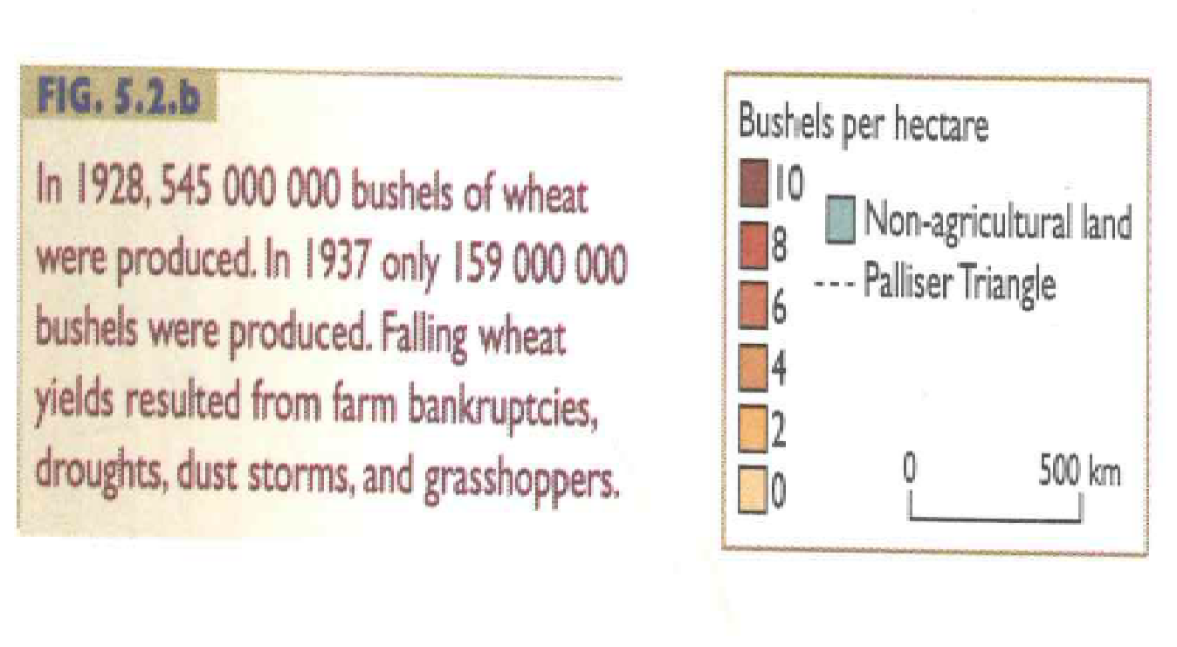
ANSWER:
Hypothesize – why do you think wheat production fell so dramatically?

Slide 8
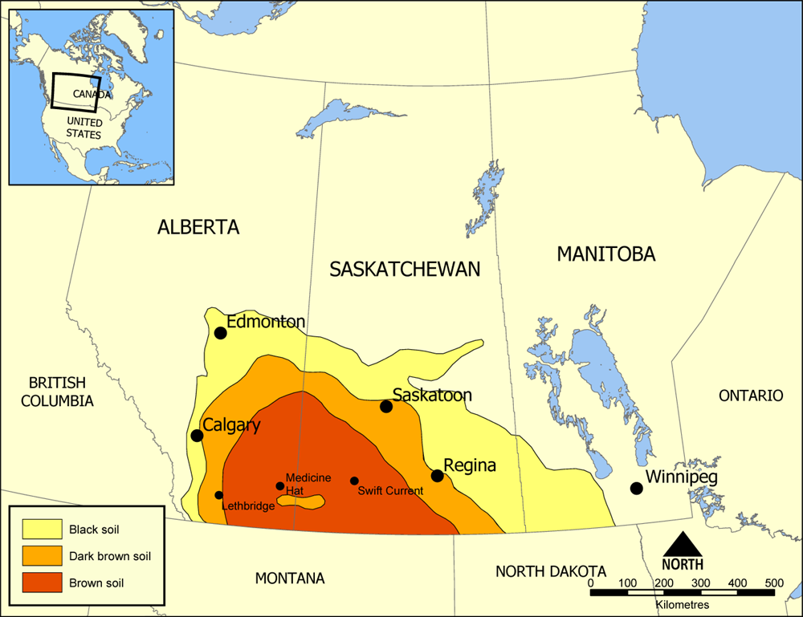
Palliser’s Triangle
Grain producing areas of western Canada
Average rainfall is low and the timing of rainfall is crucial to good harvests.

Slide 9
Apply your thinking
Choose one of these questions and answer:
Imagine you are the Prime Minister of Canada. What would you have done to help Canadians during the Depression?
Choose two pictures from Chapter 5 in the book Think History…. that illustrates the impact of the Great Depression in Canadians. Explain why you chose those pictures.

