Slide 1
Poetry – Haiku
Friday, October 3rd 2025

Slide 2
Meaning of Poetry
Poetry is a type of literature based on the interplay of words and rhythm. It often employs rhyme and meter (a set of rules governing the number and arrangement of syllables in each line.)
In poetry, words are strung together to form sounds, images, and ideas that might be too complex or abstract to describe directly.
Definition taken directly from: www.literaryterms.net/poetry/

Slide 3

Poetry Analogy
Poetry is often described as:
“the tip of the iceberg”

Slide 4


Slide 5
Haiku Poems
A haiku is a specific type of Japanese poem which has 17 syllables divided into three lines of 5, 7, and 5 syllables.
Haiku or haikus are typically written on the subject of nature.
The work haiku (pronounced hahy-koo) is derived from the Japanese word hokku meaning “starting verse.”
Definition from – www.literaryterms.net/haiku/

Slide 6
Japanese Poet Basho (1644-1694)
Japanese Haiku master and author of several poems
Visit the following websites for more info on him and his poems:
www.poetryfoundation.org/poets/basho
www.Britannica.com/biography/basho-Japanese-poet
www.poemhunter.com/Matsuo-basho

Slide 7
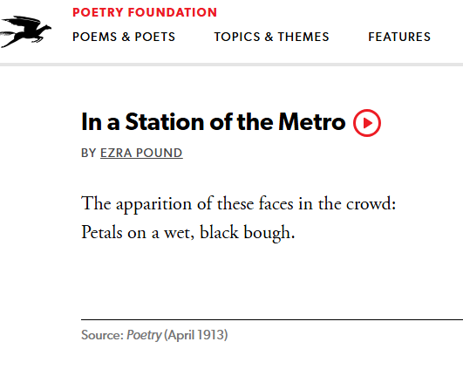
Haiku Example

Slide 8
