Slide 1
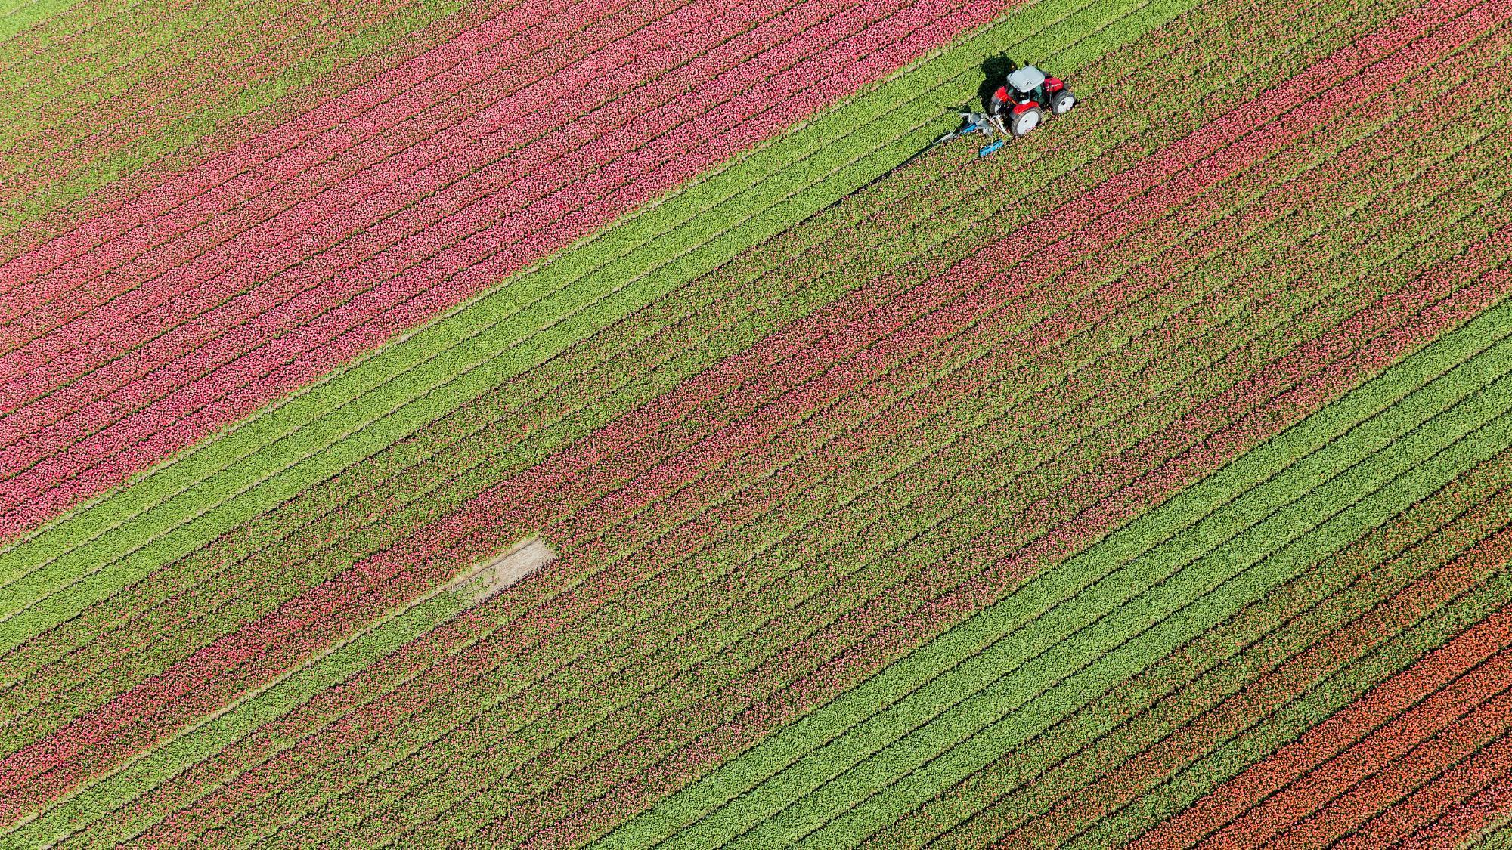
Types of Poetry
6th Jan 2022

Slide 2
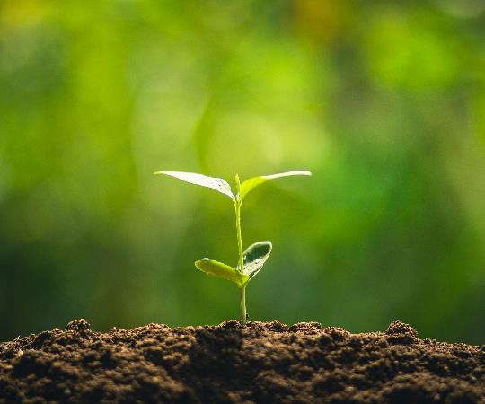
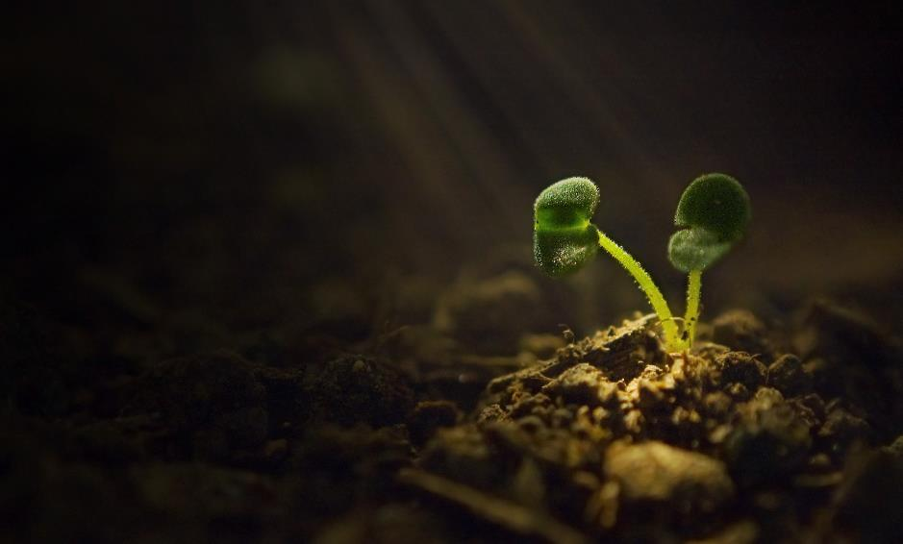
Agenda
Icebreaker
Free and Blank Verse
Allusion
The Sonnet
Group Work
Self-Directed Learning Time

Slide 3
Figurative Language Terms
Metaphor – a figure of speech in which a word or phrase literally denoting one kind of object or idea is used in place of another to suggest a likeness or analogy between them
Simile – a figure of speech compare two unlike things that is often introduced by LIKE or AS
Imagery – figurative language used to convey mental images or pictures
Hyperbole – extravagant exaggeration
3rd Person – written from he/she/it perspective
1st Person – written from the I perspective

Slide 4
Types of Poetry
Rhymed and Rhythmic - poems have a rhyming scheme
Free Verse / Blank Verse – both are free from a rhyme scheme – but blank verse has a consistent meter; usually iambic pentameter that creates a da-DUM rhythm effect – free verse is free from both meter and rhyme and the limitations of verse poetry

Slide 5
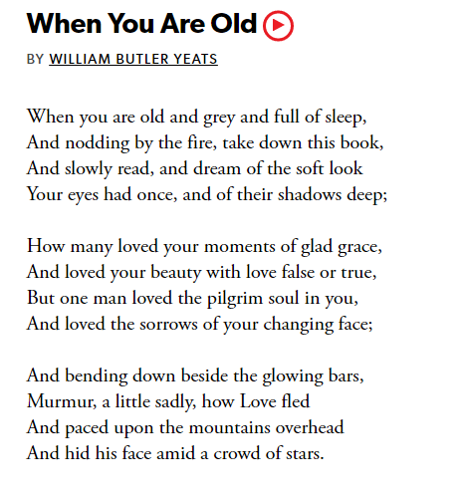
Rhyming Poems
Pattern in this poem:
ABBA
CDDC
EFFE

Slide 6
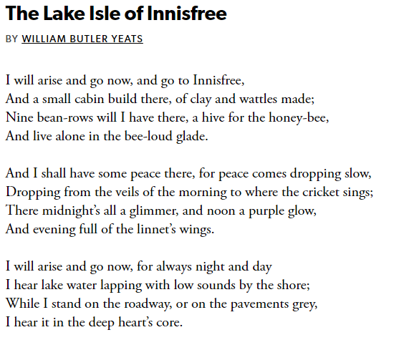
Rhyming Poems
Pattern in this poem:
ABAB
CDCD
EFEF

Slide 7
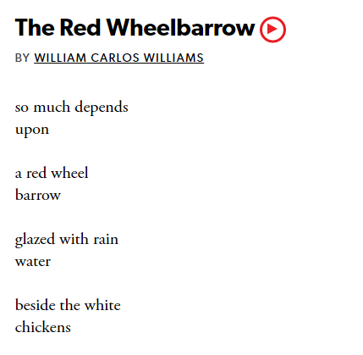
Free/Blank Verse Poems

Slide 8
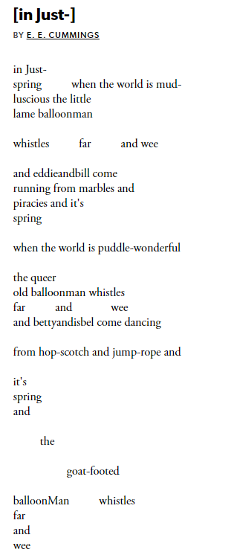
Free/Blank Verse Poems

Slide 9
Group Work
In your group discuss ONE of the four poems.
Analyze the poem for meaning and imagery.
Choose one person to present your findings to the class.
You have twenty (20) minutes for this.

