Slide 1

Chekhov quotations
are also his THEMES

Slide 2
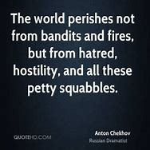

Slide 3
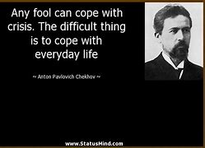

Slide 4
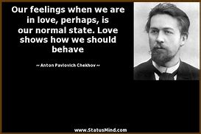

Slide 5
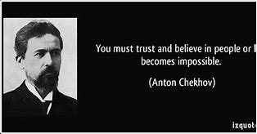
You must trust and believe in people or life
becomes impossible.
(Anton Chekhov)

