Slide 1
What is Stress?
A state of tension experienced by individuals facing extraordinary demands, constraints or opportunities.

Slide 2
What causes Stress?
Work factors:
Long hours
Excessive emails
Unrealistic work deadlines
Difficult bosses or coworkers
Unwelcome or unfamiliar work
Personal factors:
Personality type (type A vs. type B)
Individual needs (need for achievement, perfectionism, etc.)
Personal capabilities
Non-work factors:
Stressful life situations (family, economics, personal affairs)

Slide 3
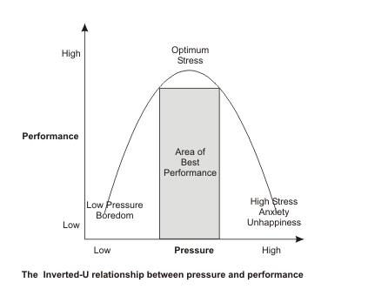
Stress vs Performance

Slide 4
Consequences of Stress
Stress can be both constructive and destructive.
Constructive stress:
Stress that acts in a positive way for the individual/organization.
Stress that encourages increased effort, stimulates creativity and enhances diligence in one’s work while not overwhelming the individual

Slide 5
Consequences of Stress
Destructive stress:
Stress that is dysfunctional for the individual or the organization.
It is intense or long-term stress that overloads and breaks down a person’s physical and mental systems
Can lead to:
Job burnout: a form of physical and mental exhaustion that can be incapacitating both personally and in respect to one’s work.
Workplace rage: overtly aggressive behaviour toward co-workers and the work setting in general.
Reduced resistance to disease, hypertension, ulcers, substance abuse, overeating, depression and muscle aches.

Slide 6
Why should managers be concerned?
Humanitarianism: managers have a humanitarian responsibility to ensure that they are not negatively affecting the health of their employees.
Productivity: healthy employees are absent less often, make fewer errors and have less turnover.
Creativity: healthy employees are more creative and more likely to take reasonable risks.
Return on investment: when poor health removes an individual’s contribution to the organization, there is no return on the time and money invested in that employees.

Slide 7
Test your stress level
Click on this link and take a quick stress test.
https://www.bemindfulonline.com/test-your-stress

Slide 8
How do you deal with stress?
Take 3 minutes to jot down 3-5 techniques you use to deal with stress.
How does it help?
How often do you do it?

Slide 9
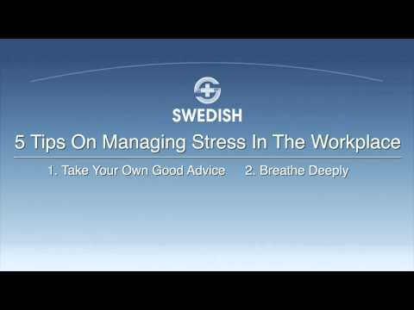
Dealing with Stress in the workplace & at home
How do you manage stress in your life?
Do you have any “tips” that you think would be helpful for someone who is in school?

Slide 10
Most effective ways to boost stress tolerance
http://www.cbc.ca/sports/olympics/kreekspeak/most-effective-ways-to-boost-stress-tolerance-1.3396243

Slide 11

Make Stress your friend
What impact does believing stress is harmful for your health have on your mortality?
What impact does believing stress is not harmful have on your mortality?
Why/how can changing how you think about stress make you healthier? How does your stress response change?
What is the built in mechanism for stress does the body automatically have?

