Slide 1
Canada Before World War 1

Slide 2

Young Canada
Imagine Canada is a teenager living in the house of its parent,Great Britain.In 1867 Canada became “federally united” as a Dominion.
Canada wanted to be a “Kingdom” but Britain said no, choosing”Dominion” because it meant Canada was still a Subordinate territory.
Canada had a “babysitter” called the Governor-General, who took direct orders from Britain not Canada.

Slide 3
Young Canada
A small population of less than 8 million people living in a massive house.

Slide 4
Young Canada
Activity: Draw a character named "Canada" in 1914. What is he wearing? (Maybe British clothes). Does he look happy or trapped?

Slide 5
The Quest
The Ten Rounds_Canada overcoming obstacles.
Canada wants to prove it can do things alone.
Boxing Match with ten rounds of small victories against British control

Slide 6
The Quest-small victories
*1859-Canada wins the right to set its own allowance(Tariffs/Taxes
*1878-Canada starts telling the babysitter(Govenor-General)what to do.
1907-The “Trade Treaty” Canada signs a deal with France ,but Britain still insist on signing the paper toylike a parent co-signing a bank account.
*

Slide 7
Young Canada
Activity: "Co-signing the Deal." students create a "Treaty" (a piece of paper). They must find a partner to "co-sign" it, representing how Canada could not act alone in foreign affairs.

Slide 8
The Hidden Story
While “Young Canada” was trying to grow up, the government was being very unfair to the original people living in the house(indigenous peoples)

Slide 9
Young Canada
  The Broken Promise: The relationship was built on "false premises"—lies that were used to remove Aboriginal people from their homelands.
  The "Epidemic of Empire": Residential Schools. Use the source's description of them as a "virulent strain of empire" designed to attack the language and spirits of children.
  The Law: The Indian Act was used to suppress Indigenous governments and cultures.

Slide 10
Young Canada
Activity: "Loss of Voice." How would you feel if you were moved to a new room and forbidden from speaking your home language.

Slide 11
Young Canada
By 1914,Canada is a“half-grown nation.
It has its own parliament but no”international signature”

Slide 12
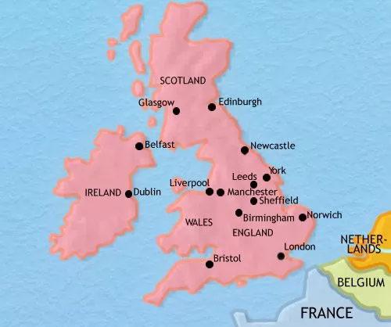
Young Canada
Britain went to war in 1914, Canada had no choice—the "Parent" decided for the "Child."

Slide 13
Young Canada
Task:
Students design a mini museum exhibit titled:
“Canada Before the Great War”
They must include:
5 artifacts (drawn or printed images)
Description cards (explaining significance)
One “Curator’s Statement” explaining:
  What kind of country Canada was in 1914
  Whether Canada was unified or divided

