Slide 1
The Roaring 20s in Canada
CHC2D
Post-WWI Canada

Slide 2
Learning Goals
Understand the Roaring 20s
Changes after WWI
Who benefited

Slide 3
What were the Roaring 20s?
1920–1929
The Roaring 20s was a time after World War I (1920–1929) when life in Canada changed a lot.
Economic growth
Fun and change

Slide 4
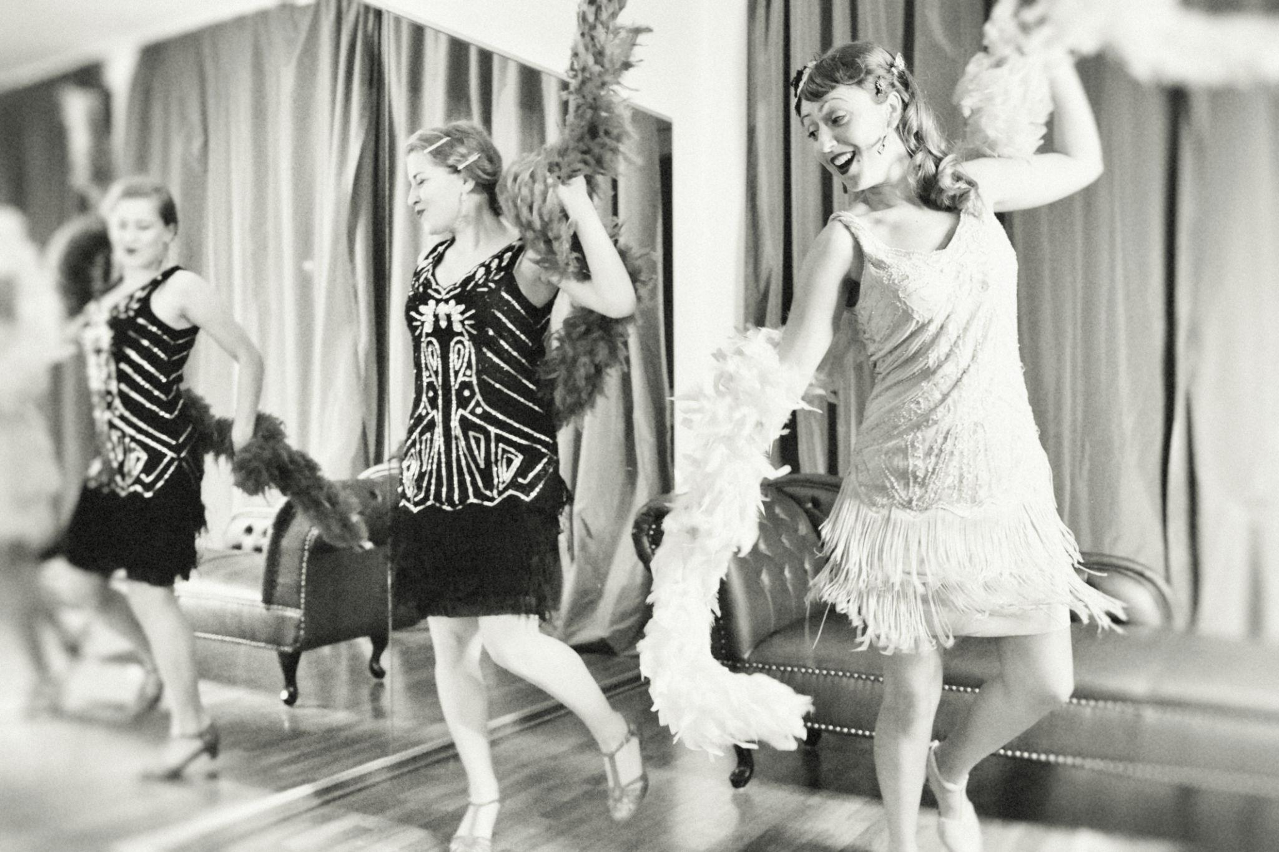

Slide 5
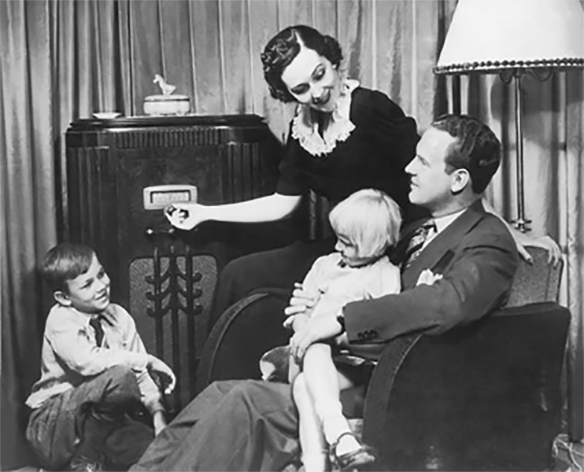

Slide 6
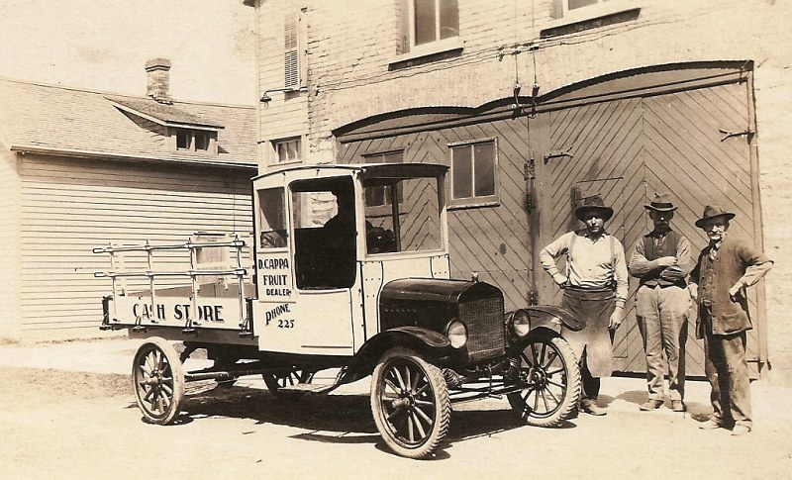

Slide 7
New Technology
Cars
Radios
Movies

Slide 8
City Life
More people in cities
Factory jobs
Urban growth

Slide 9
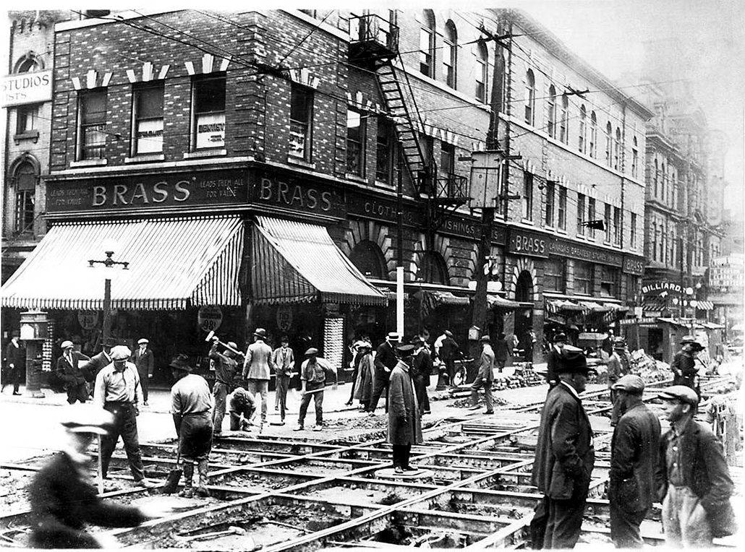

Slide 10
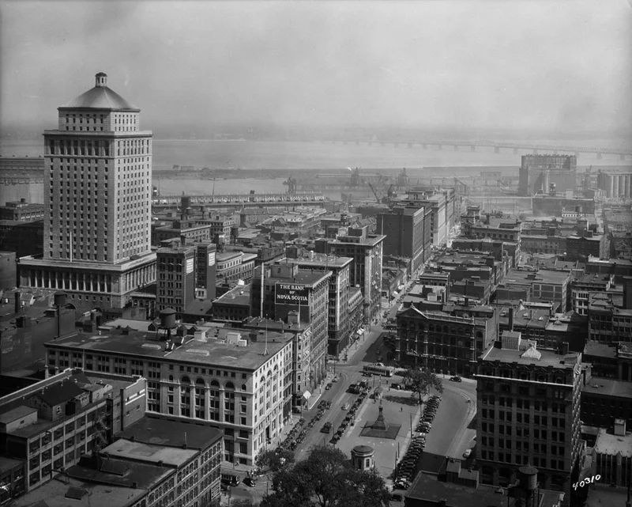

Slide 11
Women’s Roles
More freedom
New fashion
More jobs

Slide 12
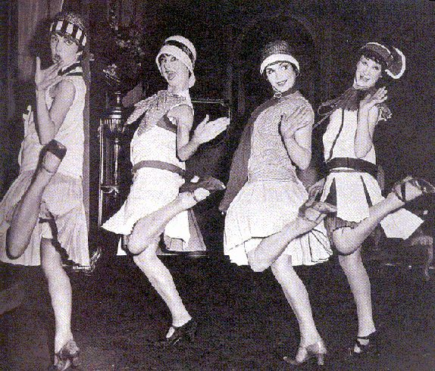

Slide 13
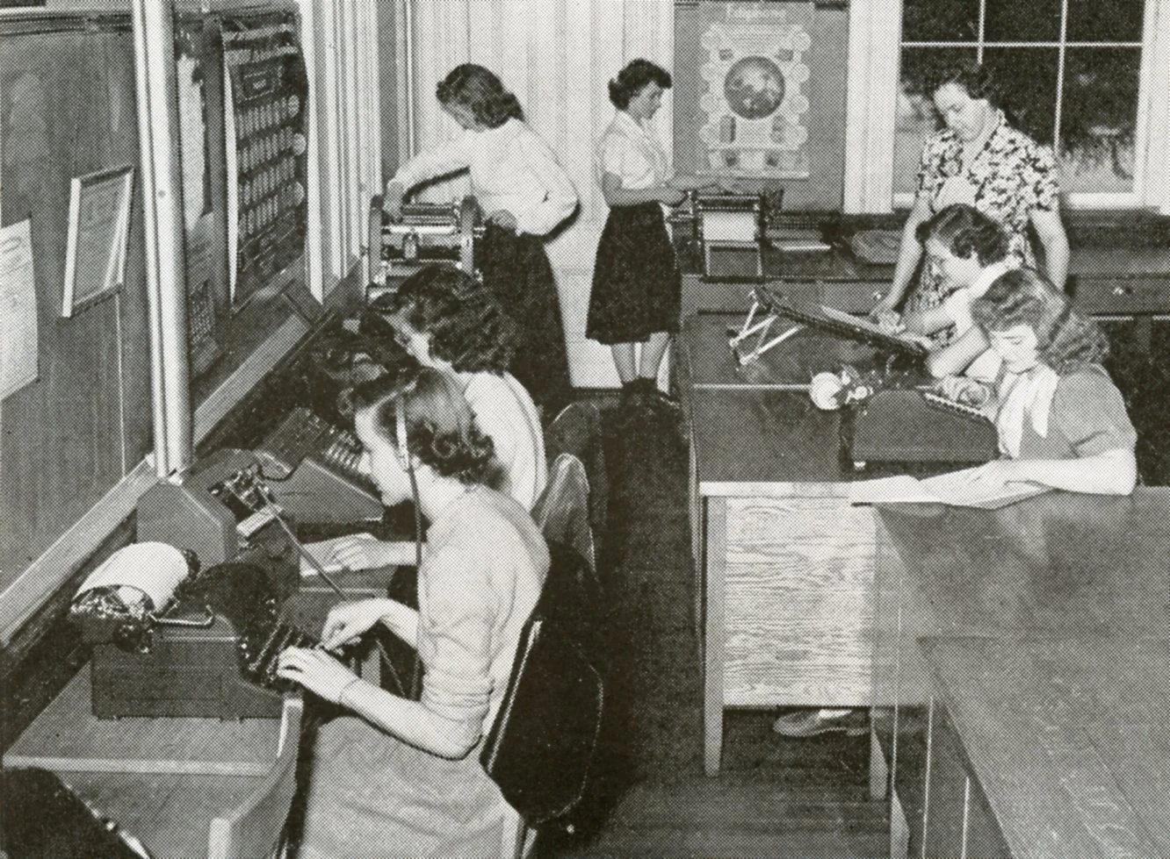

Slide 14
Entertainment
Jazz music
Dancing
Sports
People wanted to relax and have fun
Life was difficult during the war, so people wanted enjoyment and excitement.

Slide 15
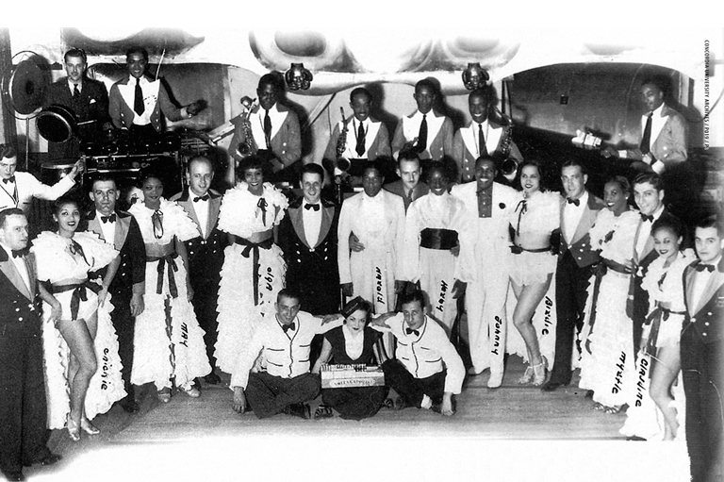

Slide 16
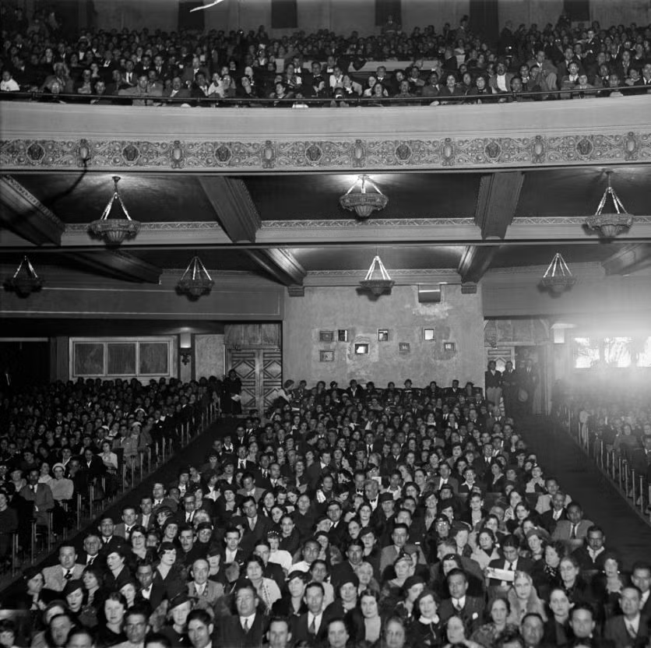

Slide 17
Not Everyone Benefited
Farmers struggled
After World War I, many Canadian farmers struggled because they had less money and poor crops.
Indigenous peoples faced discrimination
They could not speak their language or follow their culture
Some were poor

Slide 18
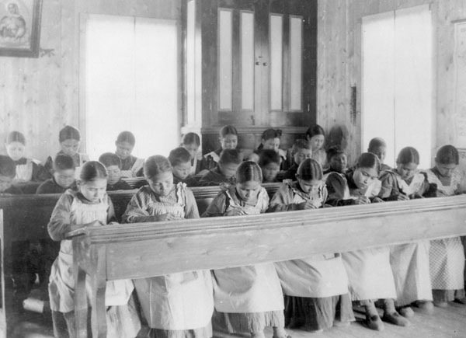

Slide 19
Big Idea
Life improved after war
But not for everyone

Slide 20
Exit Questions
2 changes?
1 technology?
Was life better?

