Slide 1
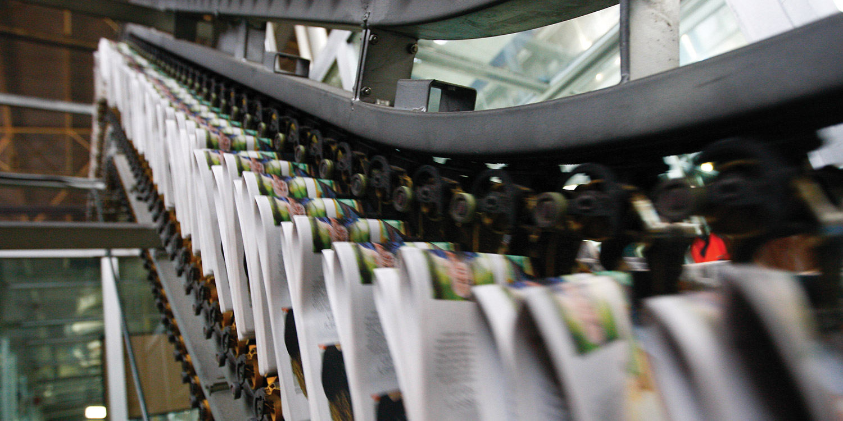
11
Business
Organization and
Finance

Slide 2
Learning Goals
Once you have completed this chapter, you should be able to:
Describe the four types of industrial activity
Describe the evolution of Canadian industry and the increasing concentration of corporate power in Canada
Identify patterns in data to explain economic relationships
Compare the different forms of business organization and finance (private and public) in Canada
Explain the function of securities and commodities markets
Conduct research to locate information from a variety of reliable sources to assess supply management strategies in Canadian agriculture and communicate recommendations clearly, effectively, and accurately

Slide 3
Key Terms
primary, secondary, tertiary, and quaternary industrial activity
high-tech industries
Staple
Firm
sole proprietorship
unlimited personal liability
progressive tax
Partnership
partnership agreement
corporation
private corporation
public corporation
articles of incorporation
Shares
Shareholders
Proxy
Dividend
co-operative
Patronage
government enterprise
Privatize
Crown corporation
non-profit/charitable organization
merger
Acquisition
horizontal integration
horizontal merger
vertical integration
holding company
Conglomerate
corporate alliance
Subsidiary
multinational corporation (MNC)
branch plant
Bond

Slide 4
Key Terms (continued)
Principal
asset value
book value
market value
stock market
stock exchange
Nasdaq
Nasdaq Composite Index
Stockbroker
mutual fund
Commodity
spot market
futures market
Dow Jones Industrial Average
blue-chip stock
S&P/TSX Composite Index
bear market
bull market

Slide 5
Types of Industrial Activity
All human industrial activity can be classified into one of four types:
Primary Industrial Activity. Primary industries are those enterprises concerned with the harvesting or extraction of natural resources.
Secondary Industrial Activity. Secondary industries are concerned with the manufacturing of marketable products.
Tertiary Industrial Activity. Tertiary industries are concerned with providing a marketable service.
Quaternary Industrial Activity. Quaternary industries are concerned with providing extremely specialized and high-tech services.

Slide 6
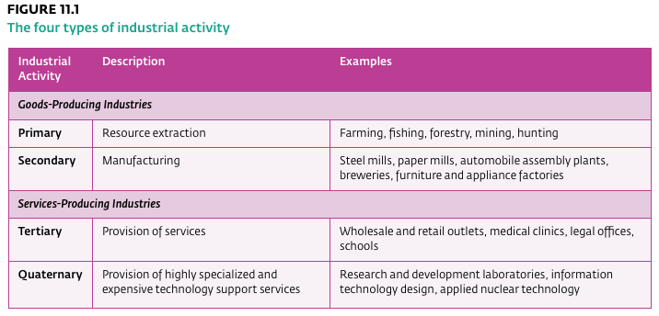
Types of Industrial Activity

Slide 7
Historical Development of Canadian Industry
Primary Industries
During the 16th, 17th, and 18th centuries, fish, fur, and lumber were the export staples that gave the new economy the largest part of its income.
  Staple: Products requiring little processing that become the main exports and economic building blocks for a national economy; from the sixteenth century to the nineteenth century, Canada’s main staples were fish, fur, and lumber.
Secondary Industries & Service Industries
Industrial Revolution that started in Britain around 1780 changed the way manufactured goods were produced. Development of steam-powered trains and ships shifted the focus towards manufacturing and distribution.
The resulting surplus in production caused a shift towards specialized services, such as transportation and warehousing, finance and insurance, retail and wholesale trade, health and education, entertainment, and personal grooming.

Slide 8
Forms of Business Organization
Sole Proprietorship is a business owned and operated by a single person.
Advantages: It is the most uncomplicated way to do business. Appeals to people who want create a small business to keep their financial affairs, business dealings, and production processes confidential.
Disadvantages: Unlimited personal liability. Ownership is personal, and income tax is progressive.
  Unlimited personal liability: When the owner or owners of a business are personally responsible for all debts incurred by the business.
  Progressive tax: A tax (such as income tax) in which the tax rate increases as an individual’s income increases.

Slide 9
Forms of Business Organization
The Partnership is a firm owned by two or more people and bound by the terms of a legal document known as a partnership agreement.
  Partnership Agreement: The legal agreement between individuals in a partnership.
Advantages: The advantages of a partnership include the pooling of talent and capital, high personal motivation, and relatively few legal expenses and restrictions. Easier to obtain credit from suppliers or to obtain loans from banks.
Disadvantages: Unlimited personal liability. Ownership is personal, and income tax is progressive.
  Unlimited personal liability: When the owner or owners of a business are personally responsible for all debts incurred by the business.
  Progressive tax: A tax (such as income tax) in which the tax rate increases as an individual’s income increases.

Slide 10
Forms of Business Organization
The Corporation is a business firm recognized legally as a separate entity in its own right. Corporations can be either public or private.
  Public Corporation: A firm or company that freely trades its ownership shares in a stock market, subject to government supervision.
  Private Corporation: A company that privately controls all sales of its ownership shares, instead of publicly trading in a stock market.
Advantages: A corporation can sue and be sued, enter into contracts, own property, and incur debts and other obligations in the same way as any adult person. Any obligations incurred are generally the legal responsibility of the corporation, but not of the individual owners. Corporate shareholders have the advantage of limited personal liability.
Disadvantages: The legal and government fees for establishing a corporation are significantly higher than those for sole proprietorships and partnerships. Corporations are more closely regulated by the government.

Slide 11
Forms of Business Organization
The Co-Operative is a business owned equally by its various members. Members of a particular co-operative must have a common relationship, goal, or economic purpose. In any co-operative enterprise, for the purposes of collective decision making, each member (regardless of the amount invested) is entitled to a single vote, and a majority vote is required to carry any decision.
Advantages: The one-vote-per-member rule allows each member an equal say in all management decisions. As well, co-operatives are not adversely affected by the death, insolvency, or incapacity of individual members. In addition, members can enjoy limited personal liability for the debts incurred by the co-op.
Disadvantages: The decision-making process can be problematic when many equal members have radically different ideas; The voluntary and therefore unpaid nature of the officers’ positions may discourage some capable people from offering their management expertise to the group; Since co-operatives are able to raise investment funds only from existing members, they have a limited ability to raise capital when needed; Co-ops are restricted to conducting business with existing members.

Slide 12
Forms of Business Organization
The Government Enterprise A business that provides services owned by the federal, provincial, or municipal government. Governments generally provide services that the private sector won’t offer because the profits generated are low relative to the amount of capital invested.
In recent years, the federal government and some provinces have made a concerted effort to privatize all or part of some government enterprises.
  Privatize: To turn over ownership and operation of a government enterprise to the private sector.
Most businesses owned by the federal government are operated as Crown corporations, which, like all other corporations, have the status of distinct legal persons. The federal government, rather than private individuals, holds all or most of the ownership shares of these corporations.
  Crown corporations: A business owned by the federal government.

Slide 13
Forms of Business Organization
Non-Profit and Charitable Organizations A government-registered form of business created not for profit but to provide a service or to organize and perform works of charity.
These private institutions are not permitted to generate profits; in return, their activities are income-tax exempt.
Examples of private non-profit charitable organizations include the Canadian Cancer Society, the Canadian National Institute for the Blind, and local food banks. District school boards are examples of public non-profit organizations
These enterprises are managed by a board of directors or elected trustees and operate through the work of both hired staff and volunteers.

Slide 14
Small and Big Businesses
Small Businesses
Small businesses are generally limited in the size and scope of their operations. In addition, they face intense competition from numerous other small firms. This level of competition keeps small businesses operating efficiently.
Many small businesses maintain their competitive advantage by limiting their operations to one specialized field or process.
The most successful small businesses are usually those that best anticipate market conditions or that best respond to market changes.
Big Businesses
Big businesses account for almost half of the private sector (non-government) jobs in Canada
Large-scale enterprises can assume greater risks and accumulate the investment capital required to initiate expensive and complex projects.

Slide 15
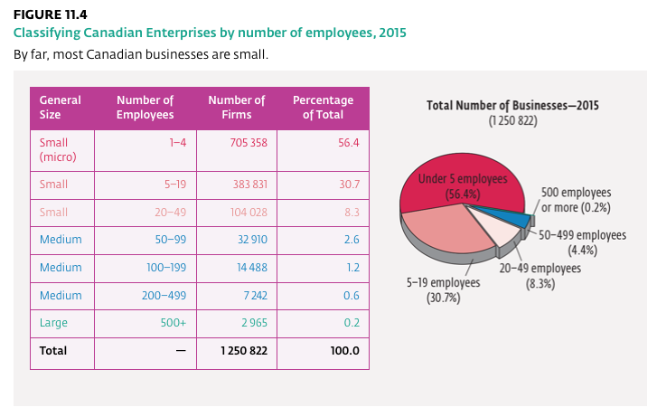
Small and Big Businesses

Slide 16
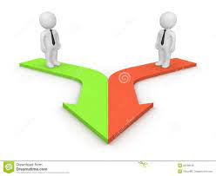
Mergers, Acquisitions, and Corporate Integration
merger
er of two firms or companies to operate more effectively as one. The joining together of two firms or companies to operate more effectively as one.

Slide 17
Merger
Merger
The joining together of two firms or companies to operate more effectively as one.
Example
1990s, several of Canada’s major banks sought to merge to achieve the size they felt was necessary to compete in global markets. Federal regulations blocked these mergers because of concerns that it would reduce competition and the availability of banking services in Canada. joining together of two firms or companies to operate more effectively as one.

Slide 18
Acquisition
The purchase of controlling interest in one company by another.
For example, after taking over a competing firm, the new firm can cease production of any goods or reduce any service that the competing firm supplies, thereby eliminating unwanted competition. In the late acquisition
purchase of controlling interests in one company by another.

Slide 19
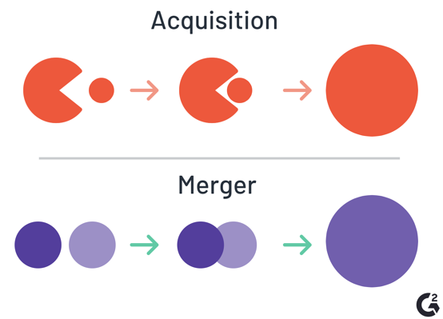
Merger and Acquisition

Slide 20
Integration
Horizontal Integration , or consolidating acquisition
takes place when one firm purchases another that produces the same product or provides the same service. Horizontal integration can create economies of scale in production processes and reduce duplication of effort.
Vertical integration
When companies involved in successive stages of the production process combine into a single firm, the result is vertical integration
Examples of vertical integration happen when a major publishing house purchases a chain of bookstores or when a broadcaster (such as Rogers Communications) buys a sports franchise (such as the Toronto Blue Jays).
The joining together of two firms that produce the same product or service to operate as one firm.

Slide 21
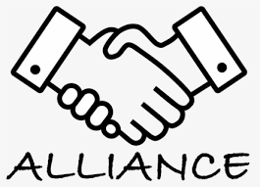

Slide 22
Corporate Alliances
Firms can also choose to strategically collaborate on specific projects with competitors or suppliers—without triggering the ownership struggles and investment anxieties that mergers and acquisitions often bring.
A corporate alliance is a group of companies that agree to form a business network that, in turn, operates like a co-ordinated mega-company.

Slide 23
Multinational Corporations
Multinational corporation (MNC) A firm that operates in more than one country; a corporation with a global production and selling strategy, having headquarters in one country and branch plants in several other countries.
Numerous multinationals operate in the Canadian economy today. For example, the Canadian automobile industry includes large MNCs from the United States, Japan, South Korea, and Germany. Numerous American multinationals (such as Apple Corp. and General Motors Company) have chosen to operate subsidiaries in Canada because of Canada’s geographical proximity, political stability, abundance of natural resources, and well-developed markets.

Slide 24
Foreign branch plants provide free access to new markets and the increased revenues these markets represent. In addition, having offices and factories abroad can give the parent company direct access to comparatively cheap raw materials and labor, effectively reducing its operating costs.
  Branch Plants: A firm or factory owned by a multinational corporation that operates in another country.

Slide 25
Financing Corporate Expansion
Corporations can obtain the funds needed to finance expansion by borrowing from banks and by reinvesting profits in their growing businesses. In addition, because of their legal status, corporations can also raise investment capital by selling bonds and additional ownership shares.
Corporate bonds are issued by corporations to raise money to run or expand their operations.
  Bond: A financial asset that represents a debt owed by a corporation to the holder, on which interest is paid by the corporation to the holder.
Corporations can also raise money by issuing and selling additional ownership shares. These shares (common or preferred) represent additional part ownership of a corporation’s capital.

Slide 26
Securities Markets and Trading
Shares in a publicly traded company can be conveniently bought and sold in the stock market in which that particular company is listed.
  Stock Market: Either a physical place or an electronic network through which shares can be bought or sold
  Stock Exchange The actual building in which shares are traded.
The National Association of Securities Dealers Automated Quotation System (Nasdaq) has grown to become one of the largest stock markets in the world.
  Nasdaq Commonly used acronym for the National Association of Securities Dealers Automated Quotation, one of the largest stock markets in the world. It is an electronic network that functions as a stock market for over 4,100 companies, including many technology companies.
  Nasdaq Composite Index: The indicator used by Nasdaq to monitor and summarize its daily trading activities and to report general or overall changes in the market value of the many stocks listed on this exchange.

Slide 27
Securities Markets and Trading
A stockbroker acts as your agent for all transactions. Trading is done directly by computer through a series of networks linking member brokerage firms to TSX computers. Member brokers of the TSX must pay an annual fee for their trading privileges, which buys them a seat at the exchange.
  Stockbroker: An agent who buys and sells shares on the stock market for individuals and companies.
Mutual funds were developed for people who prefer a more passive investment. They want to own stocks, but prefer not to be bothered with the details of buying and selling. For a fee, expert fund managers lump together the investment dollars of many clients, amass a diversified portfolio of investments, and then manage the fund on behalf of their clients.
  Mutual Fund: A fund comprising the investments of many clients; it is invested in the shares of other companies and managed by professional managers.

Slide 28
Commodities Markets
A commodity market is a place or an institution through which commodities (standardized raw or semi-processed goods resulting from primary industrial activity) are traded in bulk.
  Commodity: A raw or semi-processed good (such as minerals, lumber, or grain) that is often sold in bulk.
Soft commodities include agricultural products such as wheat, corn, sugar, coffee, soybeans, orange juice, and pork bellies. Hard commodities include mined semi-processed materials such as gold, aluminum, heating oil, gasoline, and copper.
Commodities markets include both spot markets (where goods are traded for immediate delivery) and futures markets (where prices are agreed to in advance, for delivery on a specified future date).
  Spot Market: A market (such as the Ontario Food Terminal) for commodities that are bought and sold for immediate delivery.
  Futures Markets: A market for commodities that are bought and sold for future delivery.

Slide 29
Understanding Stock Market Indicators
Bear Market: A stock market under the influence of traders expecting prices to fall, an expectation that is usually self-fulfilling.
Bull Market: A market influenced by investors expecting prices to rise, an expectation that is usually self-fulfilling.

