Slide 1
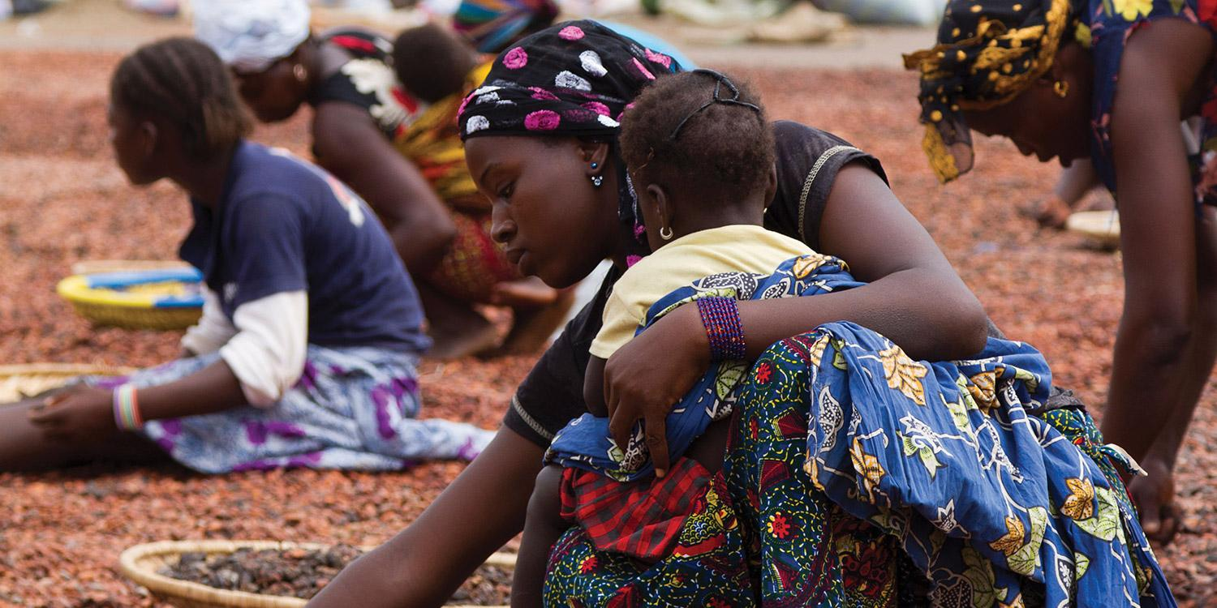
22
International Economic
Issues

Slide 2
Learning Goals
Once you have completed this chapter, you should be able to:
Understand globalization and related issues
Assess global economic disparities and explain the main causes and effects of economic marginalization
Identify barriers to economic development
Describe development strategies to reduce poverty
Assess responses to economic disparity by intergovernmental organizations
Conduct research to locate information from a variety of reliable sources to assess countries for a new free trade agreement and communicate recommendations clearly, effectively, and accurately

Slide 3
Key Terms
Globalization
multinational corporation (MNC)
Outsourcing
Subsidiary
Protectionism
gross national income (GNI) per capita
high-income economy (or industrially advanced country)
upper middle-income economy
low-income economy (or less-developed country)
economic development
Global Affairs Canada
fair trade
Xenophobia
non-governmental organization (NGO)
Fairtrade
United Nations
United Nations Declaration on the Rights of Indigenous Peoples (UNDRIP)
United Nations Development Programme (UNDP)
United Nations Educational, Scientific and Cultural Organization (UNESCO)
World Health Organization (WHO)
UN Women
International Monetary Fund (IMF)
World Bank

Slide 4
Globalization
Globalization is the process whereby national or regional economies become integrated through communication technologies, foreign direct investment, international trade, and the flow of money and people.
Globalization has provided benefits to many economies around the world.
However, globalization is also considered to be the main culprit behind the global financial crisis of 2008–2009. The global financial crisis resulted in a Great Recession that has led to a rise in protectionism in a number of countries. The global financial crisis has also led to slower economic growth in Canada and other countries.

Slide 5
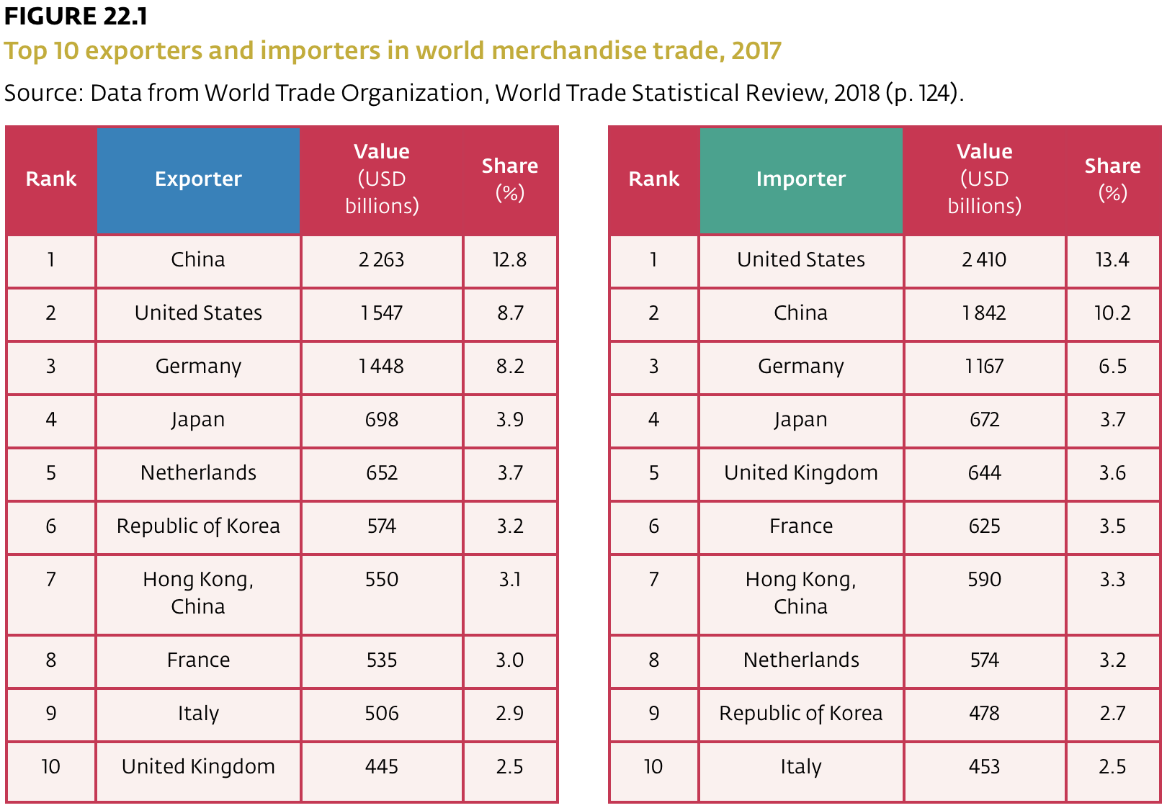
Globalization

Slide 6
The Multinational Corporation
The multinational corporation (MNC) —any company registered in one country that conducts business in two or more countries—is fundamental to globalization. MNCs are large firms that produce goods and services on a global basis and market them around the world.
  Multinational corporation (MNC): A firm that operates in more than one country; a corporation with a global production and selling strategy, having headquarters in one country and branch plants in several other countries.
Outsourcing: The practice of moving some internal business operations to third-party firms to save on costs.
Subsidiary: A branch plant of a multinational corporation.
Many subsidiaries of foreign multinationals are located in China. However, as wages in China have begun to rise, some multinationals have relocated operations to other countries in the South Asia region, such as India and Bangladesh.

Slide 7
Recovering from the Global Financial Crisis
In 2008, the subprime mortgage crisis in the United States triggered a global financial crisis that caused economic turmoil around the world.
At the time, domestic and global economies shed many jobs, putting many out of work. This outcome sparked a protectionist movement that has become a very real danger to the global economy.
Protectionism: An economic policy that aims to restrict imports through tariffs, quotas, and regulations in an effort to boost domestic industry.

Slide 8
Protectionism
An example of this trend occurred when citizens of the United Kingdom voted in a referendum in 2016 to leave the European Union, a move referred to as Brexit. In the year following the Brexit vote, Britain went from being one of the fastest-growing economies of the G7 to one of the slowest, according to the International Monetary Fund (IMF).
Protectionism fuelled the renegotiation of the North American Free Trade Agreement (NAFTA), Ultimately, NAFTA was preserved, albeit in a new agreement titled the United States-Mexico-Canada Agreement, or USMCA.
In 2018, the United States placed tariffs on over $200 billion of Chinese goods, triggering a trade war between the world’s two largest economies.

Slide 9
Underdevelopment: The Status Quo?
The World Bank classifies economies into four income groups based on annual gross national income (GNI) per capita data: high-income, upper middle-income, lower middle-income, and low-income economies.
  Gross national income (GNI) per capita: A measurement of a country’s income divided by its population. It includes all the income earned by a country’s residents and businesses, including any income earned abroad. It was formerly called GNP per capita.

Slide 10
Economy Classifications
High-income economy (or industrially advanced country): A country with high enough GNI per capita (set at US$12 056 in 2019) to provide the majority of its citizens with prosperity. This category includes Canada, the United States, most European countries, Israel, and Japan.
Upper middle-income economy: A country in which a minority of the population lives in poverty, with incomes at GNI per capita from $3 896 to $12 055 (in 2019). This category includes Brazil, China, Colombia, Cuba, and Mexico.
Lower middle-income economies are those with a GNI per capita in the range of US$996 to $3 895 (about CDN$1 300 to $5 200). This category includes El Salvador, Honduras, Cameroon, Egypt, India, and Vietnam.
Low-income economy (or less-developed country): A country in which a majority of citizens live in poverty, with incomes at or below about GNI per capita of US$995 (in 2019). This category includes Afghanistan, Haiti, Syria, Somalia, and Zimbabwe.

Slide 11
Barriers to Economic Development
Economic development: A rise in a country’s standard of living as measured by a rise in per capita GDP.
Lack of Economic Freedom and Stability: Many low-income countries have politicoeconomic systems in place that limit economic freedom and the individual pursuit of self-interest.
Malnutrition: Countries with a low GNI per capita usually have insufficient food supplies to distribute, resulting in a malnourished population. Other goods and services that contribute to improved health standards are also in short supply.
Low Capital Investment: Because individuals, households, and firms must use most of their income to purchase essential goods and services, only a minor portion of income can be saved.

Slide 12
Barriers to Economic Development
Political Instability: Political and economic stability is a prerequisite for lasting development and discourages the flight of investment funds and profits out of a less-developed economy to safer markets. Political stability permits long-term planning and promotes capital investment by multinational companies.
Natural Resource-Intensive Production: For many of the world’s less-developed countries, economic enterprise is limited largely to primary industrial activity. Their economic revenue is based on the exportation of limited natural resources, such as bauxite, latex rubber, coffee, bananas, cocoa, and sugar cane.
Debt Burden: Many less-developed countries have borrowed money from foreign banks, governments, and international institutions, such as the World Bank and the IMF. Money was borrowed to finance infrastructure projects (to build roads, schools, and water works), to feed hungry citizens, to prevent the collapse of the domestic currency and banking system, and to pay for imports.

Slide 13
Barriers to Economic Development
Population Growth and Child Labour: Population growth in most low-income economies tends to be too high to be sustained by the existing levels of production growth. Consequently, the standard of living declines steadily over time. Large families are seen as an economic necessity in low-income countries. In many low-income countries, children are required to work in factories or in dangerous conditions, such as mining for precious metals used in smartphones. As a direct result of child labour, millions of children miss the chance to go to school, and most never learn to read or write. High levels of illiteracy are always associated with high levels of poverty.

Slide 14
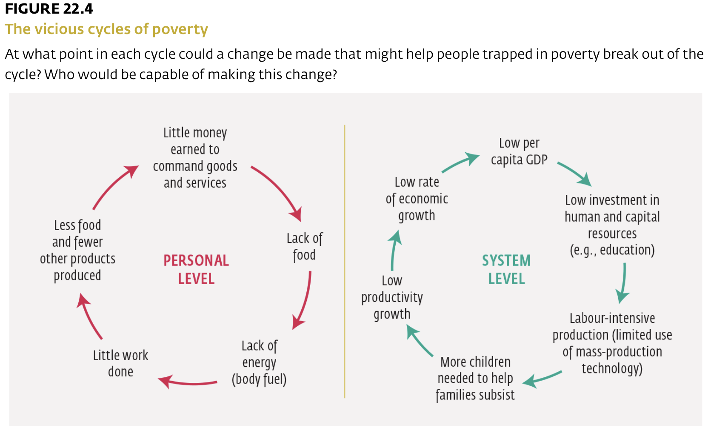
Development Strategies: Breaking the Vicious Cycles of Poverty

Slide 15
Development Strategies: Breaking the Vicious Cycles of Poverty
Investing in Productive Resources. In economies with few natural resources, government programs can work toward developing human resources by investing in their citizens’ education, health care, and nutrition.
  Education and training increase the supply of skilled labour, which in turn increases productivity and the standard of living.
  Government programs can also work toward developing capital resources by encouraging savings.
  Financial institutions that have capital can use those funds to lend to entrepreneurs.
Promoting Sustainable Growth. Less developed countries sometimes need international cooperation to achieve sustainable growth.
  When the population is growing faster than the economy, birth control can be promoted to help improve living standards.
  debt reduction or forgiveness can free up more funds for sustaining economic growth.

Slide 16
NGOs and Intergovernmental Organizations
Non-governmental organization (NGO): A non-profit group that functions independently of government. NGOs can be organized on a local, national, or international level to serve specific social or political purposes.
United Nations: Founded in 1945, it is an international organization with 193 state members. It works to address global issues such as peace and security, climate change, sustainable development, human rights, disarmament, terrorism, humanitarian and health emergencies, gender equality, governance, food production, and more.
  In an attempt to have the international community recognize the need to protect Indigenous rights, culture, and way of life, the United Nations Declaration on the Rights of Indigenous Peoples (UNDRIP) is a declaration adopted by the United Nations in 2007 that established a universal framework of minimum standards for the survival, dignity, and well-being of all Indigenous people.

Slide 17
NGOs and Intergovernmental Organizations
United Nations, continued
  United Nations Development Programme (UNDP): Part of the United Nations system, UNDP works to achieve the eradication of poverty and the reduction of inequality and exclusion. UNDP focuses on helping countries build and share solutions in three main areas: sustainable development, democratic governance and peacebuilding, and climate and disaster resilience.
  United Nations Educational, Scientific and Cultural Organization (UNESCO): The United Nations Educational, Scientific and Cultural Organization. It seeks to help build peace and security by promoting collaboration among countries in the areas of education, science, and culture.

Slide 18
NGOs and Intergovernmental Organizations
World Health Organization (WHO): Established in 1948, WHO is a specialized agency of the United Nations whose role is to be the direct authority on international health within the United Nations system and to provide leadership in global health responses.
UN Women: An entity of the United Nations that is dedicated to gender equality and the empowerment of women. It supports member states in setting global standards for achieving gender equality.
International Monetary Fund (IMF): An organization of 186 member countries that lends money to help members facing balance of payments and exchange rate problems.
World Bank: An international agency financed by the richer countries that attempts to help less-developed countries by providing direct grants and programs.

