Slide 1
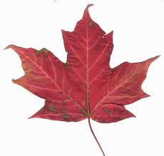
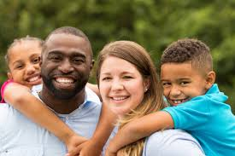
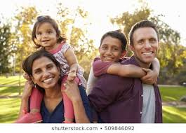
Intro to HHS4U
Families in Canada
Origins on Families
World Perspectives on Families
Modern Canadian Family

Slide 2
Family Definitions
Key Questions:
What is Family? What are differing views and perspectives on families?
What is an acceptable Definition of families according to individuals and family studies in Social Studies? (Vanier Institute of Family, 2010). Do you agree/disagree with this Definition? Explain your thinking.
Is there one particular family model? Do family models and structures change according to locations (cities, rural areas, provinces, countries)?
How do family structures change over time?

Slide 3
For Learning Student Task-Think/Pair/Share
Work in small groups to answer the questions on Slide #2. Use the resources/websites on Slide 8 to help you.
2. Share your answers with the class. (orally or by sharing screen)

Slide 4
Family Functions
AS Learning Key Questions:
What are the accepted functions/roles of family? (Vanier Institute 2010)
Do you agree/disagree? Is there anything that should be added to these functions? Is there anything that should be excluded?

Slide 5
Family Origins
AS Learning Key Questions:
How do we study the history of families and family practices in the world? Does anything change from year to year? Are world families healthier and more adjusted today (currently) than yesterday (in the past)? Explain your thinking.
2. Name 4 types of families according to history.

Slide 6
Modern Canadian Family
AS Learning Key Question:
What does the modern Canadian Family look like? Locate a picture of what you think the average Canadian family looks like and share your screen. Explain your thinking.

Slide 7
Key Vocabulary Definitions
Put in Glossary in Moodle
Affective nurturance
Nuclear family
Cultural anthropologist
Monogamy
Patriarchy
Arranged marriage
Polygamy
Extended families
Transitional Family
Dual-Income Family
Blended Families

Slide 8
Resources
Websites:
Family Definitions and Diversity
http://sociology.iresearchnet.com/sociology-of-family/family-diversity/
https://vanierinstitute.ca/family-definition-diversity/
https://vanierinstitute.ca/definition-of-family/
https://vanierinstitute.ca/whats-in-a-name-defining-family-in-a-diverse-society/
Family Roles, Functions
https://courses.lumenlearning.com/boundless-sociology/chapter/family/
https://www.innerchange.com/parents-resources/family-roles/
Family Origins/History
https://www.thecanadianencyclopedia.ca/en/article/family

Slide 9
Resources
4. Types of Families
https://courses.lumenlearning.com/culturalanthropology/chapter/types-of-families/
https://www.betterhelp.com/advice/family/there-are-6-different-family-types-and-each-one-has-a-unique-family-dynamic/
https://www.moms.com/family-structure-types/
https://www.hrc.org/resources/transgender-children-and-youth-understanding-the-basics
https://theconversation.com/how-parents-can-support-a-child-who-comes-out-as-trans-by-conquering-their-own-fears-following-their-childs-lead-and-tolerating-ambiguity-158275
Videos
https://www.youtube.com/watch?v=ajLqOJrRLqI
https://www.statcan.gc.ca/en/sc/video/census-indigenous-content
https://www.youtube.com/watch?v=EOOy8_SpvHk
5. Modern Canadian Family
https://www.recmedia.com/blog/the-modern-canadian-family/
https://www.cardus.ca/research/family/reports/the-canadian-marriage-map/
6. Resources For Families
http://www.oacas.org/what-we-do/communications-and-public-engagement/resources-and-supports-for-ontario-families/
https://ontario.cmha.ca/documents/support-for-families-and-caregivers/
https://www.toronto.ca/community-people/children-parenting/

